Slide 1
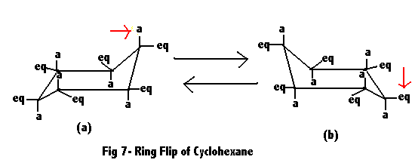

Organic Chemistry
Nomenclature:
Cyclic Alkanes

Slide 2
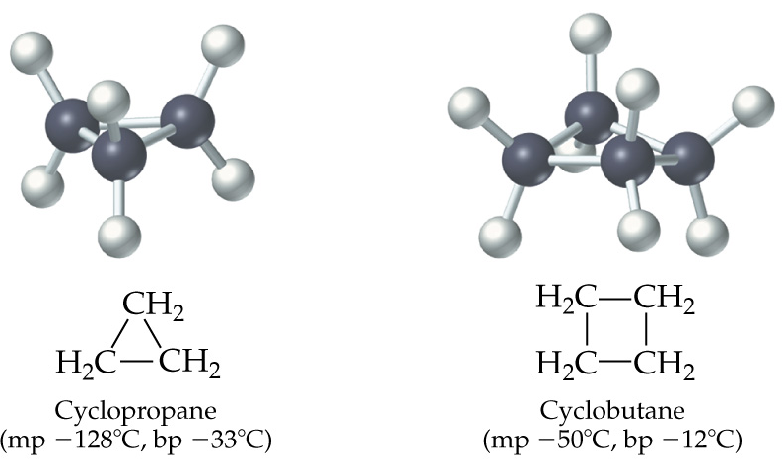
Cycloalkanes
Cycloalkanes: An alkane that contains a ring of carbon atoms. Ring sizes from 3 carbons to 30 or higher are known.

Slide 3
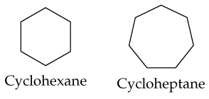
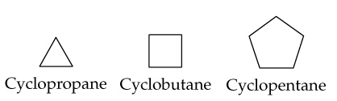
Drawing and Naming Cycloalkanes
Cycloalkanes are represented by polygons. A triangle represents cyclopropane, a square represents cyclobutane, a pentagon represents cyclopentane, and so on.

Slide 4
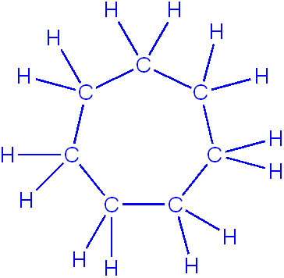
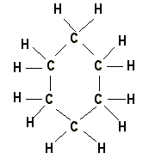
Line structure: A shorthand way of drawing structures in which atoms aren’t shown; instead a carbon atom is understood to be at each corner and hydrogens are “understood”.

Slide 5
Additional Rules for Naming Cyclics
Step 1: Use the cycloalkane name as the parent chain. (unless the straight chain is bigger)
Step 2: Number the carbons on the ring to give the lowest possible numbers. Once you establish carbon #1, proceed around the ring in the direction that gives the lowest numbers. (use tiebreaker if necessary)

Slide 6
Cycloalkanes with Side Groups

Slide 7
Learning Check

