Slide 1
Lab Measurements
Record all the digits
PLUS
One estimated digit!

Slide 2
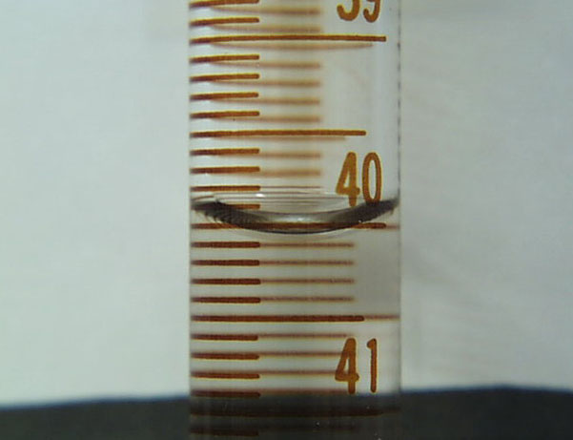
Buret
Notes:
40.03 mL

Slide 3
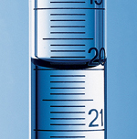
Buret
Notes:
20.00 mL

Slide 4
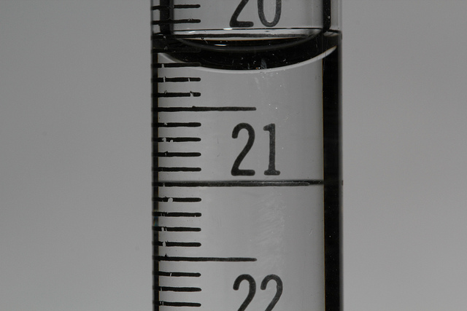
Buret
Notes:
20.24 mL

Slide 5
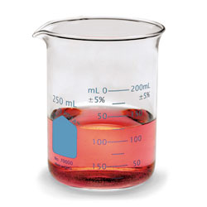
Beaker
Notes:
.2 mL graduations!

Slide 6
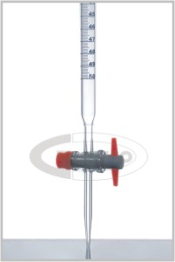
Buret
Notes:
.2 mL graduations!

Slide 7
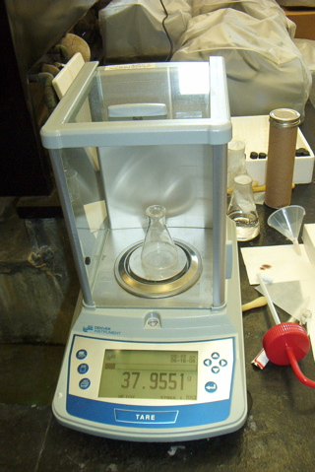
Mass
Notes:
Write down ALL the digits!

Slide 8
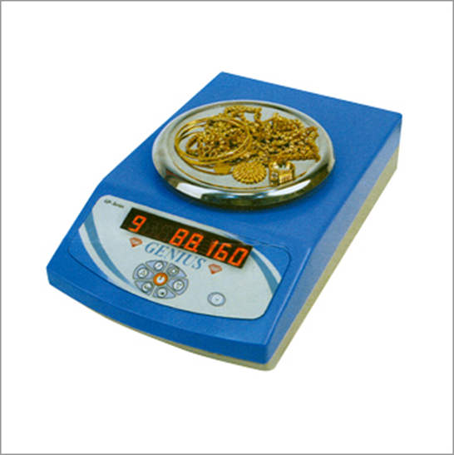
Mass
Notes:
Write down ALL the digits, including the 0! It’s a sig fig!

Slide 9
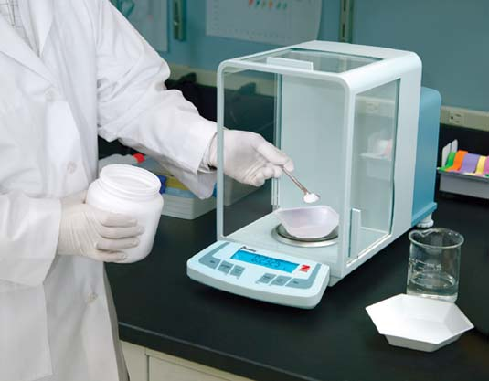
Weighing Boat
Notes:
Tare the same weighing boat you actually use… or… mass it and subtract it

