Slide 1


The Mole
Chemistry I HD – Chapter 9
Chemistry I – Chapter 10
ICP - Handouts
6.02 X 10²³
Notes:
To play the movies and simulations included, view the presentation in Slide Show Mode.

Slide 2
STOICHIOMETRY
- the study of the quantitative aspects of chemical reactions.

Slide 3
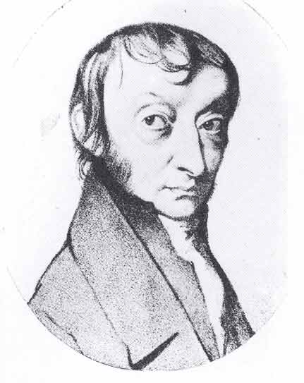
The Mole
A counting unit
Similar to a dozen, except instead of 12, it’s 602 billion trillion 602,000,000,000,000,000,000,000
6.02 X 10²³ (in scientific notation)
This number is named in honor of Amedeo Avogadro (1776 – 1856), who studied quantities of gases and discovered that no matter what the gas was, there were the same number of molecules present

Slide 4
The Mole
1 dozen cookies = 12 cookies
1 mole of cookies = 6.02 X 10²³ cookies
1 dozen cars = 12 cars
1 mole of cars = 6.02 X 10²³ cars
1 dozen Al atoms = 12 Al atoms
1 mole of Al atoms = 6.02 X 10²³ atoms
Note that the NUMBER is always the same, but the MASS is very different!
Mole is abbreviated mol (gee, that’s a lot quicker to write, huh?)

Slide 5
A Mole of Particles
Contains 6.02 x 10²³ particles
= 6.02 x 10²³ C atoms
= 6.02 x 10²³ H₂O molecules
= 6.02 x 10²³ NaCl “molecules”
(technically, ionics are compounds not molecules so they are called formula units)
6.02 x 10²³ Na⁺ ions and
6.02 x 10²³ Cl– ions
1 mole C
1 mole H₂O
1 mole NaCl

Slide 6
Avogadro’s Number as Conversion Factor
6.02 x 10²³ particles
1 mole
or
1 mole
6.02 x 10²³ particles
Note that a particle could be an atom OR a molecule!

Slide 7

Learning Check
1. Number of atoms in 0.500 mole of Al
a) 500 Al atoms
b) 6.02 x 10²³ Al atoms
c) 3.01 x 10²³ Al atoms
2.Number of moles of S in 1.8 x 10²⁴ S atoms
a) 1.0 mole S atoms
b) 3.0 mole S atoms
c) 1.1 x 10⁴⁸ mole S atoms

Slide 8
Solution
1. Number of atoms in 0.500 mol of Al
0.500 mol Al x 6.02 x 10²³ Al atoms
1 mol Al
2. Number of moles of S if a sample of S contains 1.8 x 10²⁴ S atoms
1.8 x 10²⁴ S atoms x 1 mol S
6.02 x 10²³ S atoms
= 3.01 x 10²³
Al atoms
(answer c)
= 3.0 mole S atoms
(answer b)

Slide 9
Molar Mass
The Mass of 1 mole (in grams)
Equal to the numerical value of the average atomic mass (get from periodic table)
1 mole of C atoms = 12.0 g
1 mole of Mg atoms = 24.3 g
1 mole of Cu atoms = 63.5 g

Slide 10
Molar Mass of Molecules and Compounds
Mass in grams of 1 mole equal numerically to the sum of the atomic masses
1 mole of CaCl₂ = 111.1 g/mol
1 mole Ca x 40.1 g/mol
+ 2 moles Cl x 35.5 g/mol = 111.1 g/mol CaCl₂
1 mole of N₂O₄ = 92.0 g/mol
2 moles N x 14.0 g/mol
+ 4 moles O x 16.0 g/mol = 92.0 g/mol N₂O₄

Slide 11
Converting Moles and Grams
How many grams of Al are in 3.00 moles of Al?
3.00 moles Al ? g Al

Slide 12
1. Molar mass of Al 1 mole Al = 27.0 g Al
2. Conversion factors for Al
27.0g Al or 1 mol Al
1 mol Al 27.0 g Al
3. Setup 3.00 moles Al x 27.0 g Al
1 mole Al
Answer = 81.0 g Al

Slide 13
Calculations
molar mass Avogadro’s number
Grams Moles particles
Everything must go through Moles!!!

Slide 14

Atoms/Molecules and Grams
How many atoms of Cu are present in 35.4 g of Cu?
35.4 g Cu 1 mol Cu 6.02 X 10²³ atoms Cu
63.5 g Cu 1 mol Cu
= 3.4 X 10²³ atoms Cu

