Slide 1
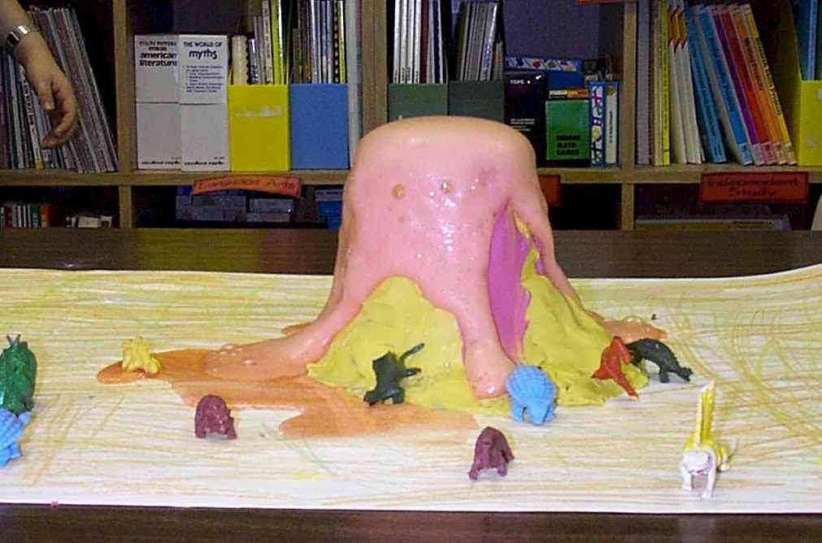
Chemical Reactions
Chemistry I – Chapter 11b Chemistry I Honors – Chapter 7 ICP – Chapter 21b

Slide 2
Types of Reactions
There are five types of chemical reactions we will talk about:
Synthesis reactions
Decomposition reactions
Single displacement reactions
Double displacement reactions
Combustion reactions
You need to be able to identify the type of reaction and predict the product(s)

Slide 3
Steps to Writing Reactions
Some steps for doing reactions
Identify the type of reaction
Predict the product(s) using the type of reaction as a model
Balance it
Don’t forget about the diatomic elements! (BrINClHOF) For example, Oxygen is O₂ as an element.
In a compound, it can’t be a diatomic element because it’s not a free element anymore, it’s part of a compound!

Slide 4
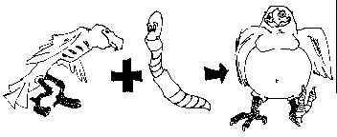
1. Synthesis reactions
Synthesis reactions occur when two substances (generally elements) combine and form a compound. (Sometimes these are called combination or addition reactions.)
reactant + reactant → 1 product
Basically: A + B → AB
Example: 2H₂ + O₂ → 2H₂O
Example: C + O₂ → CO₂

Slide 5
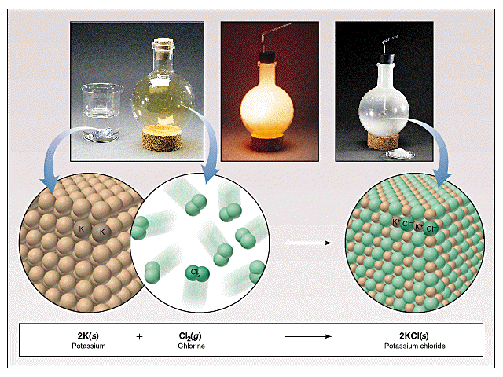
Synthesis Reactions
Here is another example of a synthesis reaction

Slide 6
Practice
Predict the products. Write and balance the following synthesis reaction equations.
Sodium metal reacts with chlorine gas
Na_{(s)} + Cl_{2(g)} →
Solid Magnesium reacts with fluorine gas
Mg_{(s)} + F_{2(g)} →
Aluminum metal reacts with fluorine gas
Al_{(s)} + F_{2(g)} →
2
2
NaCl(s)
MgF2(s)
2
3
2
AlF3(s)

Slide 7
2. Decomposition Reactions
Decomposition reactions occur when a compound breaks up into the elements or in a few to simpler compounds
1 Reactant → Product + Product
In general: AB → A + B
Example: 2 H₂O → 2H₂ + O₂
Example: 2 HgO → 2Hg + O₂

Slide 8
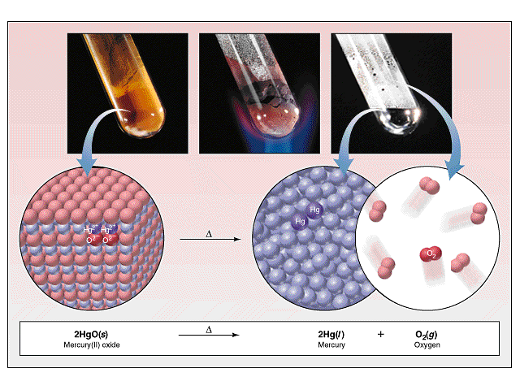
Decomposition Reactions
Another view of a decomposition reaction:

Slide 9
Decomposition Exceptions
Carbonates and chlorates are special case decomposition reactions that do not go to the elements.
Carbonates (CO₃²⁻) decompose to carbon dioxide and a metal oxide
Example: CaCO₃ → CO₂ + CaO
Chlorates (ClO₃⁻) decompose to oxygen gas and a metal chloride
Example: 2 Al(ClO₃)₃ → 2 AlCl₃ + 9 O₂
There are other special cases, but we will not explore those in Chemistry I

Slide 10
Practice
Predict the products. Then, write and balance the following decomposition reaction equations:
Solid Lead (IV) oxide decomposes PbO_{2(s)} →
Aluminum nitride decomposes
AlN_{(s)} →
Pb(s) + O2(g)
2
2
Al(s) + N2(g)

Slide 11
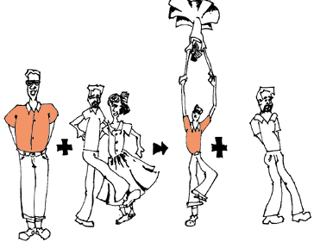
3. Single Replacement Reactions
Single Replacement Reactions occur when one element replaces another in a compound.
A metal can replace a metal (+) OR a nonmetal can replace a nonmetal (-).
element + compound→ element + compound
A + BC → AC + B (if A is a metal) OR
A + BC → BA + C (if A is a nonmetal)
(remember the cation always goes first!)
When H₂O splits into ions, it splits into
H⁺ and OH⁻ (not H+ and O⁻² !!)

Slide 12
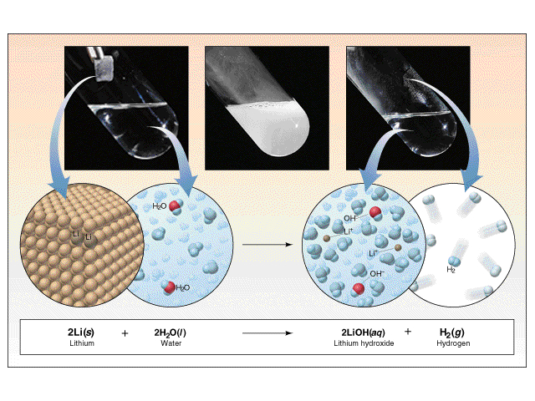
Single Replacement Reactions
Another view:

Slide 13
Single Replacement Reactions
Write and balance the following single replacement reaction equation:
Zinc metal reacts with aqueous hydrochloric acid
Zn_{(s)} + HCl_{(aq)} → ZnCl₂ + H_{2(g)}
2

Slide 14
Single Replacement Reactions
Sodium chloride solid reacts with fluorine gas
NaCl_{(s)} + F_{2(g)} → NaF_{(s)} + Cl_{2(g)}
Note that fluorine replaces chlorine in the compound
Aluminum metal reacts with aqueous copper (II) nitrate
Al_{(s)}+ Cu(NO₃)_{2(aq)}→ Cu_{(s)} + Al(NO₃)_{3(aq)}
2
2
2
3
3
2

Slide 15
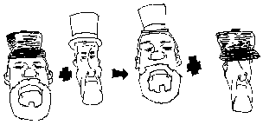
4. Double Replacement Reactions
Double Replacement Reactions occur when a metal replaces a metal in a compound and a nonmetal replaces a nonmetal in a compound
Compound + compound → compound + compound
AB + CD → AD + CB

Slide 16
Double Replacement Reactions
Think about it like “foil”ing in algebra, first and last ions go together + inside ions go together
Example:
AgNO_{3(aq)} + NaCl_{(s)} → AgCl_{(s)} + NaNO_{3(aq)}
Another example:
K₂SO_{4(aq)} + Ba(NO₃)_{2(aq)} → KNO_{3(aq)} + BaSO_{4(s)}
2

Slide 17
Practice
Predict the products. Balance the equation
HCl_{(aq)} + AgNO_{3(aq)} →
CaCl_{2(aq)} + Na₃PO_{4(aq)} →
Pb(NO₃)_{2(aq)} + BaCl_{2(aq)} →
FeCl_{3(aq)} + NaOH_{(aq)} →
H₂SO_{4(aq)} + NaOH_{(aq)} →
KOH_{(aq)} + CuSO_{4(aq)} →
HNO3(aq) + AgCl(s)
3
2
Ca3(PO4)2(s) + NaCl(aq)
6
PbCl2(s) + Ba(NO3)2(aq)
3
Fe(OH)3(s) + NaCl(aq)
3
2
2
H2O(l) + Na2SO4(aq)
2
K2SO4(aq) + Cu(OH)2(s)

Slide 18
5. Combustion Reactions
Combustion reactions occur when a hydrocarbon reacts with oxygen gas.
This is also called burning!!! In order to burn something you need the 3 things in the “fire triangle”: 1) A Fuel (hydrocarbon) 2) Oxygen to burn it with 3) Something to ignite the reaction (spark)

Slide 19
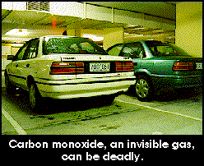
Combustion Reactions
In general: C_{x}H_{y} + O₂ → CO₂ + H₂O
Products in combustion are ALWAYS carbon dioxide and water. (although incomplete burning does cause some by-products like carbon monoxide)
Used to heat homes and run automobiles (octane, as in gasoline, is C₈H₁₈)

Slide 20
Combustion Reactions
Edgar Allen Poe’s drooping eyes and mouth are potential signs of CO poisoning.

Slide 21
Combustion
Example
C₅H₁₂ + O₂ → CO₂ + H₂O
Write the products and balance the following combustion reaction:
C₁₀H₂₂ + O₂ →
8
5
6
31
20
11
2
10
22
CO2 + H2O

Slide 22
Mixed Practice
State the type, predict the products, and balance the following reactions:
BaCl₂ + H₂SO₄ →
C₆H₁₂ + O₂ →
Zn + CuSO₄ →
Cs + Br₂ →
FeCO₃ →
BaSO4 + HCl
2
6
6
9
CO2 + H2O
ZnSO4 + Cu
2
2
CsBr
FeO + CO2

Slide 23
Total Ionic Equations
Once you write the molecular equation (synthesis, decomposition, etc.), check for reactants and products that are soluble or insoluble.
Assume the reaction is in water
Use a solubility table to tell what compounds dissolve in water
If the compound is soluble (does dissolve in water), then split the compound into its component ions
If the compound is insoluble (does NOT dissolve in water), then it remains as a compound

Slide 24
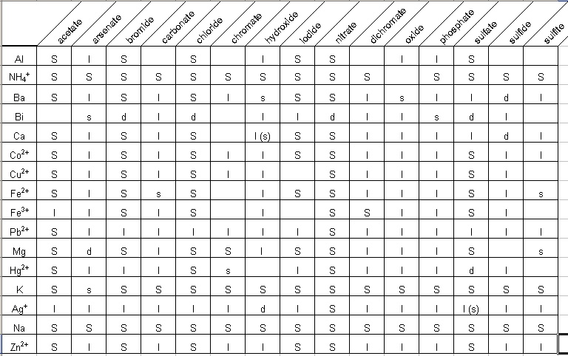
Solubility Table

Slide 25
Solubilities Not on the Table!
Gases only slightly dissolve in water
Strong acids and bases dissolve in water
Hydrochloric, Hydrobromic, Hydroiodic, Nitric, Sulfuric, Perchloric Acids
Group I hydroxides (should be on your chart anyway)
Water slightly dissolves in water! (H⁺ and OH⁻)
There are other tables and rules that cover more compounds than your table!

Slide 26
Total Ionic Equations
Molecular Equation:
K₂CrO₄ + Pb(NO₃)₂ → PbCrO₄ + 2 KNO₃
Soluble Soluble Insoluble Soluble
Total Ionic Equation:
2 K⁺ + CrO₄ ⁻² + Pb⁺² + 2 NO₃⁻ →
PbCrO₄ (s) + 2 K⁺ + 2 NO₃⁻

Slide 27
Net Ionic Equations
These are the same as total ionic equations, but you should cancel out ions that appear on BOTH sides of the equation
Total Ionic Equation:
2 K⁺ + CrO₄ ⁻² + Pb⁺² + 2 NO₃⁻ →
PbCrO₄ (s) + 2 K⁺ + 2 NO₃⁻
Net Ionic Equation:
CrO₄ ⁻² + Pb⁺² → PbCrO₄ (s)

Slide 28
Net Ionic Equations
Try this one! Write the molecular, total ionic, and net ionic equations for this reaction: Silver nitrate reacts with Lead (II) Chloride in hot water (Lead (II) chloride WILL dissolve in hot water, but not in cold!).
AgNO₃ + PbCl₂ →
Molecular:
2 AgNO₃ + PbCl₂ → 2 AgCl + Pb(NO₃)₂
Total Ionic:
2 Ag⁺ + 2 NO₃⁻ + Pb⁺² + 2 Cl⁻ → 2 AgCl (s) + Pb⁺² + 2 NO₃⁻
Net Ionic:
Ag⁺ + Cl⁻ → AgCl (s)

