Slide 1
CHEMICAL REACTIONS
Chemistry I – Chapter 11a
Chemistry I Honors – Chapter 7
ICP – Chapter 21a
Reactants: Zn + I₂
Product: Zn I₂

Slide 2
Chemical Equations
Their Job: Depict the kind of reactants and products and their relative amounts in a reaction.
4 Al _{(s)} + 3 O_{2 (g)} ---> 2 Al₂O_{3 (s)}
The numbers in the front are called
stoichiometric coefficients
The letters (s), (g), and (l) are the physical states.

Slide 3
Parts of a Reaction Equation
  Chemical equations show the conversion of reactants (on the left) into products (on the right).
    + sign separates molecules on the same side
    The arrow is read as “yields”
    Example
      C + O₂ → CO₂
    This reads “carbon plus oxygen yields carbon dioxide”

Slide 4
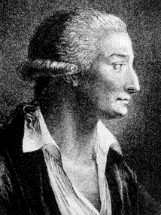
Chemical Equations
Because of the principle of the conservation of matter,
an equation must be balanced.
It must have the same number of atoms of the same kind on both sides.
Lavoisier, 1788

Slide 5
Symbols Used in Equations
    Solid (s)
    Liquid (l)
    Gas (g)
    Aqueous solution (aq)
    Catalyst ^{H2SO4}
    Escaping gas (↑)
    Change of temperature (Δ)

Slide 6
Balancing Equations
2
2
___ H₂(g) + ___ O₂(g) ---> ___ H₂O(l)
What Happened to the Other Oxygen Atom?????
This equation is not balanced!
Two hydrogen atoms from a hydrogen molecule (H₂) combines with one of the oxygen atoms from an oxygen molecule (O₂) to form H₂O. Then, the remaining oxygen atom combines with two more hydrogen atoms (from another H₂ molecule) to make a second H₂O molecule.

Slide 7
Balancing Equations
  When balancing, you may add coefficients in front of the compounds to balance the reaction, but you may not change the subscripts.
  Changing the subscripts changes the compound. Subscripts are determined by the valence electrons (charges for ionic or sharing for covalent)

Slide 8
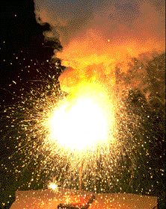
Chemical Equations
4 Al(s) + 3 O₂(g) ---> 2 Al₂O₃(s)
This equation means
4 Al atoms + 3 O₂ molecules ---produces--->
2 molecules of Al₂O₃
_{AND/OR}
4 moles of Al + 3 moles of O₂ ---produces--->
2 moles of Al₂O₃

Slide 9
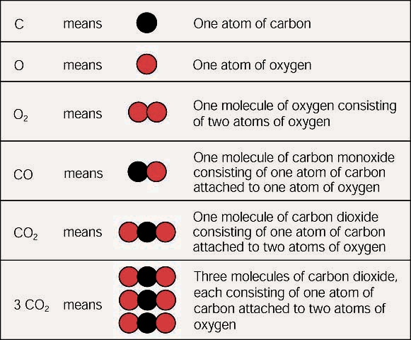
Subscripts vs. Coefficients
The subscripts tell you how many atoms of a particular element are in a compound. The coefficient tells you about the quantity, or number, of molecules of the compound.

Slide 10
Steps to Balancing Equations
  There are four basic steps to balancing a chemical equation.
    Write the correct formula for the reactants and the products. DO NOT TRY TO BALANCE IT YET! You must write the correct formulas first. And most importantly, DO NOT CHANGE THE FORMULAS!
    Find the number of atoms for each element on the left side. Compare those against the number of the atoms of the same element on the right side.
    Determine where to place coefficients in front of formulas so that the left side has the same number of atoms as the right side for EACH element in order to balance the equation.
    Check your answer to see if:
      The numbers of atoms on both sides of the equation are now balanced.
      The coefficients are in the lowest possible whole number ratios. (reduced)

Slide 11
Some Suggestions to Help You
  Some of Mr. Rapp’s Helpful Hints for balancing equations:
    Take one element at a time, working left to right except for H and O. Save H for next to last, and O until last.
    IF everything balances except for O, and there is no way to balance O with a whole number, double all the coefficients and try again. (Because O is diatomic as an element)
    (Shortcut) Polyatomic ions that appear on both sides of the equation should be balanced as independent units

Slide 12
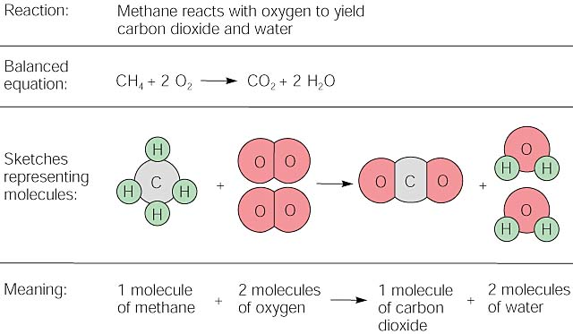

Slide 13
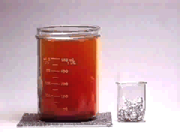
Balancing
Equations
2
3
___ Al(s) + ___ Br₂(l) ---> ___ Al₂Br₆(s)

Slide 14
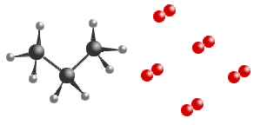
Balancing Equations
5
____C₃H₈(g) + _____ O₂(g) ----> _____CO₂(g) + _____ H₂O(g)
3
4
2
11
____B₄H₁₀(g) + _____ O₂(g) ----> ___ B₂O₃(g) + _____ H₂O(g)
4
2
10
5

Slide 15
Balancing Equations
Sodium phosphate + iron (III) oxide → sodium oxide + iron (III) phosphate
Na₃PO₄ + Fe₂O₃ ----> Na₂O + FePO₄
2
3
2

