Slide 1
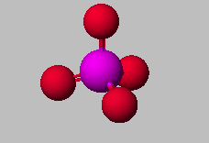
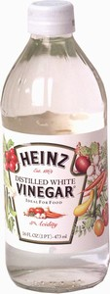
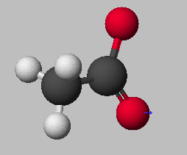
Chemistry 1: Chapter 9
Chemistry 1 Honors: Chapter 4
ICP: Chapter 20
Nomenclature
PO₄³⁻
phosphate ion
HC₂H₃O₂
Acetic Acid
C₂H₃O₂⁻
acetate ion

Slide 2

Forms of Chemical Bonds
There are 3 forms bonding atoms:
Ionic—complete transfer of 1 or more electrons from one atom to another (one loses, the other gains)
Covalent—some valence electrons shared between atoms
Metallic – holds atoms of a metal together
Most bonds are somewhere in between ionic and covalent.

Slide 3
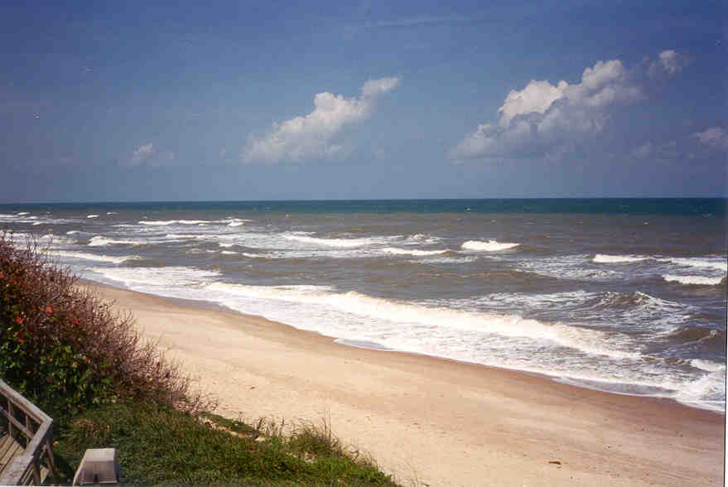
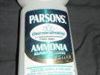
Common Names
A lot of chemicals have common names as well as the proper IUPAC name.
Chemicals that should always be named by common name and never named by the IUPAC method are:
  H₂O water, not dihydrogen monoxide
  NH₃ ammonia, not nitrogen trihydride

Slide 4
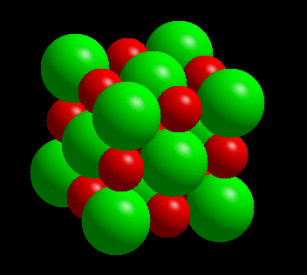
COMPOUNDS FORMED FROM IONS
CATION +
ANION --->
COMPOUND
Na⁺ + Cl⁻ --> NaCl
A neutral compound
requires
equal number of +
and - charges.

Slide 5
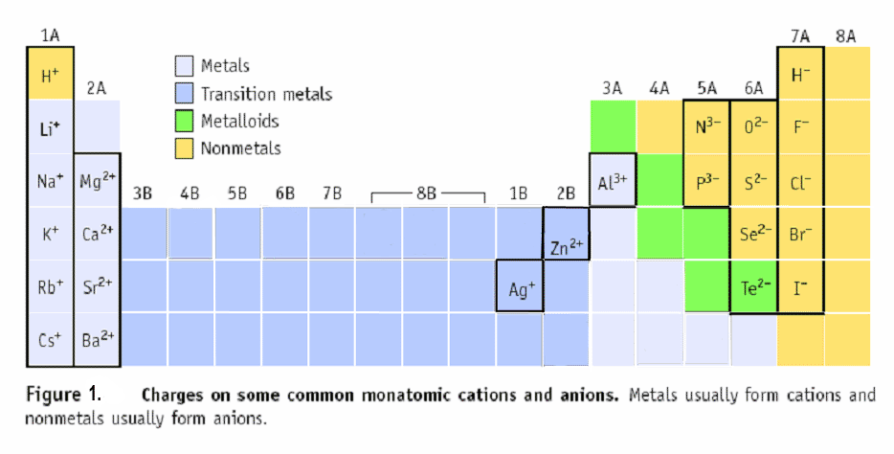
Predicting Charges on Monatomic Ions
KNOW THESE !!!!
+1 +2 -3 -2 -1 0
Cd⁺²

Slide 6
Formulas of Ionic Compounds
Formulas of ionic compounds are determined from the charges on the ions
atoms ions
• • • • –
Na • + • F : ⎯→ Na⁺ : F : ⎯→ NaF
• • • •
sodium + fluorine sodium fluoride formula
Charge balance: 1+ 1- = 0

Slide 7
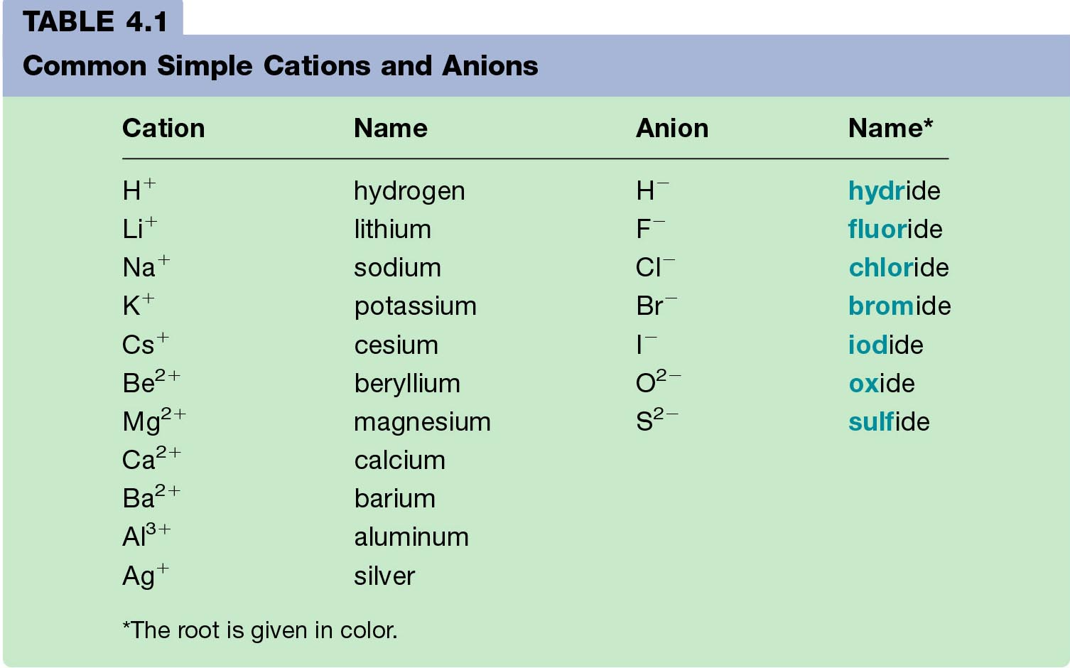
Monatomic Ions

Slide 8
Naming Compounds
Binary Ionic Compounds:
1. Cation first, then anion
2. Monatomic cation = name of the element
Ca²⁺ = calcium ion
3. Monatomic anion = root + -ide
Cl⁻ = chloride
CaCl₂ = calcium chloride

Slide 9
Names of Variable Ions
These elements REQUIRE Roman Numerals because they can have more than one possible charge:
anything except Group 1A, 2A, Ag, Zn, Cd, and Al
(You should already know the charges on these!)
Or another way to say it is: Transition metals and the metals in groups 4A and
5A (except Ag, Zn, Cd, and Al) require a Roman Numeral.
FeCl₃ (Fe³⁺) iron (III) chloride
CuCl (Cu⁺ ) copper (I) chloride
SnF₄ (Sn⁴⁺) tin (IV) fluoride
PbCl₂ (Pb²⁺) lead (II) chloride
Fe₂S₃ (Fe³⁺) iron (III) sulfide

Slide 10
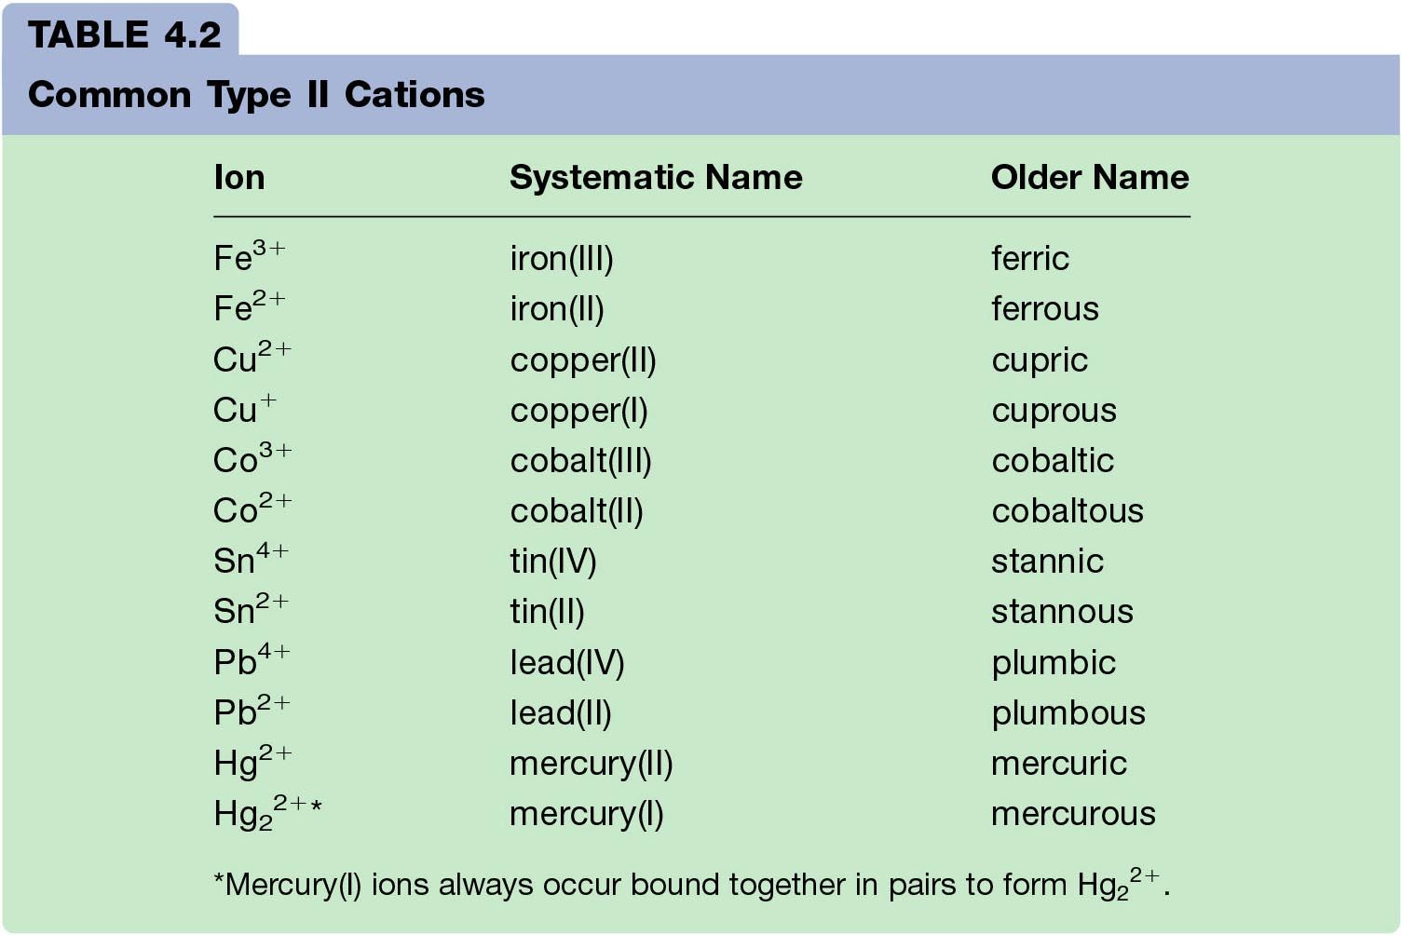
Examples of Older Names of Cations formed from Transition Metals
(you do not have to memorize these)

Slide 11
Naming Binary Ionic Compounds
Examples:
      NaCl
      ZnI₂
      Al₂O₃
sodium chloride
zinc iodide
aluminum oxide

Slide 12
Naming Ternary Compounds
Contains at least 3 elements
There MUST be at least one polyatomic ion
(it helps to circle the ions)
Examples:
NaNO₃ Sodium nitrate
K₂SO₄ Potassium sulfate
Al(HCO₃)₃ Aluminum bicarbonate
or
Aluminum hydrogen carbonate

Slide 13

Mixed Practice!
Name the following:
Na₂O
CaCO₃
PbS₂
Sn₃N₂
Cu₃PO₄
HgF₂
Sodium oxide
Calcium carbonate
Lead (IV) sulfide
Tin (II) nitride
Copper (I) phosphate
Mercury (II) fluoride

Slide 14
Mixed Up… The Other Way
Write the formula:
Copper (II) chlorate
Calcium nitride
Aluminum carbonate
Potassium bromide
Barium fluoride
Cesium hydroxide
Cu(ClO₃)₂
Ca₃N₂
Al₂(CO₃)₃
KBr
BaF₂
CsOH

Slide 15
Rainbow Matrix Game
Link on Chemistry Geek.com on Chemistry I page
http://chemistrygeek.com/rainbow
Use [ ] to represent subscripts since you can’t enter subscripts into the computer
So H₂O would be H[2]O
And Al₂(SO₄)₃ would be Al[2](SO[4])[3]
Additional Polyatomic Ions (you do not have to memorize these, but they are in the game!)
Borate = BO₃ ⁻³ ; Silicate = SiO₄ ⁻⁴ ;
Manganate = MnO₄ ⁻² (permanganate is -1)

Slide 16
Naming Molecular Compounds
All are formed from two or more nonmetals.
CO₂ Carbon dioxide
Ionic compounds generally involve a metal and nonmetal
(NaCl)
BCl₃
boron trichloride

Slide 17
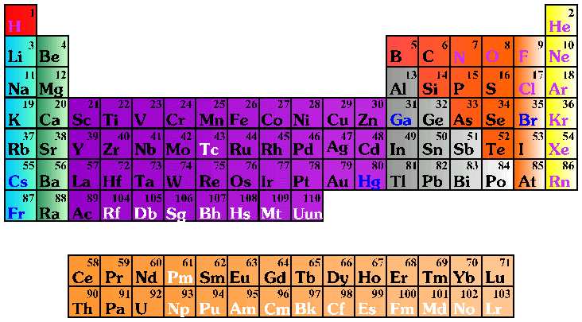
Molecular (Covalent) Nomenclature for two nonmetals
Prefix System (binary compounds)
  1. Less electronegative atom
  comes first.
  2. Add prefixes to indicate # of atoms. Omit mono- prefix on the FIRST element. Mono- is OPTIONAL on the SECOND element (in this class, it’s NOT optional!).
  3. Change the ending of the
  second element to -ide.

Slide 18
Molecular Nomenclature Prefixes
PREFIX
mono-
di-
tri-
tetra-
penta-
hexa-
hepta-
octa-
nona-
deca-
NUMBER
1
2
3
4
5
6
7
8
9
10

Slide 19
Molecular Nomenclature: Examples
CCl₄
N₂O
SF₆
  carbon tetrachloride
  dinitrogen monoxide
  sulfur hexafluoride

Slide 20
More Molecular Examples
arsenic trichloride
dinitrogen pentoxide
tetraphosphorus decoxide
  AsCl₃
  N₂O₅
  P₄O₁₀

Slide 21
Acid Nomenclature
Acids
  Compounds that form H⁺ in water.
  Formulas usually begin with ‘H’.
  In order to be an acid instead of a gas, binary acids must be aqueous (dissolved in water)
  Ternary acids are ALL aqueous
Examples:
  HCl _{(aq)} – hydrochloric acid
  HNO₃ – nitric acid
  H₂SO₄ – sulfuric acid

Slide 22
Acid Nomenclature Review
No Oxygen→
w/Oxygen
An easy way to remember which goes with which…
“In the cafeteria, you ATE something ICky”

Slide 23
Acid Nomenclature
HBr _{(aq)}
H₂CO₃
H₂SO₃
  No oxygen, -ide
⇒ hydrobromic acid
  Has oxygen, -ate
⇒ carbonic acid
  Has oxygen, -ite
⇒ sulfurous acid

Slide 24
Acid Nomenclature
hydrofluoric acid
sulfuric acid
nitrous acid
  2 elements
⇒ H⁺ F-
⇒ HF _{(aq)}
  3 elements, -ic
⇒ H⁺ SO₄²⁻
⇒ H₂SO₄
  3 elements, -ous
⇒ H⁺ NO₂⁻
⇒ HNO₂

Slide 25
Name ‘Em!
HI _{(aq)}
HCl
H₂SO₃
HNO₃
HIO₄
Hydroiodic acid
Hydrogen chloride (not aq!)
Sulfurous acid
Nitric acid
Periodic acid

Slide 26
Write the Formula!
Hydrobromic acid
Nitrous acid
Carbonic acid
Phosphoric acid
Hydrotelluric acid
HBr _{(aq)}
HNO₂
H₂CO₃
H₃PO₄
H₂Te _{(aq)}

Slide 27
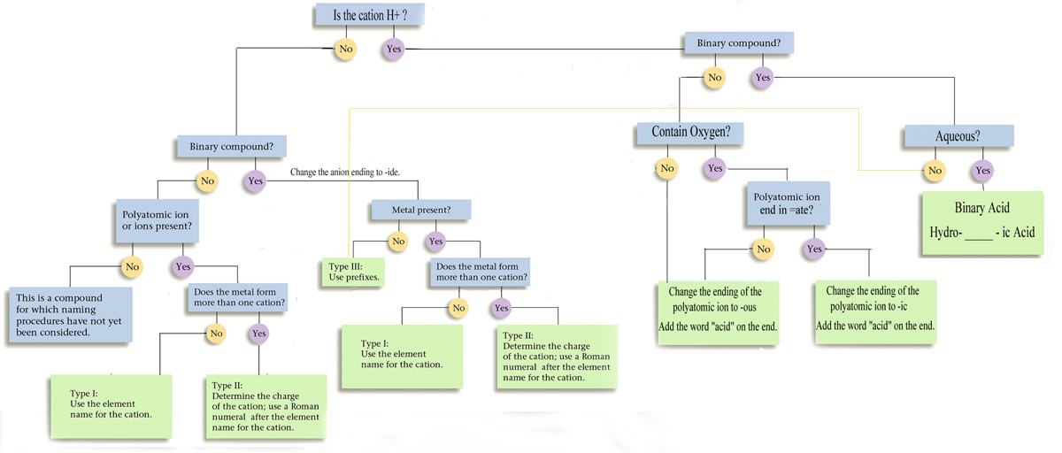
Nomenclature Summary Flowchart

Slide 28
Mixed Practice
BaI₂
P₄S₃
Ca(OH)₂
FeCO₃
Na₂Cr₂O₇
I₂O₅
Cu(ClO₄)₂
CS₂
B₂Cl₄
Barium iodide
Tetraphosphorus trisulfide
Calcium hydroxide
Iron (II) carbonate
Sodium dichromate
Diiodine pentoxide
Copper (II) perchlorate
Carbon disulfide
Diboron tetrachloride

Slide 29
Mixed Practice
Dinitrogen monoxide
Potassium sulfide
Copper (II) nitrate
Dichlorine heptoxide
Chromium (III) sulfate
Iron (III) sulfite
Calcium oxide
Barium carbonate
Iodine monochloride
N₂O
K₂S
Cu(NO₃)₂
Cl₂O₇
Cr₂(SO₄)₃
Fe₂(SO₃)₃
CaO
BaCO₃
ICl

Slide 30
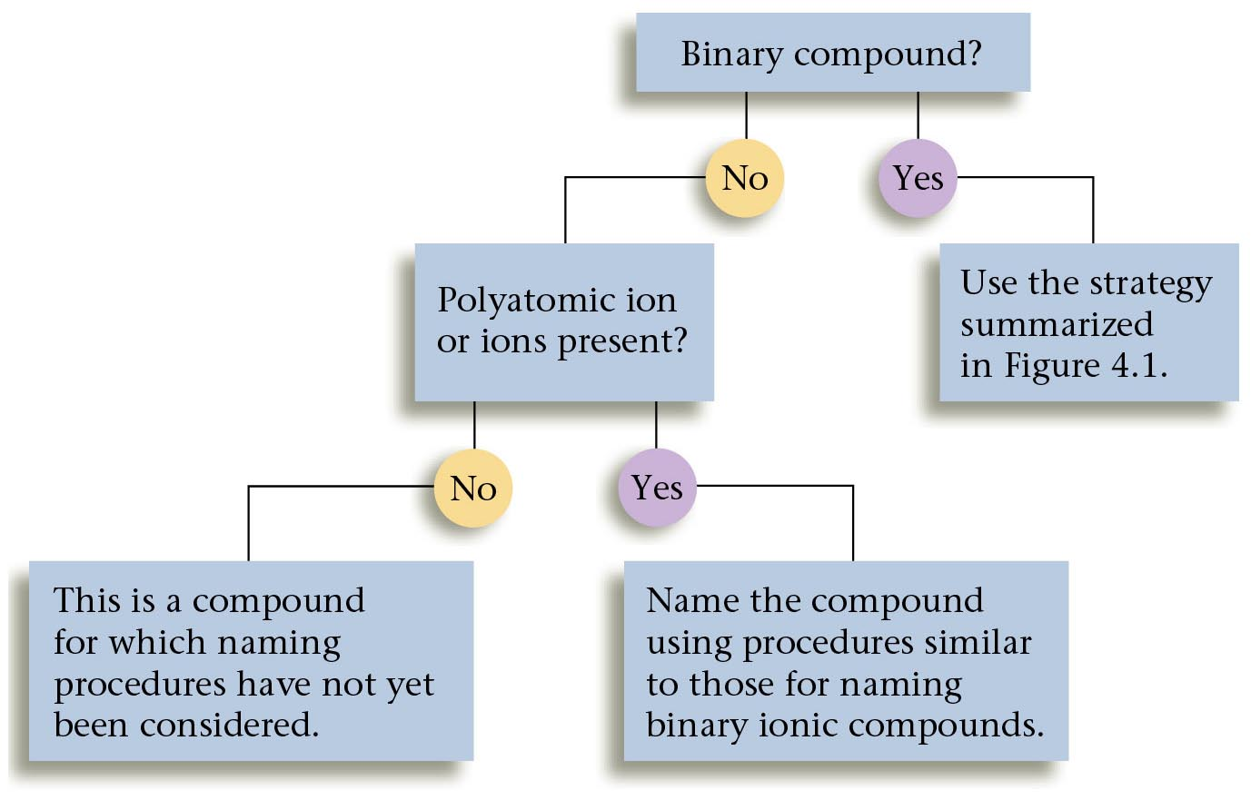
Overall strategy for naming chemical compounds.

Slide 31
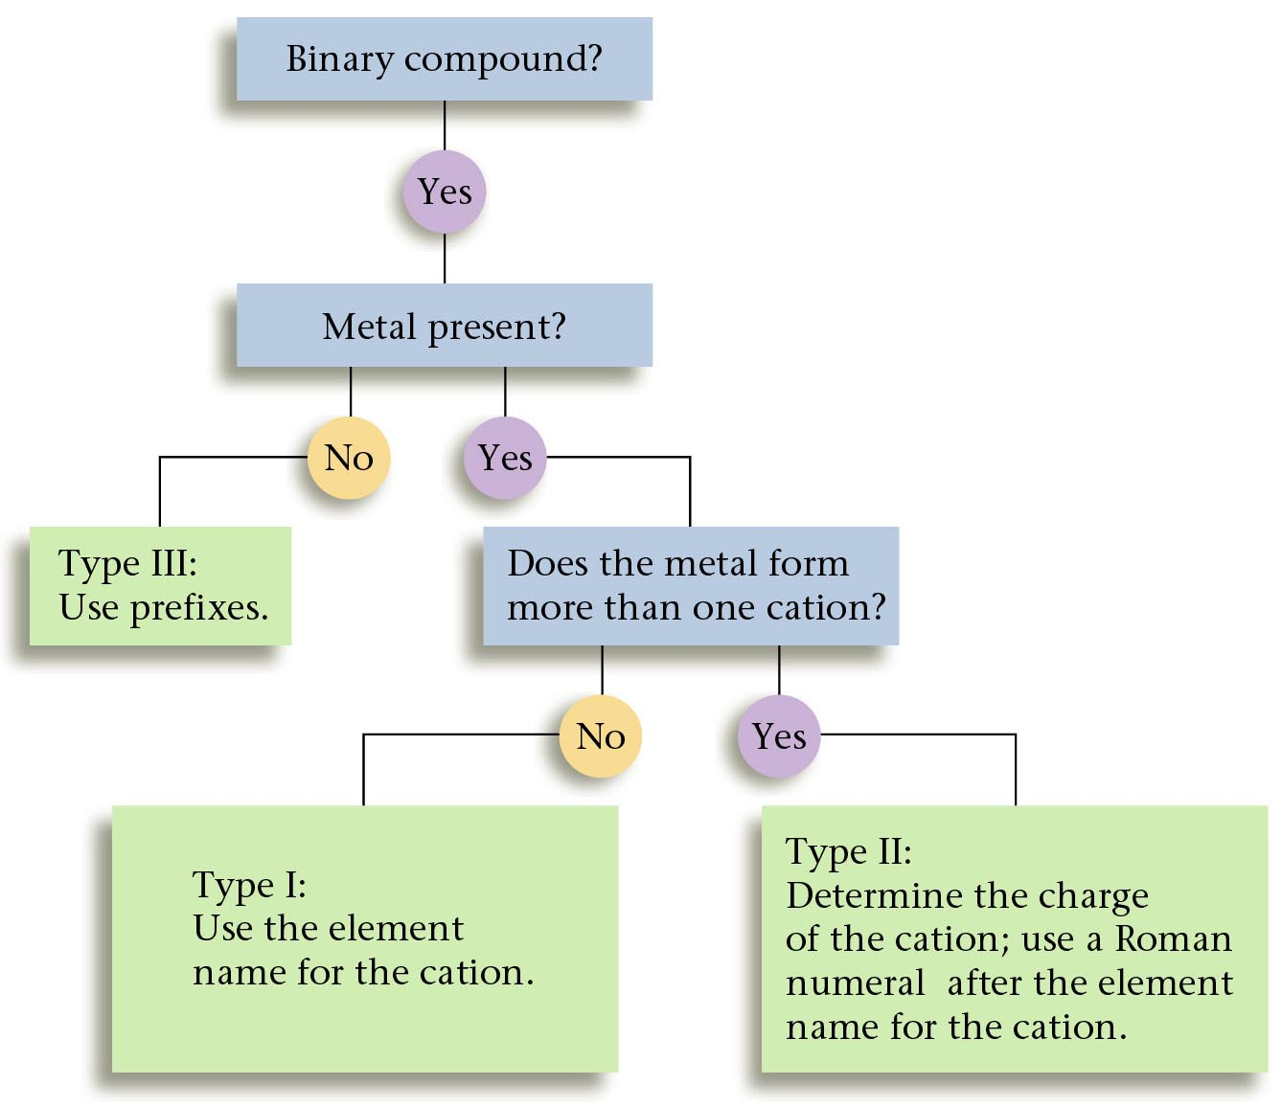
A flow chart for naming binary compounds.

Slide 32
Mixed Review
Name the following compounds:
1. CaO
a) calcium oxide b) calcium(I) oxide
c) calcium (II) oxide
2. SnCl₄
a) tin tetrachloride b) tin(II) chloride
c) tin(IV) chloride
3. N₂O₃
a) nitrogen oxide b) dinitrogen trioxide
c) nitrogen trioxide

Slide 33
Solution
Name the following compounds:
1. CaO
2. SnCl₄
3. N₂O₃
a) calcium oxide
c) tin(IV) chloride
b) Dinitrogen trioxide

Slide 34

Now it’s Study Time
DONE

