Slide 1
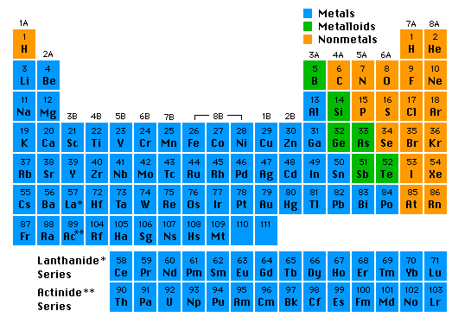
Elements, Atoms, and Ions
Chemistry I Honors: Chapter 3

Slide 2
The Language of Chemistry
CHEMICAL ELEMENTS -
  pure substances that cannot be decomposed by ordinary means to other substances.
Aluminum
Bromine
Sodium

Slide 3
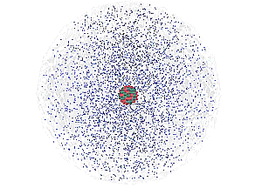
The Atom
An atom consists of a
nucleus
  (of protons and neutrons)
electrons in space about the nucleus.
Electron cloud
Nucleus

Slide 4
Copper atoms on silica surface.
An atom is the smallest particle of an element that has the chemical properties of the element.
Distance across = 1.8 nanometer (1.8 x 10⁻⁹ m)

Slide 5
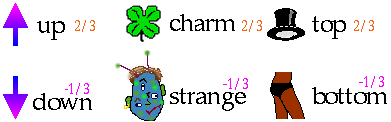
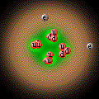
Subatomic Particles
Quarks
  component of protons & neutrons
  6 types
He
  3 quarks =
  1 proton or
  1 neutron

Slide 6
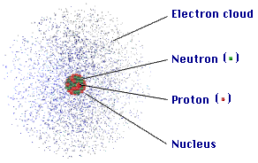
ATOM
COMPOSITION
The atom is mostly
empty space
protons and neutrons in the nucleus.
the number of electrons is equal to the number of protons.
electrons in space around the nucleus.
extremely small. One teaspoon of water has 3 times as many atoms as the Atlantic Ocean has teaspoons of water.

Slide 7
ATOMIC COMPOSITION
Protons (p⁺)
  + electrical charge
  mass = 1.672623 x 10⁻²⁴ g
  relative mass = 1.007 atomic mass units (amu) but we can round to 1
Electrons (e⁻)
  negative electrical charge
  relative mass = 0.0005 amu
  but we can round to 0
Neutrons (nº)
  no electrical charge
  mass = 1.009 amu but we can round to 1

Slide 8
Atomic Number, Z
All atoms of the same element have the same number of protons in the nucleus, Z
13
Atomic number
Al
Atom symbol
26.981
AVERAGE Atomic Mass

Slide 9
Mass Number, A
C atom with 6 protons and 6 neutrons is the mass standard = 12 atomic mass units (amu)
Mass Number (A) = # protons + # neutrons
NOT on the periodic table…(AVERAGE atomic mass is on the table)
A boron atom can have A = 5 p + 5 n = 10 amu

Slide 10
Isotopes
Atoms of the same element (same Z) but different mass number (A).
Boron-10 (¹⁰B) has 5 p and 5 n
Boron-11 (¹¹B) has 5 p and 6 n
¹¹B
¹⁰B

Slide 11
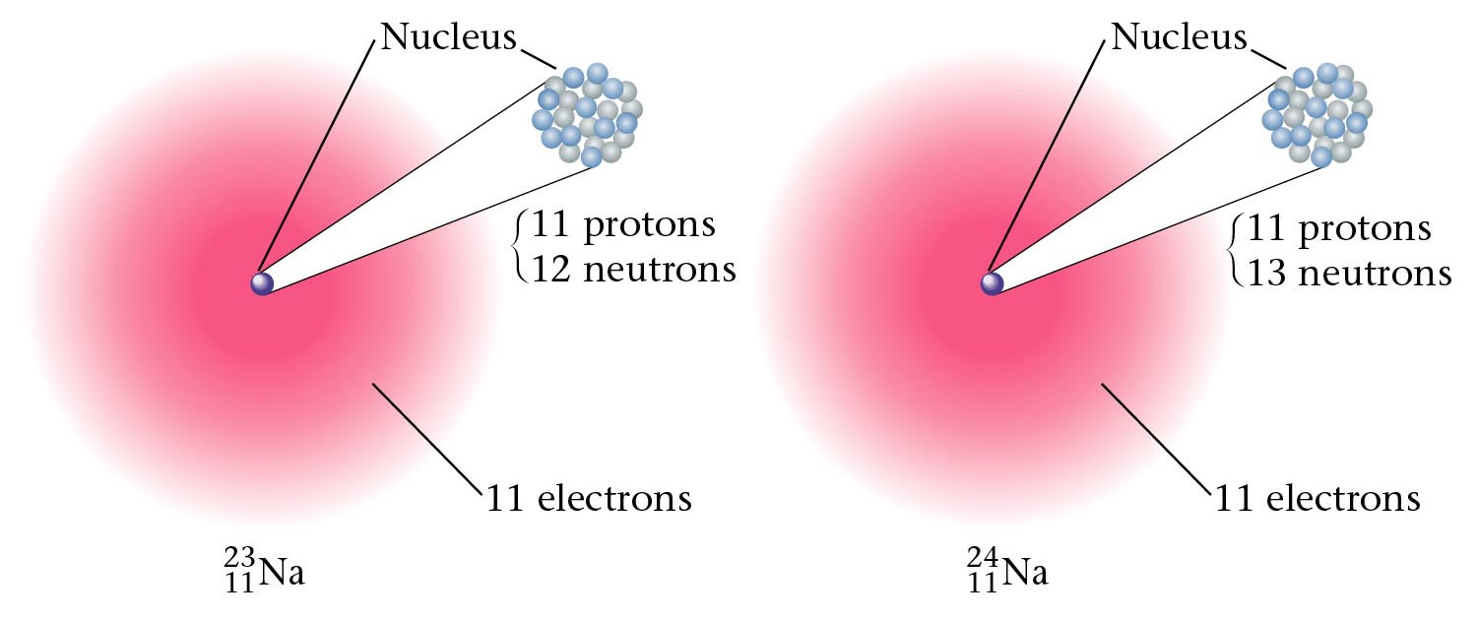
Figure 3.10: Two isotopes of sodium.

Slide 12
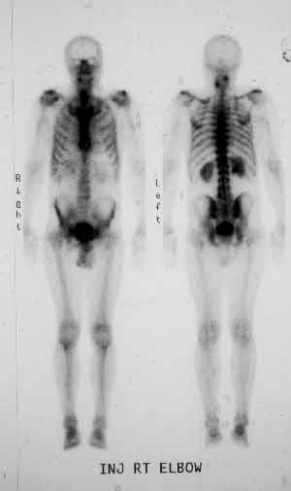
Isotopes & Their Uses
Bone scans with radioactive technetium-99.

Slide 13

Isotopes & Their Uses
The tritium content of ground water is used to discover the source of the water, for example, in municipal water or the source of the steam from a volcano.

Slide 14
Atomic Symbols
Hyphen notation name of the element, a hyphen, and the mass number
sodium-23
Nuclear symbol form
mass number
²³ Na
atomic number ¹¹

Slide 15
Isotopes?
Which of the following represent isotopes of the same element? Which element?
²³⁴ _{X} ²³⁴ _{X} ²³⁵ _{X} ²³⁸ _{X}
⁹² ⁹³ ⁹² ⁹²

Slide 16
Answer:
²³⁴ _{U} ²³⁴ _{Np} ²³⁵ _{U} ²³⁸ _{U}
⁹² ⁹³ ⁹² ⁹²
²³⁴ _{Np} is not an isotope of Uranium.
⁹³

Slide 17
Counting Protons, Neutrons, and Electrons
Protons: Atomic Number (from periodic table)
Neutrons: Mass Number minus the number of protons
Electrons:
  If it’s an atom, the protons and electrons must be EQUAL (no electrical charge)
  If it does NOT have an equal number of electrons, it is not an atom, it is an ION. For each negative charge, add an extra electron. For each positive charge, subtract an electron (Don’t add a proton!!! That changes the element!)

Slide 18
IONS
IONS are atoms or groups of atoms with a positive or negative charge.
Taking away an electron from an atom gives a CATION with a positive charge
Adding an electron to an atom gives an ANION with a negative charge.
To tell the difference between an atom and an ion, look to see if there is a charge in the superscript! Examples: Na⁺ Ca⁺² I⁻ O⁻²
Na Ca I O

Slide 19

Learning Check – Counting
State the number of protons, neutrons, and electrons in each of these ions.
³⁹ K⁺ ¹⁶O ⁻² ⁴¹Ca ⁺²
19 8 20
#p⁺ ______ ______ _______
#nº ______ ______ _______
#e⁻ ______ ______ _______

Slide 20
Learning Check – Counting
State the number of protons, neutrons, and electrons in each of these ions.
³⁹ K⁺ ¹⁶O ⁻² ⁴¹Ca ⁺²
19 8 20
#P 19 8 20
#N 20 8 21
#E 18 10 18

Slide 21
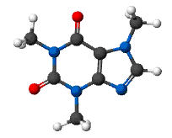
A MOLECULE is the smallest unit of a compound that retains the chemical characteristics of the compound.
Composition of molecules is given by a MOLECULAR FORMULA
H₂O
C₈H₁₀N₄O₂ - caffeine

Slide 22
The red compound is composed of
• nickel (Ni) (silver)
• carbon (C) (black)
• hydrogen (H) (white)
• oxygen (O) (red)
• nitrogen (N) (blue)
CHEMICAL COMPOUNDS are composed of atoms and so can be decomposed to those atoms.

Slide 23
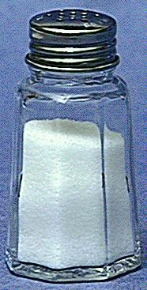
Compounds
  composed of 2 or more elements in a fixed ratio
  properties differ from those of individual elements
  EX: table salt (NaCl)

Slide 24
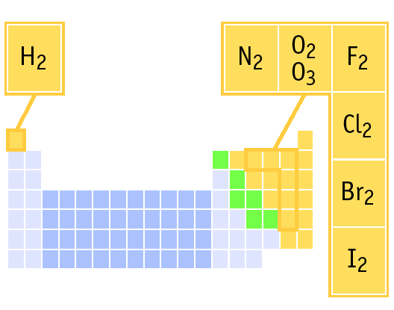
ELEMENTS THAT EXIST AS DIATOMIC MOLECULES
Remember:
BrINClHOF
These elements only exist as PAIRS. Note that when they combine to make compounds, they are no longer elements so they are no longer in pairs!

Slide 25
PREDICTING ION CHARGES
In general
metals (Mg) lose electrons ---> cations
nonmetals (F) gain electrons ---> anions

Slide 26
Dalton’s Atomic Theory
John Dalton (1766-1844) proposed an atomic theory
While this theory was not completely correct, it revolutionized how chemists looked at matter and brought about chemistry as we know it today instead of alchemy
Thus, it’s an important landmark in the history of science.

Slide 27
Dalton’s Atomic Theory - Summary
matter is composed, indivisible particles (atoms)
all atoms of a particular element are identical
different elements have different atoms
atoms combine in certain whole-number ratios
In a chemical reaction, atoms are merely rearranged to form new compounds; they are not created, destroyed, or changed into atoms of any other elements.

Slide 28
Problems with Dalton’s Atomic Theory?
1. matter is composed, indivisible particles
Atoms Can Be Divided, but only in a nuclear reaction
2. all atoms of a particular element are identical
Does Not Account for Isotopes (atoms of the same element but a different mass due to a different number of neutrons)!
3. different elements have different atoms
YES!
4. atoms combine in certain whole-number ratios
YES! Called the Law of Definite Proportions
5. In a chemical reaction, atoms are merely rearranged to form new compounds; they are not created, destroyed, or changed into atoms of any other elements.
Yes, except for nuclear reactions that can change atoms of one element to a different element

Slide 29
AVERAGE ATOMIC MASS
¹¹B
¹⁰B
Because of the existence of isotopes, the mass of a collection of atoms has an average value.
Boron is 20% ¹⁰B and 80% ¹¹B. That is, ¹¹B is 80 percent abundant on earth.
For boron atomic weight
= 0.20 (10 amu) + 0.80 (11 amu) = 10.8 amu

Slide 30
Isotopes & Average Atomic Mass
Because of the existence of isotopes, the mass of a collection of atoms has an average value.
⁶Li = 7.5% abundant and ⁷Li = 92.5%
  Avg. Atomic mass of Li = ______________
²⁸Si = 92.23%, ²⁹Si = 4.67%, ³⁰Si = 3.10%
  Avg. Atomic mass of Si = ______________

Slide 31
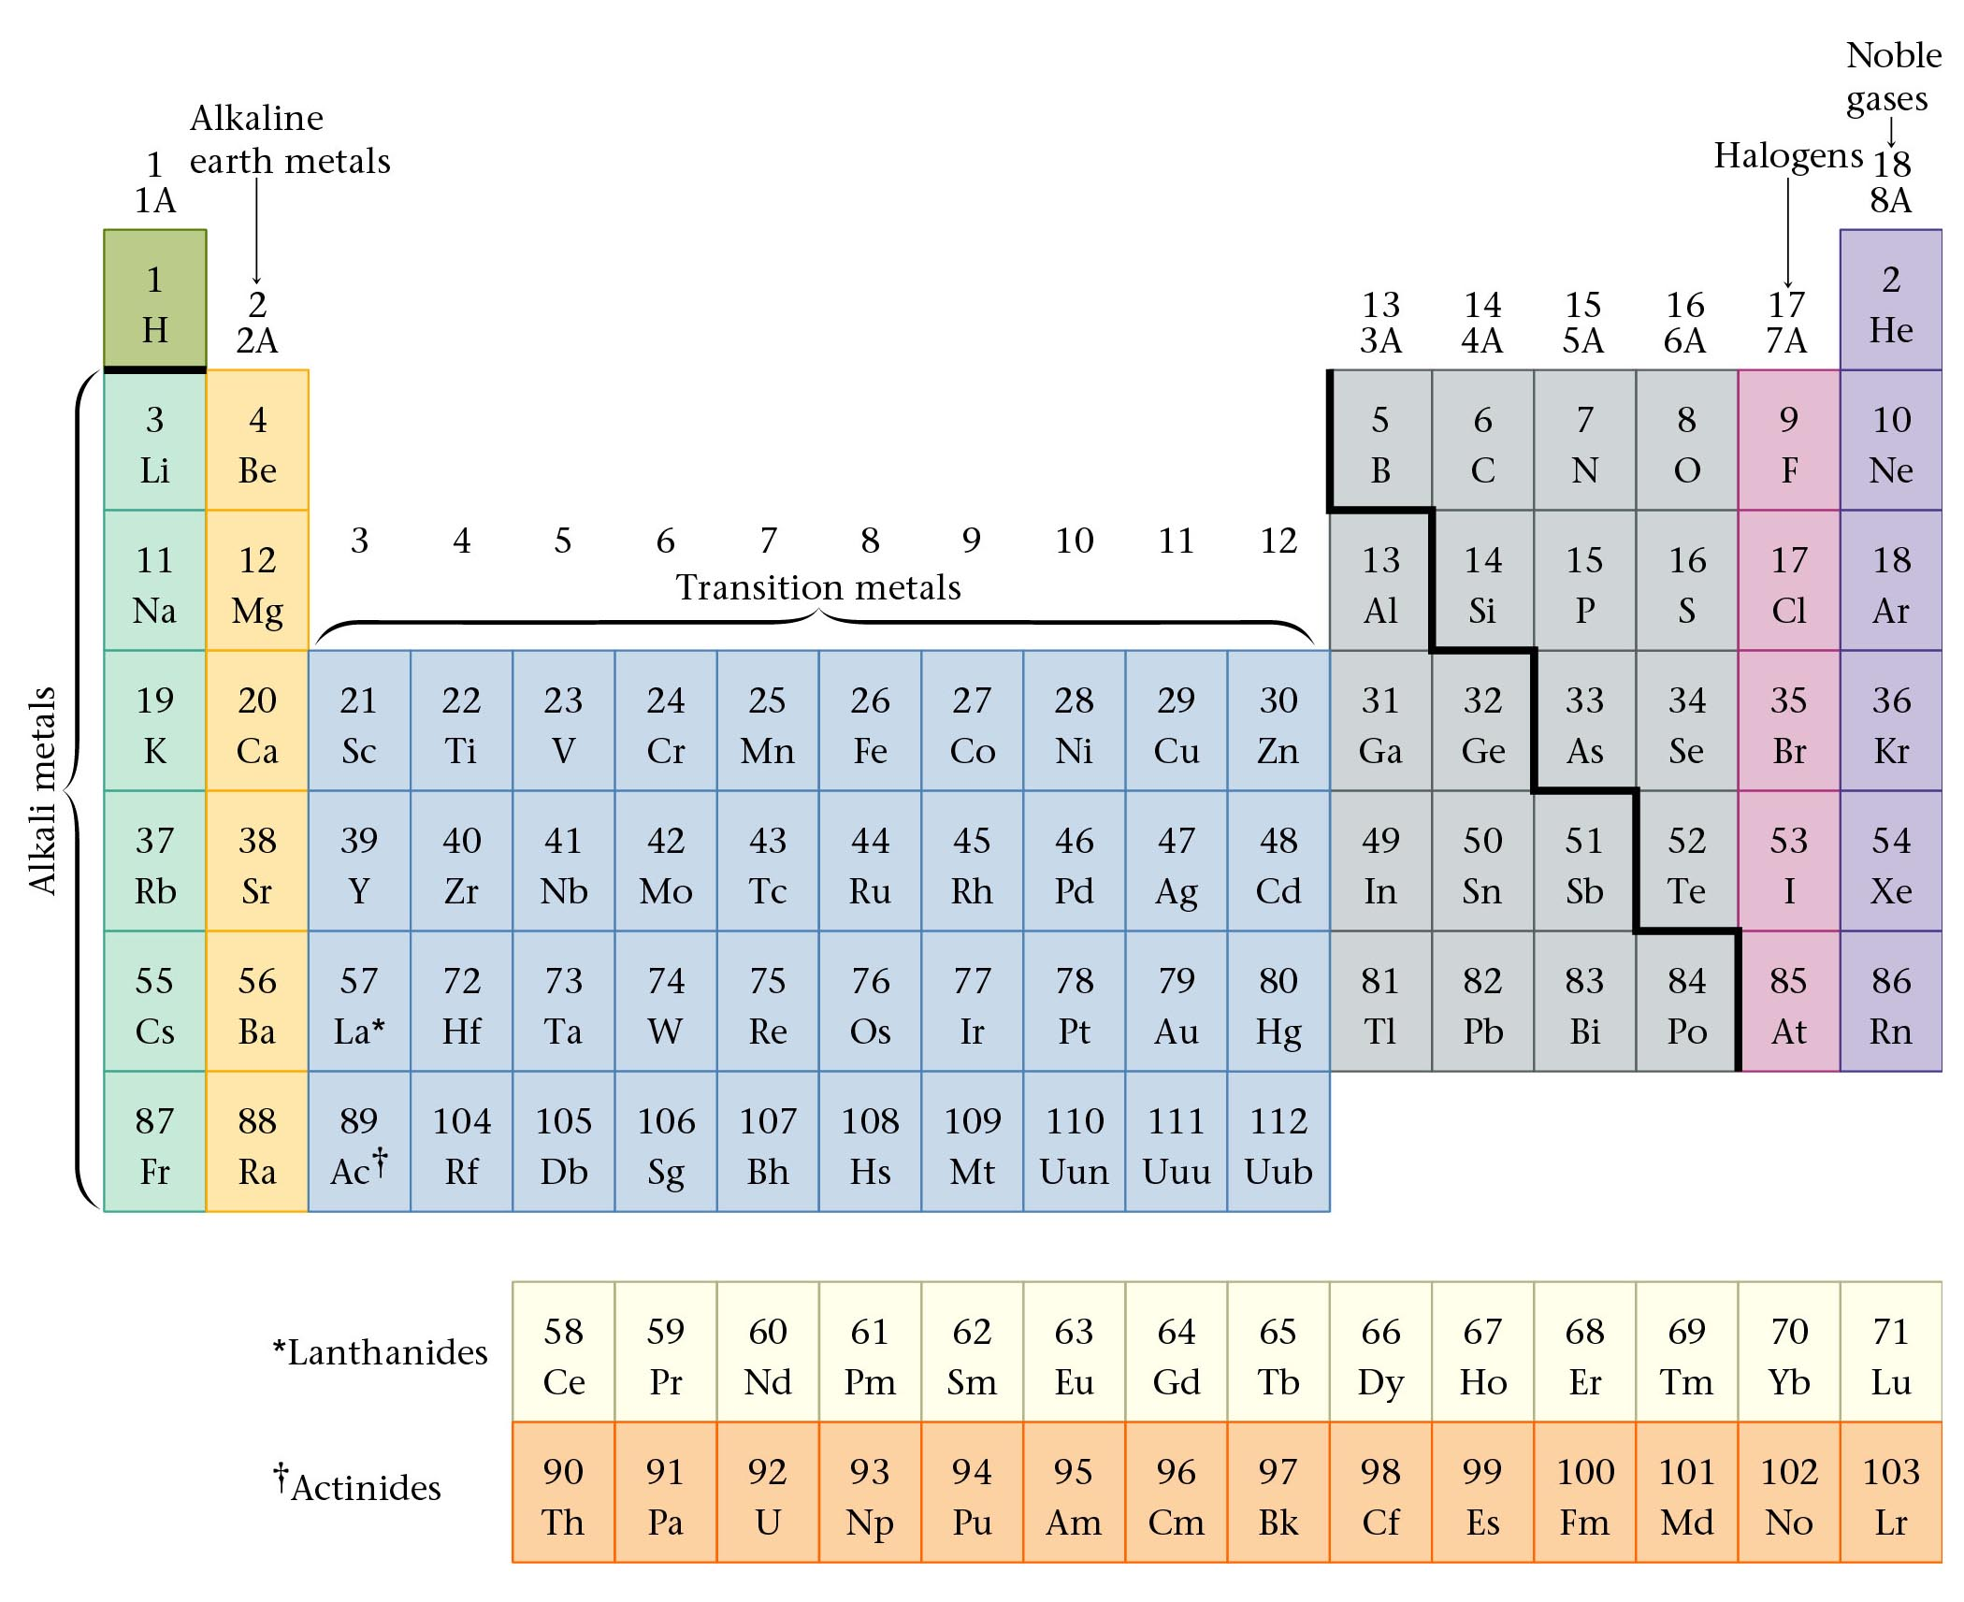
The Periodic Table

Slide 32
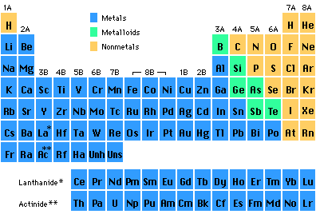
Periods in the Periodic Table

Slide 33
Groups in the Periodic Table
Elements in groups react in similar ways!

Slide 34
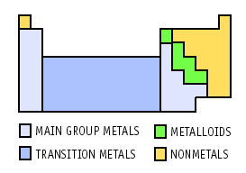
Regions of the Periodic Table

Slide 35
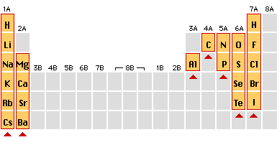
Charges on Common Ions
-3
-2
-1
+1
+2
By losing or gaining e-, atom has same number of e-’s as nearest Group 8A atom.

Slide 36
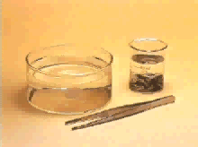
Group 1A: Alkali Metals
Reaction of potassium + H₂O
Cutting sodium metal

Slide 37
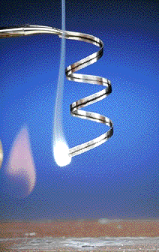
Group 2A: Alkaline Earth Metals
Magnesium
Magnesium oxide

Slide 38
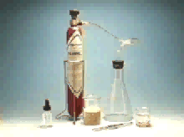
Group 7A: The Halogens (salt makers)
F, Cl, Br, I, At

Slide 39

Group 8A: The Noble (Inert) Gases
He, Ne, Ar, Kr, Xe, Rn
Lighter than air balloons
“Neon” signs
Very Unreactive because they have full electron levels
XeOF₄

Slide 40

Transition Elements
Lanthanides and actinides
Iron in air gives iron(III) oxide

Slide 41
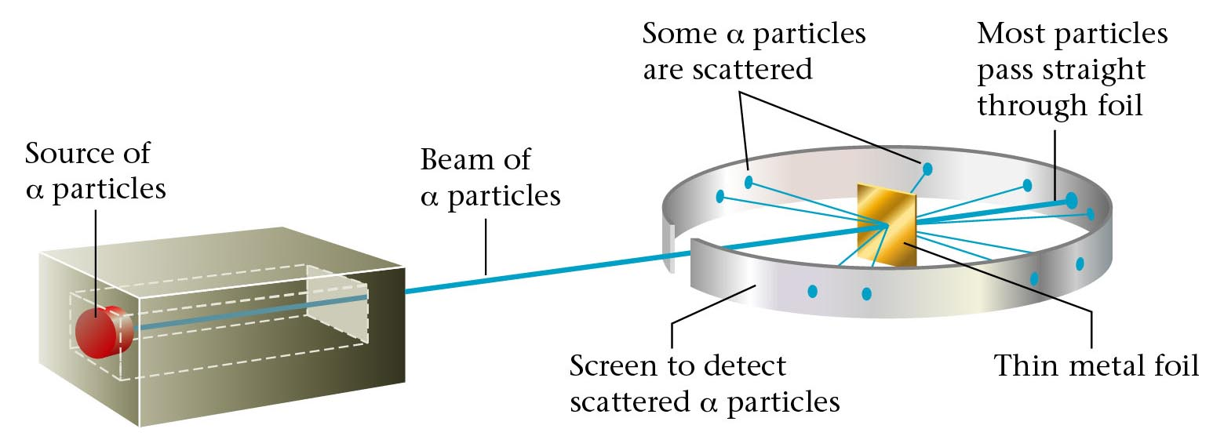
Rutherford’s experiment.

Slide 42
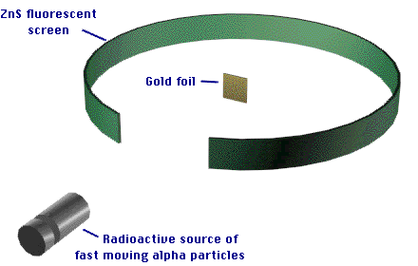
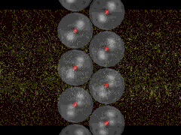
The modern view of the atom was developed by Ernest Rutherford (1871-1937).

Slide 43
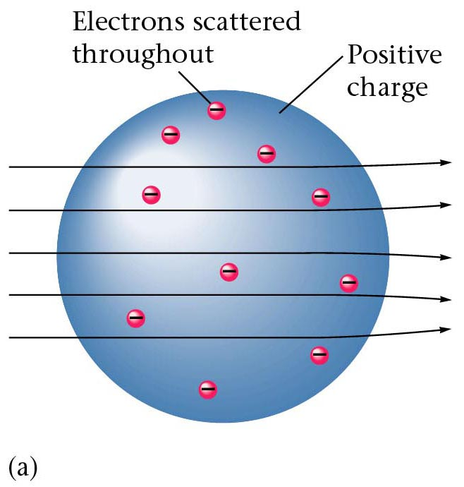
Results of foil experiment if Plum Pudding model had been correct.

Slide 44
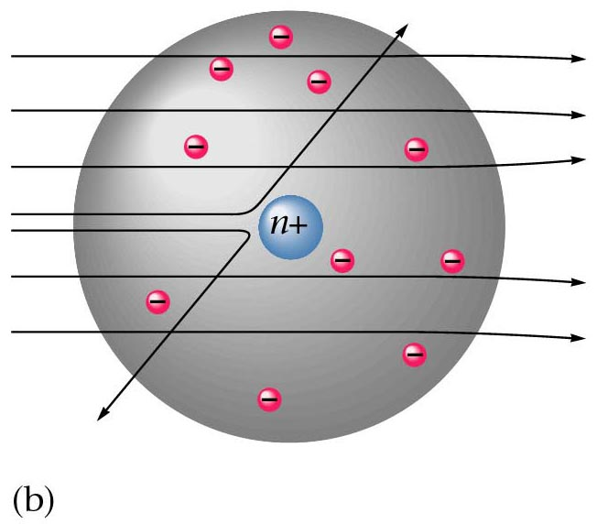
What Actually Happened

