Slide 1
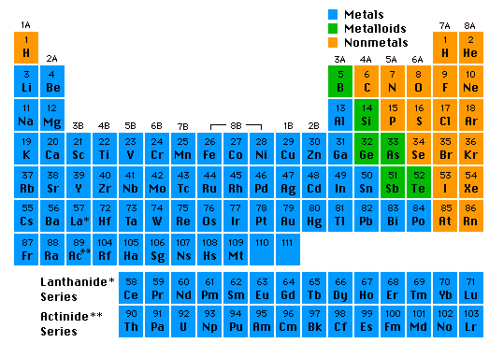
Elements, Atoms, and Ions
Chemistry I Honors: Chapter 4

Slide 2
The Language of Chemistry
CHEMICAL ELEMENTS -
  pure substances that cannot be decomposed by ordinary means to other substances.
Aluminum
Bromine
Sodium

Slide 3
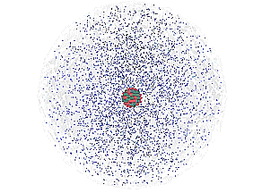
The Atom
An atom consists of a
nucleus
  (of protons and neutrons)
electrons in space about the nucleus.
Electron cloud
Nucleus

Slide 4
Copper atoms on silica surface.
An atom is the smallest particle of an element that has the chemical properties of the element.
Distance across = 1.8 nanometer (1.8 x 10⁻⁹ m)

Slide 5
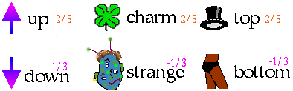
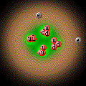
Subatomic Particles
Quarks
  component of protons & neutrons
  6 types
He
  3 quarks =
  1 proton or
  1 neutron

Slide 6
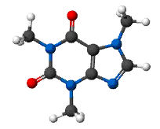
A MOLECULE is the smallest unit of a compound that retains the chemical characteristics of the compound.
Composition of molecules is given by a MOLECULAR FORMULA
H₂O
C₈H₁₀N₄O₂ - caffeine

Slide 7
The red compound is composed of
• nickel (Ni) (silver)
• carbon (C) (black)
• hydrogen (H) (white)
• oxygen (O) (red)
• nitrogen (N) (blue)
CHEMICAL COMPOUNDS are composed of atoms and so can be decomposed to those atoms.

Slide 8
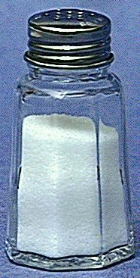
Compounds
  composed of 2 or more elements in a fixed ratio
  properties differ from those of individual elements
  EX: table salt (NaCl)

Slide 9
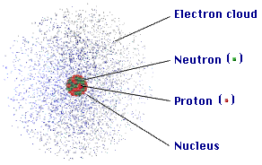
ATOM
COMPOSITION
The atom is mostly
empty space
protons and neutrons in the nucleus.
the number of electrons is equal to the number of protons.
electrons in space around the nucleus.
extremely small. One teaspoon of water has 3 times as many atoms as the Atlantic Ocean has teaspoons of water.

Slide 10
ATOMIC COMPOSITION
Protons (p⁺)
  + electrical charge
  mass = 1.672623 x 10⁻²⁴ g
  relative mass = 1.007 atomic mass units (amu) but we can round to 1
Electrons (e⁻)
  negative electrical charge
  relative mass = 0.0005 amu
  but we can round to 0
Neutrons (nº)
  no electrical charge
  mass = 1.009 amu but we can round to 1

Slide 11
Atomic Number, Z
All atoms of the same element have the same number of protons in the nucleus, Z
13
Atomic number
Al
Atom symbol
26.981
AVERAGE Atomic Mass

Slide 12
Mass Number, A
C atom with 6 protons and 6 neutrons is the mass standard = 12 atomic mass units (amu)
Mass Number (A) = # protons + # neutrons
NOT on the periodic table…(AVERAGE atomic mass is on the table)
A boron atom can have A = 5 p + 5 n = 10 amu

Slide 13
Isotopes
Atoms of the same element (same Z) but different mass number (A).
Boron-10 (¹⁰B) has 5 p and 5 n
Boron-11 (¹¹B) has 5 p and 6 n
¹¹B
¹⁰B

Slide 14
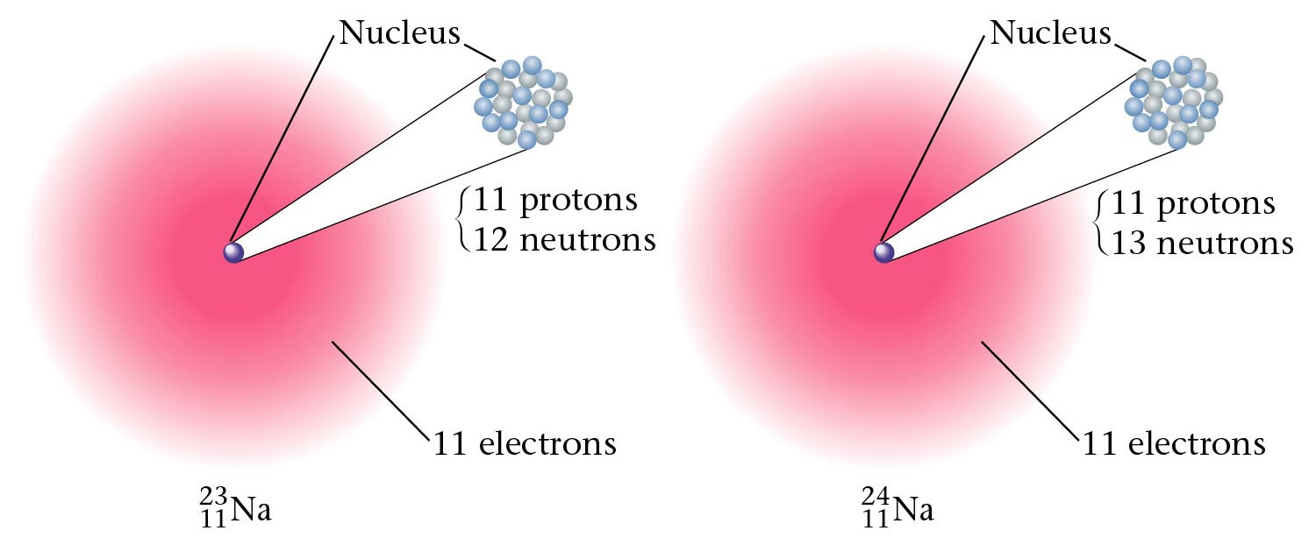
Figure 3.10: Two isotopes of sodium.

Slide 15
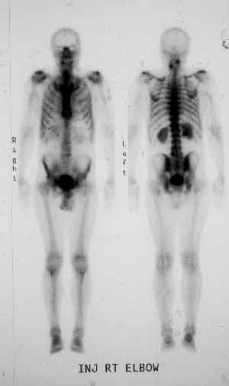
Isotopes & Their Uses
Bone scans with radioactive technetium-99.

Slide 16

Isotopes & Their Uses
The tritium content of ground water is used to discover the source of the water, for example, in municipal water or the source of the steam from a volcano.

Slide 17
Atomic Symbols
Hyphen notation name of the element, a hyphen, and the mass number
sodium-23
Nuclear symbol form
mass number
²³ Na
atomic number ¹¹

Slide 18
Isotopes?
Which of the following represent isotopes of the same element? Which element?
²³⁴ _{X} ²³⁴ _{X} ²³⁵ _{X} ²³⁸ _{X}
⁹² ⁹³ ⁹² ⁹²

Slide 19
Answer:
²³⁴ _{U} ²³⁴ _{Np} ²³⁵ _{U} ²³⁸ _{U}
⁹² ⁹³ ⁹² ⁹²
²³⁴ _{Np} is not an isotope of Uranium.
⁹³

Slide 20
Counting Protons, Neutrons, and Electrons
Protons: Atomic Number (from periodic table)
Neutrons: Mass Number minus the number of protons
Electrons:
  If it’s an atom, the protons and electrons must be EQUAL (no electrical charge)
  If it does NOT have an equal number of electrons, it is not an atom, it is an ION. For each negative charge, add an extra electron. For each positive charge, subtract an electron (Don’t add a proton!!! That changes the element!)

Slide 21

Learning Check – Counting
Naturally occurring carbon consists of three isotopes, ¹²C, ¹³C, and ¹⁴C. State the number of protons, neutrons, and electrons in each of these carbon atoms.
¹²C ¹³C ¹⁴C
6 6 6
#p⁺ _______ _______ _______
#nº _______ _______ _______
#e⁻ _______ _______ _______

Slide 22

Answers
¹²C ¹³C ¹⁴C
6 6 6
#p⁺ 6 6 6
#nº 6 7 8
#e⁻ 6 6 6

Slide 23
Learning Check
An atom has 14 protons and 20 neutrons.
A. Its atomic number is
1) 14 2) 16 3) 34
B. Its mass number is
1) 14 2) 16 3) 34
C. The element is
1) Si 2) Ca 3) Se
D. Another isotope of this element is
1) ³⁴X 2) ³⁴X 3) ³⁶X
¹⁶ 14 14

Slide 24
Solution
An atom has 14 protons and 20 neutrons.
A. It has atomic number
1) 14
B. It has a mass number of
3) 34
C. The element is
1) Si
D. Another isotope of this element would be
3) ³⁶X
¹⁴

Slide 25
IONS
IONS are atoms or groups of atoms with a positive or negative charge.
Taking away an electron from an atom gives a CATION with a positive charge
Adding an electron to an atom gives an ANION with a negative charge.
To tell the difference between an atom and an ion, look to see if there is a charge in the superscript! Examples: Na⁺ Ca⁺² I⁻ O⁻²
Na Ca I O

Slide 26
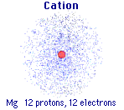
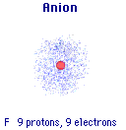
Forming Cations & Anions
A CATION forms when an atom loses one or more electrons.
An ANION forms when an atom gains one or more electrons
Mg --> Mg²⁺ + 2 e-
F + e- --> F⁻

Slide 27
PREDICTING ION CHARGES
In general
metals (Mg) lose electrons ---> cations
nonmetals (F) gain electrons ---> anions

Slide 28
Learning Check – Counting
State the number of protons, neutrons, and electrons in each of these ions.
³⁹ K⁺ ¹⁶O ⁻² ⁴¹Ca ⁺²
19 8 20
#p⁺ ______ ______ _______
#nº ______ ______ _______
#e⁻ ______ ______ _______

Slide 29
Learning Check – Counting
State the number of protons, neutrons, and electrons in each of these ions.
³⁹ K⁺ ¹⁶O ⁻² ⁴¹Ca ⁺²
19 8 20
#P 19 8 20
#N 20 8 21
#E 18 10 18

Slide 30
One Last Learning Check
Write the nuclear symbol form for the following atoms or ions:
A. 8 p⁺, 8 n, 8 e⁻ ___________
B. 17p⁺, 20n, 17e⁻ ___________
C. 47p⁺, 60 n, 46 e⁻ ___________

Slide 31
Answers
Write the nuclear symbol form for the following atoms or ions:
A. 8 p⁺, 8 n, 8 e⁻ ¹⁶O
⁸
B. 17p⁺, 20n, 17e⁻ ³⁷Cl
¹⁷
C. 47p⁺, 60 n, 46 e⁻ ¹⁰⁷Ag⁺
⁴⁷

Slide 32
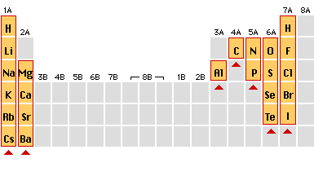
Charges on Common Ions
-3
-2
-1
+1
+2
By losing or gaining e-, atom has same number of e-’s as nearest Group 8A atom.

Slide 33
Dalton’s Atomic Theory
John Dalton (1766-1844) proposed an atomic theory
While this theory was not completely correct, it revolutionized how chemists looked at matter and brought about chemistry as we know it today instead of alchemy
Thus, it’s an important landmark in the history of science.

Slide 34
Dalton’s Atomic Theory - Summary
matter is composed, indivisible particles (atoms)
all atoms of a particular element are identical
different elements have different atoms
atoms combine in certain whole-number ratios
In a chemical reaction, atoms are merely rearranged to form new compounds; they are not created, destroyed, or changed into atoms of any other elements.

Slide 35
Problems with Dalton’s Atomic Theory?
1. matter is composed, indivisible particles
Atoms Can Be Divided, but only in a nuclear reaction
2. all atoms of a particular element are identical
Does Not Account for Isotopes (atoms of the same element but a different mass due to a different number of neutrons)!
3. different elements have different atoms
YES!
4. atoms combine in certain whole-number ratios
YES! Called the Law of Definite Proportions
5. In a chemical reaction, atoms are merely rearranged to form new compounds; they are not created, destroyed, or changed into atoms of any other elements.
Yes, except for nuclear reactions that can change atoms of one element to a different element

Slide 36
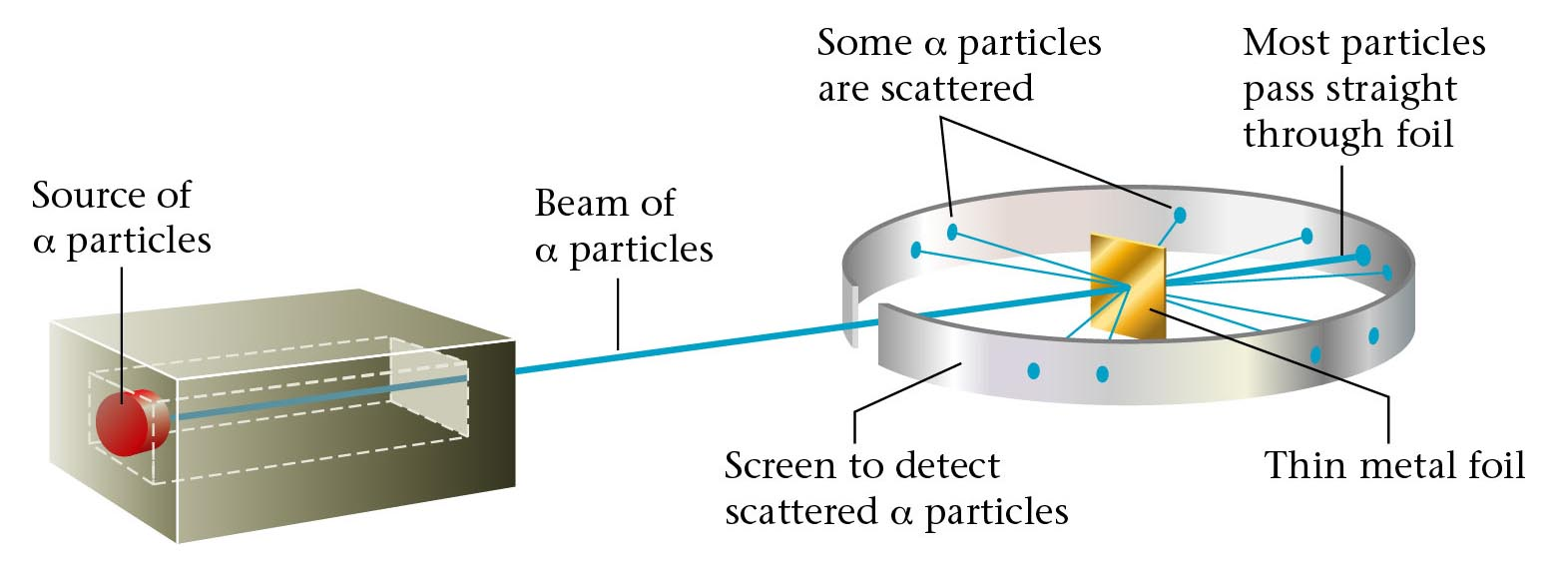
Rutherford’s experiment.

Slide 37
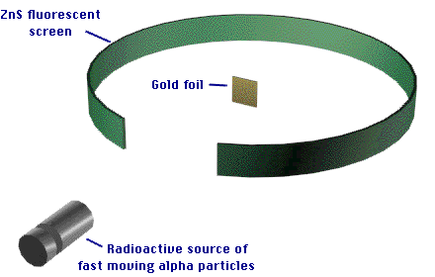
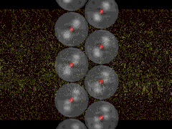
The modern view of the atom was developed by Ernest Rutherford (1871-1937).

Slide 38
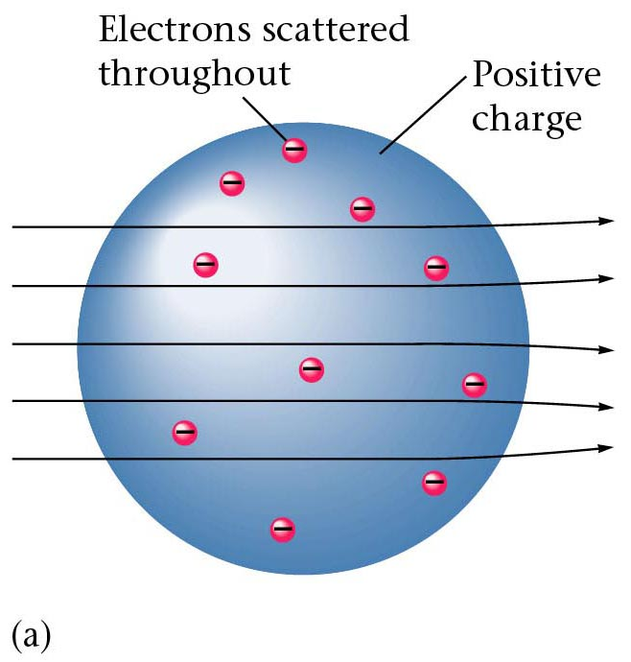
Results of foil experiment if Plum Pudding model had been correct.

Slide 39
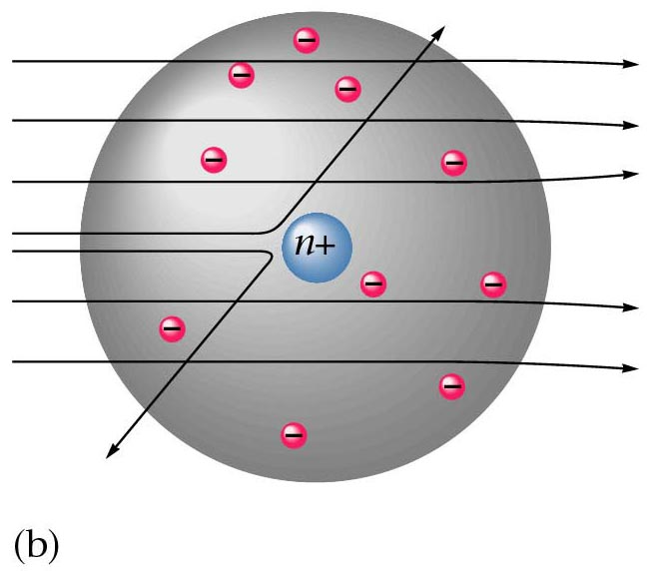
What Actually Happened

Slide 40
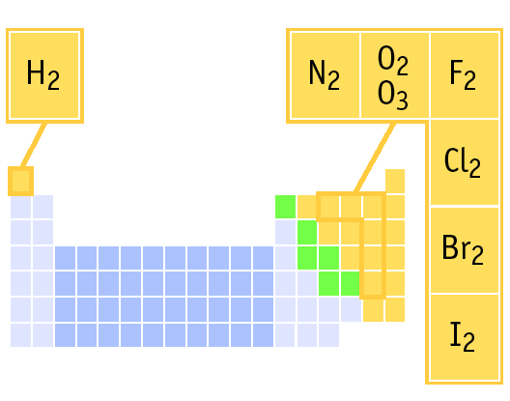
ELEMENTS THAT EXIST AS DIATOMIC MOLECULES
Remember:
BrINClHOF
These elements only exist as PAIRS. Note that when they combine to make compounds, they are no longer elements so they are no longer in pairs!

Slide 41
AVERAGE ATOMIC MASS
¹¹B
¹⁰B
Because of the existence of isotopes, the mass of a collection of atoms has an average value.
Boron is 20% ¹⁰B and 80% ¹¹B. That is, ¹¹B is 80 percent abundant on earth.
For boron atomic weight
= 0.20 (10 amu) + 0.80 (11 amu) = 10.8 amu

Slide 42
Isotopes & Average Atomic Mass
Because of the existence of isotopes, the mass of a collection of atoms has an average value.
⁶Li = 7.5% abundant and ⁷Li = 92.5%
  Avg. Atomic mass of Li = ______________
²⁸Si = 92.23%, ²⁹Si = 4.67%, ³⁰Si = 3.10%
  Avg. Atomic mass of Si = ______________

Slide 43
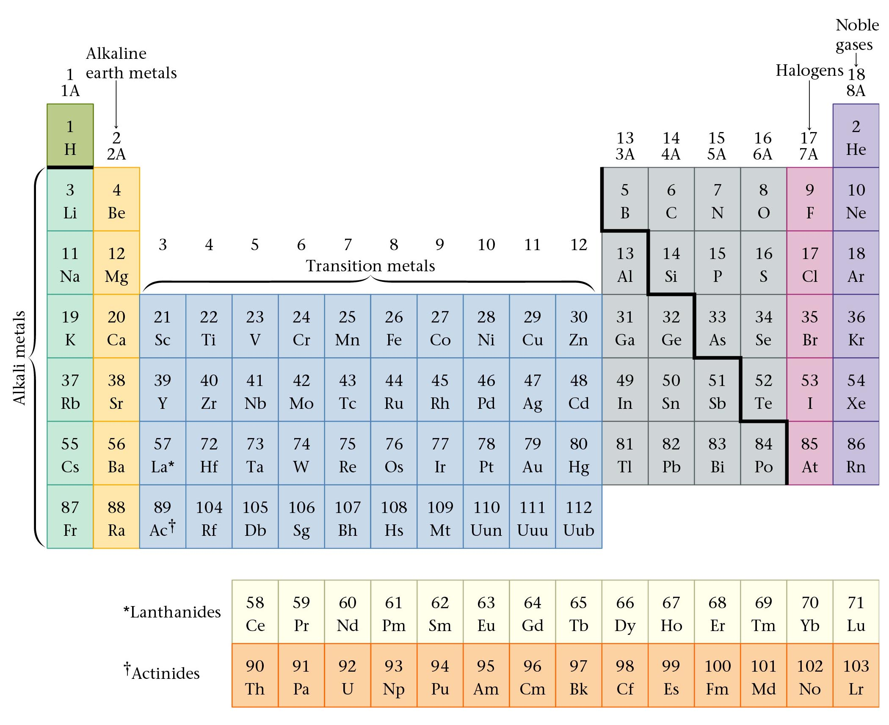
The Periodic Table

Slide 44
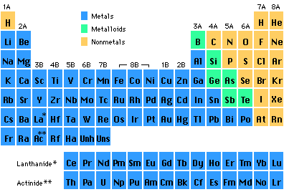
Periods in the Periodic Table

Slide 45
Groups in the Periodic Table
Elements in groups react in similar ways!

Slide 46
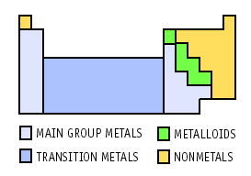
Regions of the Periodic Table

Slide 47
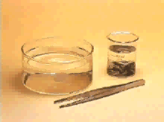
Group 1A: Alkali Metals
Reaction of potassium + H₂O
Cutting sodium metal

Slide 48
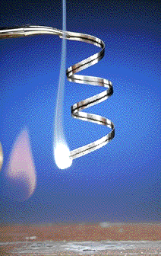
Group 2A: Alkaline Earth Metals
Magnesium
Magnesium oxide

Slide 49
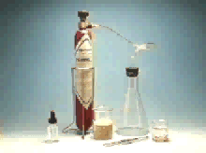
Group 7A: The Halogens (salt makers)
F, Cl, Br, I, At

Slide 50

Group 8A: The Noble (Inert) Gases
He, Ne, Ar, Kr, Xe, Rn
Lighter than air balloons
“Neon” signs
Very Unreactive because they have full electron levels
XeOF₄

Slide 51

Transition Elements
Lanthanides and actinides
Iron in air gives iron(III) oxide

