Slide 1
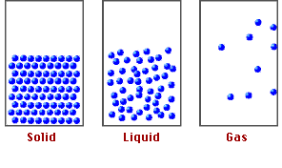
Matter And Energy
Chemistry I Honors: Chapter 3

Slide 2
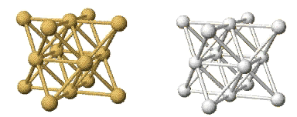
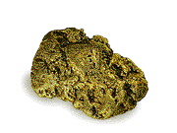
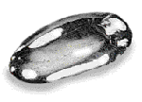
The Nature of Matter
Gold
Mercury
Chemists are interested in the nature of matter and how this is related to its atoms and molecules.

Slide 3
Chemistry & Matter
We can explore the MACROSCOPIC world — what we can see —
to understand the PARTICULATE worlds we cannot see.
We write SYMBOLS to describe these worlds.

Slide 4
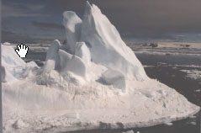

A Chemist’s View of Water
Macroscopic
H₂O
(gas, liquid, solid)
Symbolic
Particulate

Slide 5
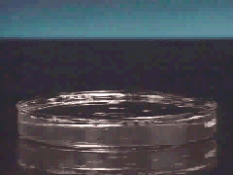
A Chemist’s View
Macroscopic
2 H₂(g) + O₂ (g)
--> 2 H₂O(g)
Particulate
Symbolic

Slide 6
Kinetic Nature of Matter
Matter consists of atoms and molecules in motion.

Slide 7
STATES OF MATTER
SOLIDS — have rigid shape, fixed volume. External shape can reflect the atomic and molecular arrangement.
  Reasonably well understood.
LIQUIDS — have no fixed shape and may not fill a container completely.
  Not well understood.
GASES — expand to fill their container.
  Good theoretical understanding.

Slide 8
OTHER STATES OF MATTER
PLASMA — an electrically charged gas; Example: the sun or any other star
BOSE-EINSTEIN CONDENSATE — a condensate that forms near absolute zero that has superconductive properties; Example: supercooled Rb gas

Slide 9
Physical Properties
What are some physical properties?
color
melting and boiling point
odor

Slide 10
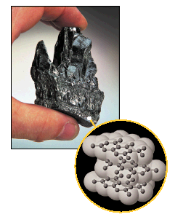
Graphite — layer structure of carbon atoms reflects physical properties.

Slide 11
Physical Changes
  can be observed without changing the identity of the substance
Some physical changes would be
boiling of a liquid
melting of a solid
dissolving a solid in a liquid to give a homogeneous mixture — a SOLUTION.

Slide 12
Chemical Properties and Chemical Change
Chemical change or chemical reaction — transformation of one or more atoms or molecules into one or more different molecules.
Example: Burning hydrogen (H₂) in oxygen (O₂) gives H₂O.

Slide 13

Sure Signs of a Chemical Change
Heat
Light
Gas Produced (not from boiling!)
Precipitate – a solid formed by mixing two liquids together
http://www.youtube.com/watch?v=DITY2rXYU-I&feature=fvwrel

Slide 14

Physical vs. Chemical
  physical
  chemical
  physical
  physical
  chemical
Examples:
  melting point
  flammable
  density
  magnetic
  tarnishes in air

Slide 15
Physical vs. Chemical
  chemical
  physical
  chemical
  physical
  physical
Examples:
  rusting iron
  dissolving in water
  burning a log
  melting ice
  grinding spices

Slide 16
Matter Flowchart
MATTER
yes
no
Can it be physically separated?
MIXTURE
PURE SUBSTANCE
yes
Is the composition uniform?
no
yes
Can it be chemically decomposed?
no
Homogeneous Mixture
(solution)
Heterogeneous Mixture
Compound
Element
Colloids
Suspensions

Slide 17
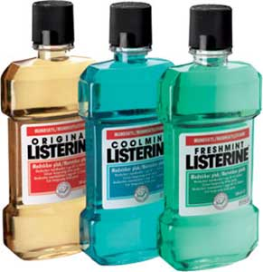
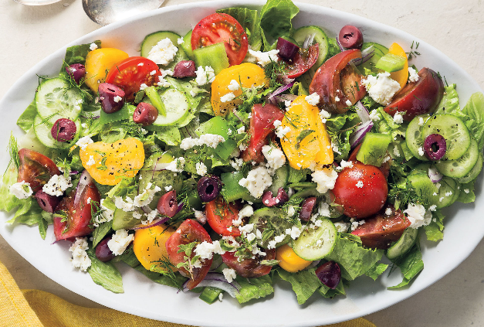
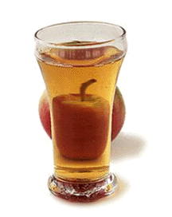
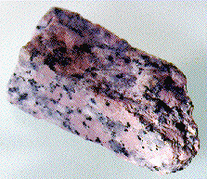
Types of Mixtures
Variable combination of 2 or more pure substances.
Heterogeneous –
visibly separate phases
Homogeneous –
Same throughout

Slide 18
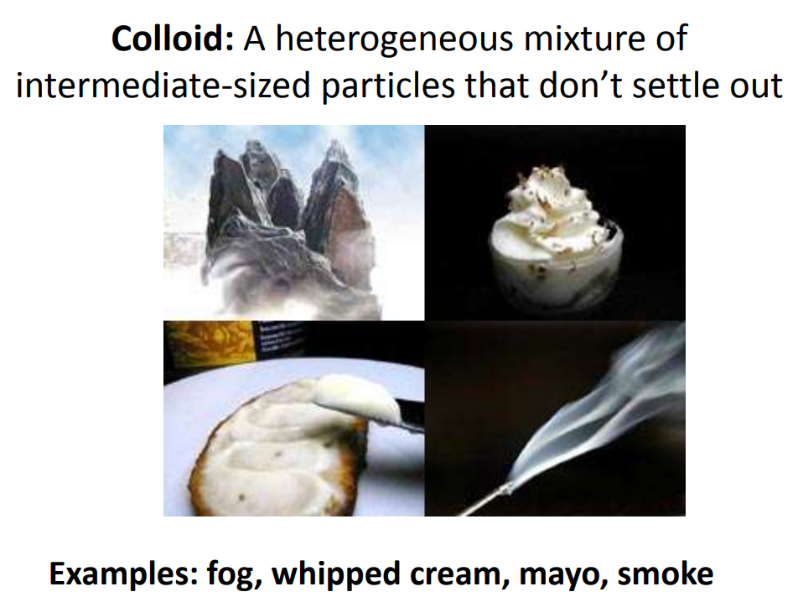

Slide 19
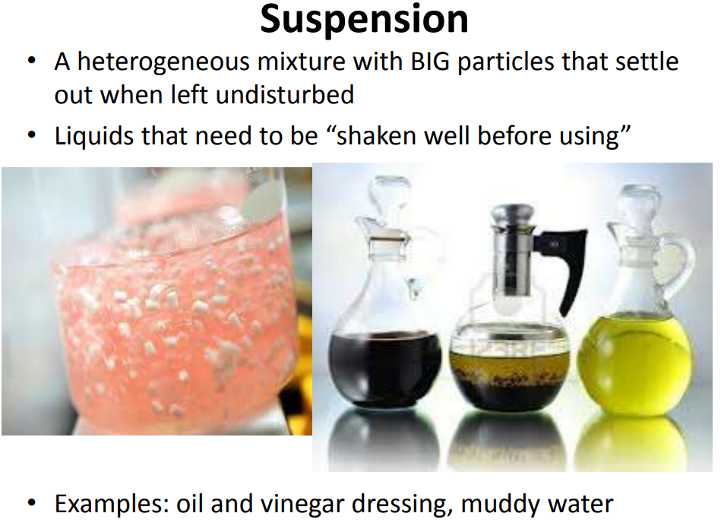

Slide 20
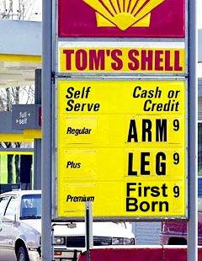

Energy
Mostly covered in physics
Two types
  Kinetic
  Potential

