Slide 1
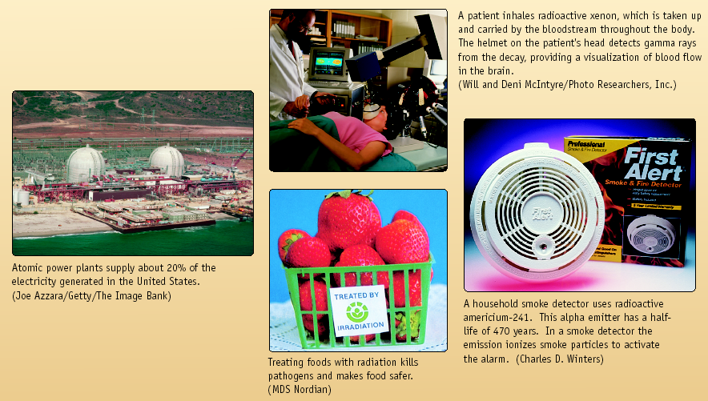
Nuclear Chemistry
Chemistry I – Chapter 17
Chemistry I Honors – Chapter 17
ICP – Chapter 18

Slide 2
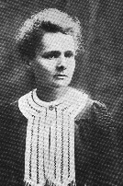
Radioactivity
One of the pieces of evidence for the fact that atoms are made of smaller particles came from the work of Marie Curie (1876-1934).
She discovered radioactivity, the spontaneous disintegration of some elements into smaller pieces.

Slide 3
Nuclear Reactions vs. Normal Chemical Changes
Nuclear reactions involve the nucleus
Protons and neutrons are rearranged
A tremendous amount of energy that holds the nucleus together – called binding energy – is released
“Normal” Chemical Reactions involve electrons, not protons and neutrons

Slide 4

Mass Defect
Some of the mass can be converted into energy
Shown by a very famous equation!
E=mc²
Energy
Mass
Speed of light

Slide 5
Types of Radiation
Alpha (ά) – a positively charged helium isotope - we usually ignore the charge because it involves electrons, not protons and neutrons
Beta (β) – an electron
Gamma (γ) – pure energy; called a ray rather than a particle

Slide 6
Other Nuclear Particles
Neutron
Positron – a positive electron
Proton – usually referred to as hydrogen-1
Any other elemental isotope

Slide 7
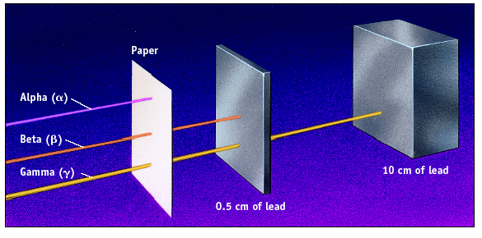
Penetrating Ability

Slide 8
Balancing Nuclear Reactions
In the reactants (starting materials – on the left side of an equation) and products (final products – on the right side of an equation)
Atomic numbers must balance
and
Mass numbers must balance
Use a particle or isotope to fill in the missing protons and neutrons

Slide 9
Emission vs. Capture
An emission is when something is released
A capture is when something is taken in
Decay in this case could mean either, but assume an emission unless told otherwise

Slide 10
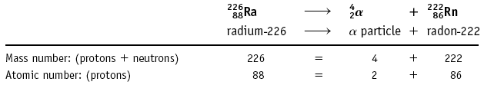
Nuclear Reactions
Alpha emission
Note that mass number (A) goes down by 4 and atomic number (Z) goes down by 2.
Nucleons (nuclear particles… protons and neutrons) are rearranged but conserved

Slide 11
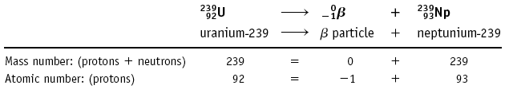
Nuclear Reactions
Beta emission
Note that mass number (A) is unchanged and atomic number (Z) goes up by 1.

Slide 12
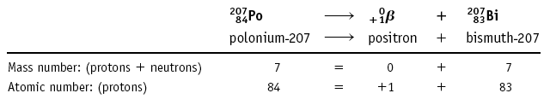
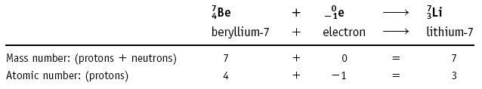
Other Types of Nuclear Reactions
Positron (⁰₊₁β): a positive electron
207
207
Electron capture: the capture of an electron

Slide 13
Learning Check
What radioactive isotope is produced in the following bombardment of boron?
¹⁰B + ⁴He ? + ¹n
5 2 0

Slide 14
Learning Check
What radioactive isotope is produced in the following bombardment of boron?
¹⁰B + ⁴He ¹³N + ¹n
5 2 7 ⁰

Slide 15
Write Nuclear Equations!
Write the nuclear equation for the beta emitter Co-60.
⁶⁰Co ⁰e + ⁶⁰Ni
²⁷ ⁻¹ ²⁸

Slide 16
Artificial Nuclear Reactions
New elements or new isotopes of known elements are produced by bombarding an atom with a subatomic particle -- or even a much heavier particle such as ⁴He and ¹¹B.
Reactions using neutrons are called
γ reactions.
Radioisotopes used in medicine are often made by γ reactions.

Slide 17
Half-Life
HALF-LIFE is the time that it takes for 1/2 a sample to decompose.
Rate depends only on the “reactant” remaining

Slide 18
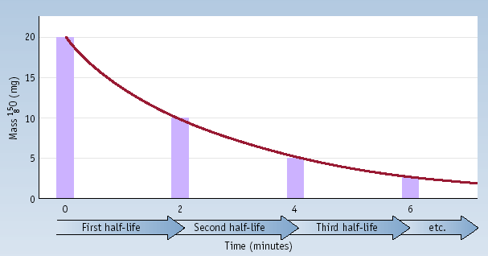
Half-Life
Decay of 20.0 mg of ¹⁵O. What remains after 3 half-lives? After 5 half-lives?

Slide 19
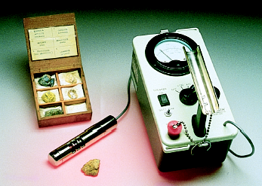
Kinetics of Radioactive Decay
For each duration (half-life), one half of the substance decomposes.
For example: Ra-234 has a half-life of 3.6 days
If you start with 50 grams of Ra-234…
After 3.6 days > 25 grams
After 7.2 days > 12.5 grams
After 10.8 days > 6.25 grams

Slide 20
Learning Check!
The half life of I-123 is 13 hr. How much of a 64 mg sample of I-123 is left after 39 hours?

Slide 21
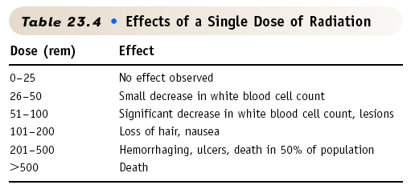
Effects of Radiation

Slide 22
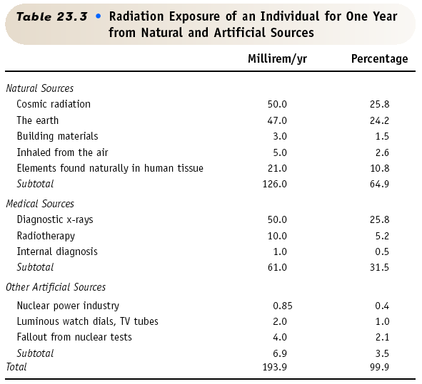

Slide 23
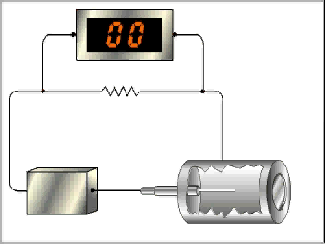
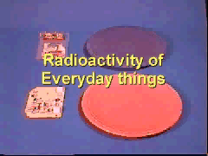
Geiger Counter
Used to detect radioactive substances

Slide 24
Radiocarbon Dating
Radioactive C-14 is formed in the upper atmosphere by nuclear reactions initiated by neutrons in cosmic radiation
¹⁴N + ¹_{o}n ---> ¹⁴C + ¹H
The C-14 is oxidized to CO₂, which circulates through the biosphere.
When a plant dies, the C-14 is not replenished.
But the C-14 continues to decay with t_{1/2} = 5730 years.
Activity of a sample can be used to approximately date the sample.

Slide 25
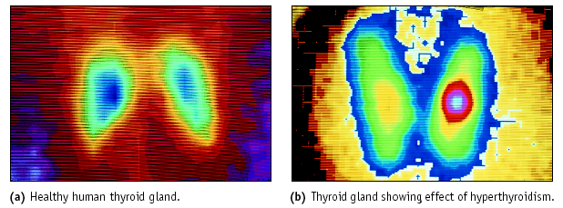
Nuclear Medicine: Imaging
Thyroid imaging using Tc-99m

Slide 26
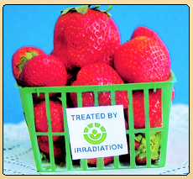
Food Irradiation
Food can be irradiated with γ rays from ⁶⁰Co or ¹³⁷Cs.
Irradiated milk has a shelf life of 3 mo. without refrigeration.
USDA has approved irradiation of meats and eggs.

Slide 27
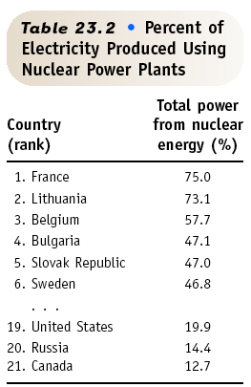
Nuclear Fission & POWER
Currently about 103 nuclear power plants in the U.S. and about 435 worldwide.
17% of the world’s energy comes from nuclear.

Slide 28
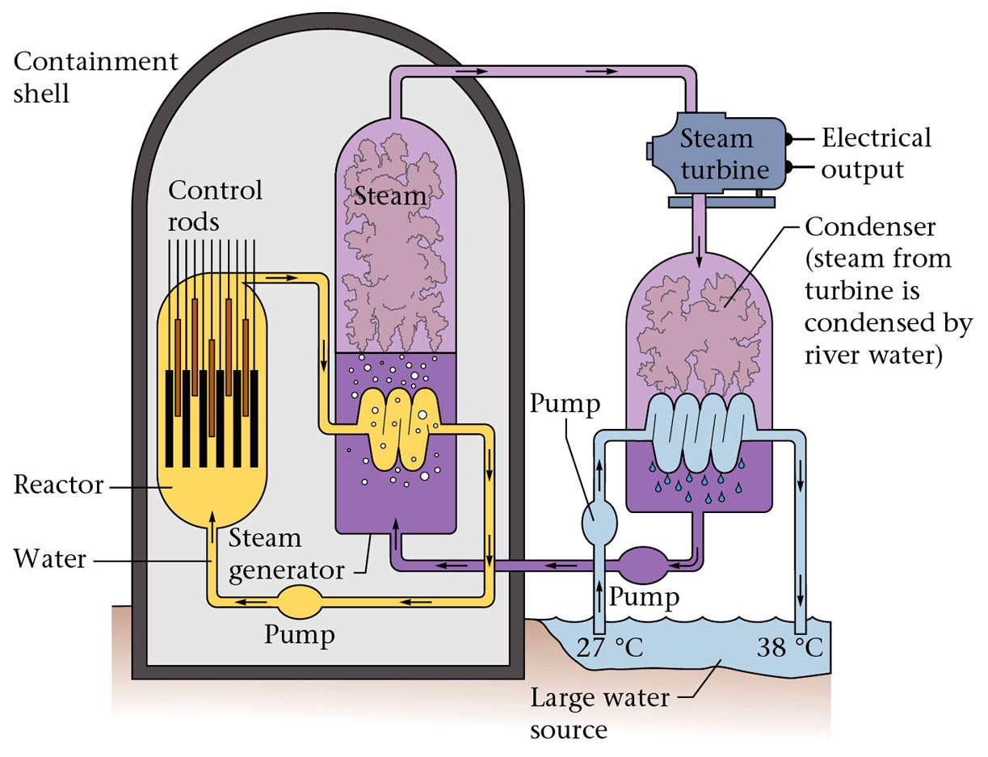
Figure 19.6: Diagram of a nuclear power plant.

