Slide 1
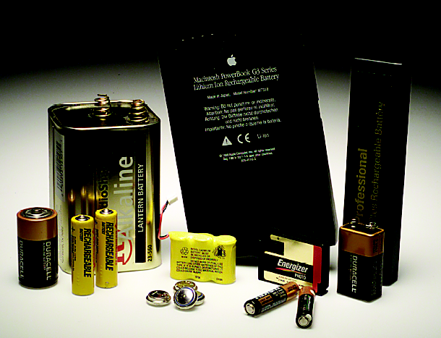
ELECTROCHEMISTRY
Chapter 18
Notes:
To play the movies and simulations included, view the presentation in Slide Show Mode.

Slide 2
Electron Transfer Reactions
Electron transfer reactions are oxidation-reduction or redox reactions.
Results in the generation of an electric current (electricity) or be caused by imposing an electric current.
Therefore, this field of chemistry is often called ELECTROCHEMISTRY.

Slide 3
Terminology for Redox Reactions
OXIDATION—loss of electron(s) by a species; increase in oxidation number; increase in oxygen.
REDUCTION—gain of electron(s); decrease in oxidation number; decrease in oxygen; increase in hydrogen.
OXIDIZING AGENT—electron acceptor; species is reduced.
REDUCING AGENT—electron donor; species is oxidized.

Slide 4
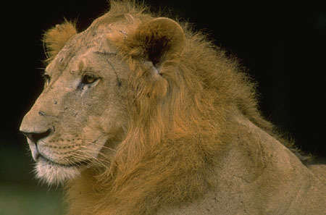
You can’t have one… without the other!
Reduction (gaining electrons) can’t happen without an oxidation to provide the electrons.
You can’t have 2 oxidations or 2 reductions in the same equation. Reduction has to occur at the cost of oxidation
LEO the lion says GER!
ose
lectrons
xidation
ain
lectrons
eduction
GER!

Slide 5
Another way to remember
OIL RIG
s
eduction
s
xidation
ose
ain

Slide 6
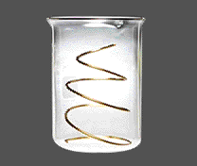
OXIDATION-REDUCTION REACTIONS
Direct Redox Reaction
Oxidizing and reducing agents in direct contact.
Cu(s) + 2 Ag⁺(aq) ---> Cu²⁺(aq) + 2 Ag(s)

Slide 7
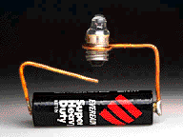
OXIDATION-REDUCTION REACTIONS
Indirect Redox Reaction
A battery functions by transferring electrons through an external wire from the reducing agent to the oxidizing agent.

Slide 8
Why Study Electrochemistry?
Batteries
Corrosion
Industrial production of chemicals such as Cl₂, NaOH, F₂ and Al
Biological redox reactions
The heme group

Slide 9
Electrochemical Cells
An apparatus that allows a redox reaction to occur by transferring electrons through an external connector.
Product favored reaction ---> voltaic or galvanic cell ----> electric current
Reactant favored reaction ---> electrolytic cell ---> electric current used to cause chemical change.
Batteries are voltaic cells

Slide 10
Basic Concepts
of Electrochemical Cells
Anode
Cathode

Slide 11
CHEMICAL CHANGE --->
ELECTRIC CURRENT
With time, Cu plates out onto Zn metal strip, and Zn strip “disappears.”
Zn is oxidized and is the reducing agent
Zn(s) ---> Zn²⁺(aq) + 2e-
Cu²⁺ is reduced and is the oxidizing agent
Cu²⁺(aq) + 2e- ---> Cu(s)

Slide 12
CHEMICAL CHANGE --->
ELECTRIC CURRENT
To obtain a useful current, we separate the oxidizing and reducing agents so that electron transfer occurs thru an external wire.
This is accomplished in a GALVANIC or VOLTAIC cell.
A group of such cells is called a battery.
http://www.mhhe.com/physsci/chemistry/essentialchemistry/flash/galvan5.swf

Slide 13
Zn --> Zn²⁺ + 2e-
Cu²⁺ + 2e- --> Cu
Oxidation
Anode
Negative
Reduction
Cathode
Positive
<--Anions
Cations-->
RED CAT
•Electrons travel thru external wire.
Salt bridge allows anions and cations to move between electrode compartments.

Slide 14
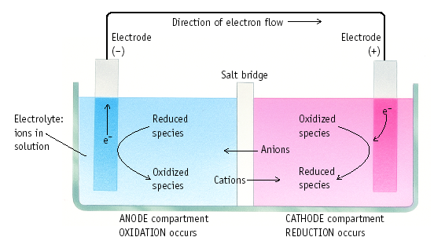
Terms Used for Voltaic Cells

Slide 15
CELL POTENTIAL, E
For Zn/Cu cell, potential is +1.10 V at 25 ˚C and when [Zn²⁺] and [Cu²⁺] = 1.0 M.
This is the STANDARD CELL POTENTIAL, Eº
—a quantitative measure of the tendency of reactants to proceed to products when all are in their standard states at 25 ˚C.

Slide 16
Calculating Cell Voltage
Balanced half-reactions can be added together to get overall, balanced equation.
Zn(s) ---> Zn²⁺(aq) + 2e-
Cu²⁺(aq) + 2e- ---> Cu(s)
--------------------------------------------
Cu²⁺(aq) + Zn(s) ---> Zn²⁺(aq) + Cu(s)
If we know Eº for each half-reaction, we could get Eº for net reaction.

Slide 17
TABLE OF STANDARD REDUCTION POTENTIALS
oxidizing
ability of ion
o
E
(V)
Cu
2+
+ 2e- Cu
+0.34
+
2 H
+ 2e- H
0.00
2
Zn
2+
+ 2e- Zn
-0.76
To determine an oxidation from a reduction table, just take the opposite sign of the reduction!
reducing ability
of element

Slide 18
Zn/Cu Electrochemical Cell
+
Anode, negative, source of electrons
Cathode, positive, sink for electrons
Zn(s) ---> Zn²⁺(aq) + 2e- Eº = +0.76 V
Cu²⁺(aq) + 2e- ---> Cu(s) Eº = +0.34 V
---------------------------------------------------------------
Cu²⁺(aq) + Zn(s) ---> Zn²⁺(aq) + Cu(s)
Eº = +1.10 V

Slide 19
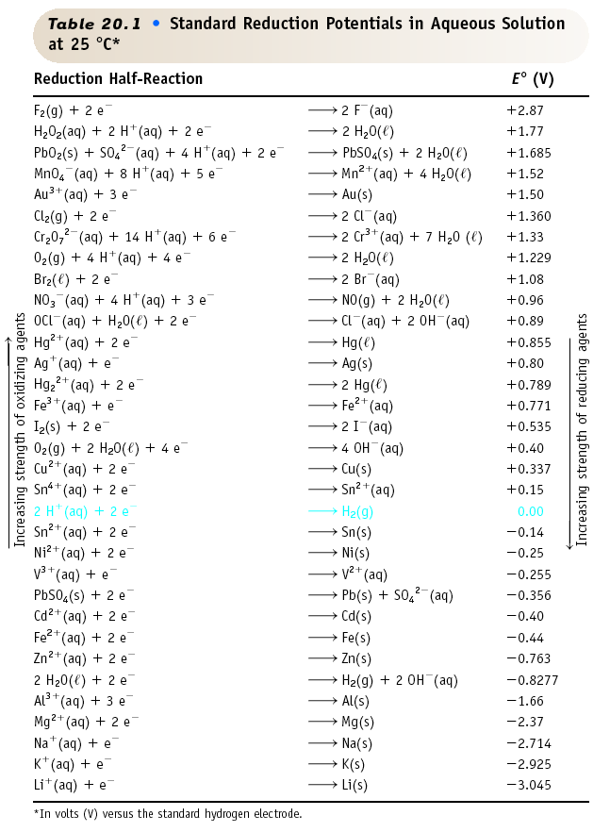

Slide 20
Eº for a Voltaic Cell
Cd --> Cd²⁺ + 2e-
or
Cd²⁺ + 2e- --> Cd
Fe --> Fe²⁺ + 2e-
or
Fe²⁺ + 2e- --> Fe
All ingredients are present. Which way does reaction proceed?

Slide 21
Eº for a Voltaic Cell
From the table, you see
• Fe is a better reducing agent than Cd
• Cd²⁺ is a better oxidizing agent than Fe²⁺
Overall reaction
Fe + Cd²⁺ ---> Cd + Fe²⁺
Eº = E˚_{cathode} + E˚_{anode}
= (-0.40 V) + - (-0.44 V)
= +0.04 V

Slide 22
More About
Calculating Cell Voltage
Assume I⁻ ion can reduce water.
2 H₂O + 2e- ---> H₂ + 2 OH⁻ Cathode
2 I⁻ ---> I₂ + 2e- Anode
-------------------------------------------------
2 I⁻ + 2 H₂O --> I₂ + 2 OH⁻ + H₂
Assuming reaction occurs as written,
E˚ = E˚_{cat}+ E˚_{an}= (-0.828 V) - (- +0.535 V) = -1.363 V
Minus E˚ means rxn. occurs in opposite direction
(the connection is backwards or you are recharging the battery)

Slide 23
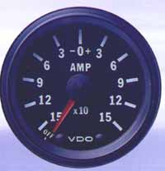
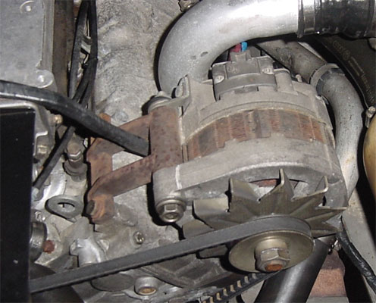
Charging a Battery
When you charge a battery, you are forcing the electrons backwards (from the + to the -). To do this, you will need a higher voltage backwards than forwards. This is why the ammeter in your car often goes slightly higher while your battery is charging, and then returns to normal.
In your car, the battery charger is called an alternator. If you have a dead battery, it could be the battery needs to be replaced OR the alternator is not charging the battery properly.

Slide 24
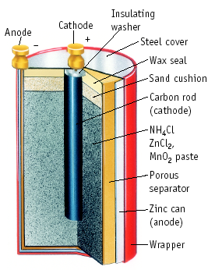
Dry Cell Battery
Anode (-)
Zn ---> Zn²⁺ + 2e-
Cathode (+)
2 NH₄⁺ + 2e- ---> 2 NH₃ + H₂

Slide 25
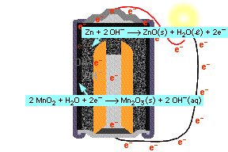
Alkaline Battery
Nearly same reactions as in common dry cell, but under basic conditions.
Anode (-): Zn + 2 OH⁻ ---> ZnO + H₂O + 2e-
Cathode (+): 2 MnO₂ + H₂O + 2e- --->
Mn₂O₃ + 2 OH⁻

Slide 26
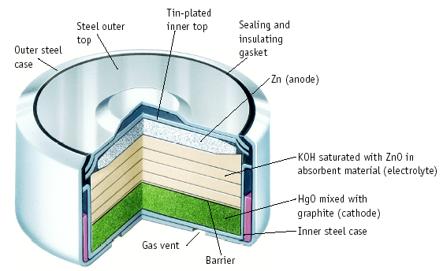
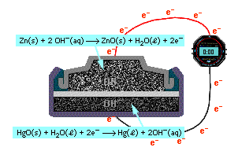
Mercury Battery
Anode:
Zn is reducing agent under basic conditions
Cathode:
HgO + H₂O + 2e- ---> Hg + 2 OH⁻

Slide 27
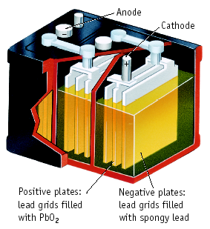
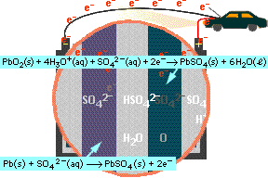
Lead Storage Battery
Anode (-) Eº = +0.36 V
Pb + HSO₄⁻ ---> PbSO₄ + H⁺ + 2e-
Cathode (+) Eº = +1.68 V
PbO₂ + HSO₄⁻ + 3 H⁺ + 2e- ---> PbSO₄ + 2 H₂O

Slide 28
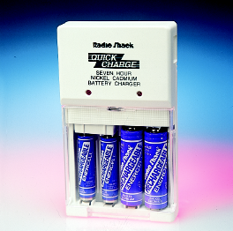
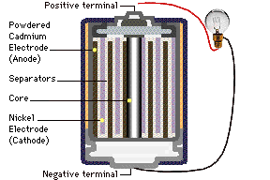
Ni-Cad Battery
Anode (-)
Cd + 2 OH⁻ ---> Cd(OH)₂ + 2e-
Cathode (+)
NiO(OH) + H₂O + e- ---> Ni(OH)₂ + OH⁻

Slide 29
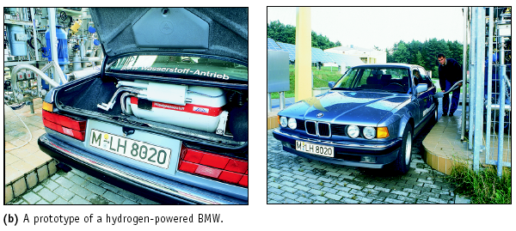
H₂ as a Fuel
Cars can use electricity generated by H₂/O₂ fuel cells.
H₂ carried in tanks or generated from hydrocarbons

Slide 30
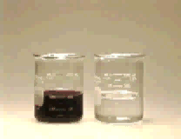
Balancing Equations for Redox Reactions
Some redox reactions have equations that must be balanced by special techniques.
MnO₄⁻ + 5 Fe²⁺ + 8 H⁺ ---> Mn²⁺ + 5 Fe³⁺ + 4 H₂O
Mn = +7
Fe = +2
Mn = +2
Fe = +3

Slide 31
Balancing Equations
Consider the reduction of Ag⁺ ions with copper metal.
Cu + Ag⁺ --give--> Cu²⁺ + Ag

Slide 32
Balancing Equations
Step 1: Divide the reaction into half-reactions, one for oxidation and the other for reduction.
Ox Cu ---> Cu²⁺
Red Ag⁺ ---> Ag
Step 2: Balance each element for mass. Already done in this case.
Step 3: Balance each half-reaction for charge by adding electrons.
Ox Cu ---> Cu²⁺ + 2e-
Red Ag⁺ + e- ---> Ag

Slide 33
Balancing Equations
Step 4: Multiply each half-reaction by a factor so that the reducing agent supplies as many electrons as the oxidizing agent requires.
Reducing agent Cu ---> Cu²⁺ + 2e-
Oxidizing agent 2 Ag⁺ + 2 e- ---> 2 Ag
Step 5: Add half-reactions to give the overall equation.
Cu + 2 Ag⁺ ---> Cu²⁺ + 2Ag
The equation is now balanced for both charge and mass.

Slide 34
Balancing Equations
Balance the following in acid solution—
VO₂⁺ + Zn ---> VO²⁺ + Zn²⁺
Step 1: Write the half-reactions
Ox Zn ---> Zn²⁺
Red VO₂⁺ ---> VO²⁺
Step 2: Balance each half-reaction for mass.
Ox Zn ---> Zn²⁺
Red
2 H⁺ +
VO₂⁺ ---> VO²⁺ + H₂O
Add H₂O on O-deficient side and add H⁺ on other side for H-balance.

Slide 35
Balancing Equations
Step 3: Balance half-reactions for charge.
Ox Zn ---> Zn²⁺ + 2e-
Red e- + 2 H⁺ + VO₂⁺ ---> VO²⁺ + H₂O
Step 4: Multiply by an appropriate factor.
Ox Zn ---> Zn²⁺ + 2e-
Red 2e- + 4 H⁺ + 2 VO₂⁺ ---> 2 VO²⁺ + 2 H₂O
Step 5: Add balanced half-reactions
Zn + 4 H⁺ + 2 VO₂⁺ ---> Zn²⁺ + 2 VO²⁺ + 2 H₂O

Slide 36
Tips on Balancing Equations
Never add O₂, O atoms, or O²⁻ to balance oxygen.
Never add H₂ or H atoms to balance hydrogen.
Be sure to write the correct charges on all the ions.
Check your work at the end to make sure mass and charge are balanced.
PRACTICE!

