Slide 1
The Chemistry of Acids and Bases
Chemistry I – Chapter 19
Chemistry I HD – Chapter 16
ICP – Chapter 23
Notes:
To play the movies and simulations included, view the presentation in Slide Show Mode.

Slide 2
Acid/Base definitions
Definition #1: Arrhenius (traditional)
  Acids – produce H⁺ ions (or hydronium ions H₃O⁺)
  Bases – produce OH⁻ ions
  (problem: some bases don’t have hydroxide ions!)

Slide 3
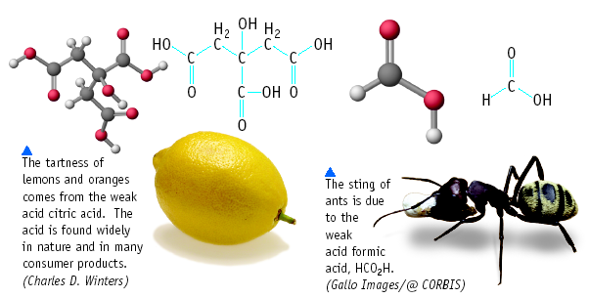
Acid and Bases

Slide 4
Some Properties of Acids
Produce H⁺ (as H₃O⁺) ions in water (the hydronium ion is a hydrogen ion attached to a water molecule)
Taste sour
Corrode metals
Electrolytes
React with bases to form a salt and water
pH is less than 7
Turns blue litmus paper to red “Blue to Red A-CID”

Slide 5
Some Properties of Bases
Produce OH⁻ ions in water
Taste bitter, chalky
Are electrolytes
Feel soapy, slippery
React with acids to form salts and water
pH greater than 7
Turns red litmus paper to blue “Basic Blue”

Slide 6
Some Common Bases
NaOH sodium hydroxide lye
KOH potassium hydroxide liquid soap
Ba(OH)₂ barium hydroxide stabilizer for plastics
Mg(OH)₂ magnesium hydroxide “MOM” Milk of magnesia
Al(OH)₃ aluminum hydroxide Maalox (antacid)

Slide 7
Acid Nomenclature Review
No Oxygen →
Contains Oxygen
An easy way to remember which goes with which…
“In the cafeteria, you ATE something ICky”

Slide 8
Acid Nomenclature Review
HBr _{(aq)}
H₂CO₃
H₂SO₃
⇒ hydrobromic acid
⇒ carbonic acid
⇒ sulfurous acid

Slide 9

Name ‘Em!
HI _{(aq)}
HCl _{(aq)}
H₂SO₃
HNO₃
HIO₄
Hydroiodic acid
Hydrochloric acid
Sulfurous acid
Nitric acid
Periodic acid

Slide 10
Acid/Base definitions
Definition #1: Arrhenius (traditional)
  Acids – produce H⁺ ions (or hydronium ions H₃O⁺)
  Bases – produce OH⁻ ions
  (problem: some bases don’t have hydroxide ions!)

Slide 11
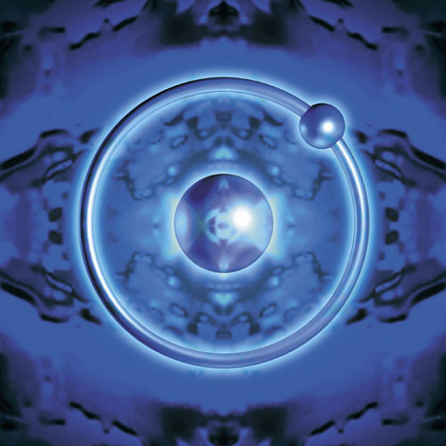
Acid/Base Definitions
Definition #2: Brønsted – Lowry
  Acids – proton donor
  Bases – proton acceptor
  A “proton” is really just a hydrogen atom that has lost its electron!

Slide 12
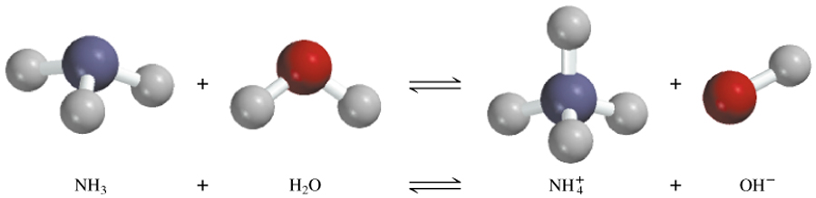
A Brønsted-Lowry acid is a proton donor
A Brønsted-Lowry base is a proton acceptor
conjugate acid
conjugate base
base
acid

Slide 13
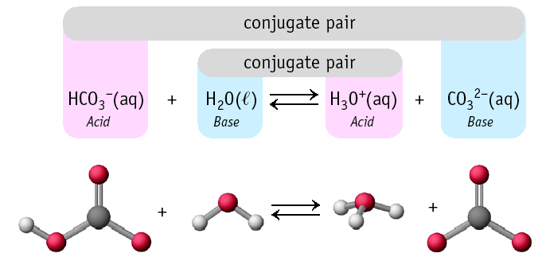
Conjugate Pairs

Slide 14
Learning Check!
HONORS ONLY!
Label the acid, base, conjugate acid, and conjugate base in each reaction:
HCl + OH⁻ → Cl⁻ + H₂O
Acid
Base
Conj.Base
Conj.Acid
H₂O + H₂SO₄ → HSO₄⁻ + H₃O⁺
Conj.Base
Conj.Acid
Base
Acid

Slide 15
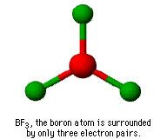
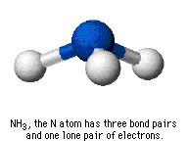
Acids & Base Definitions
Definition #3 – Lewis
Lewis acid - a substance that accepts an electron pair
Lewis base - a substance that donates an electron pair

Slide 16
Lewis Acids & Bases
Formation of hydronium ion is also an excellent example.
Electron pair of the new O-H bond originates on the Lewis base.

Slide 17
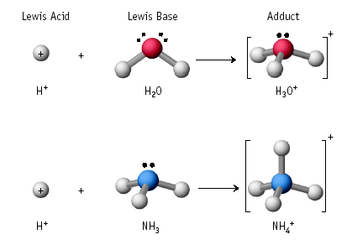
Lewis Acid/Base Reaction

Slide 18
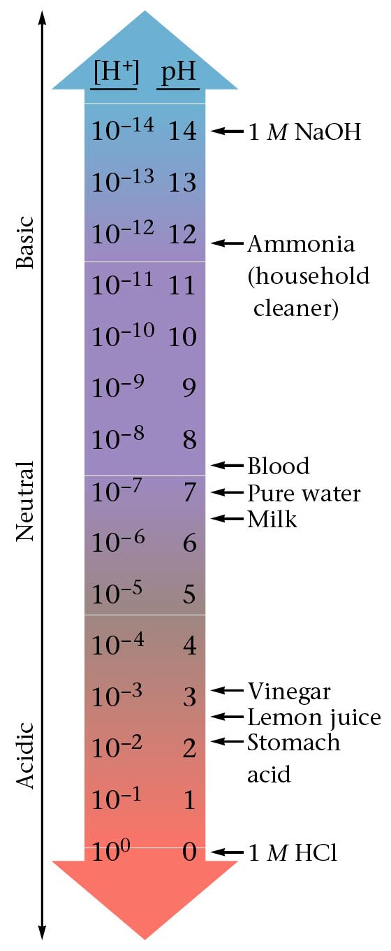
The pH scale is a way of expressing the strength of acids and bases. Instead of using very small numbers, we just use the NEGATIVE power of 10 on the Molarity of the H⁺ (or OH⁻) ion.
Under 7 = acid
7 = neutral
Over 7 = base

Slide 19
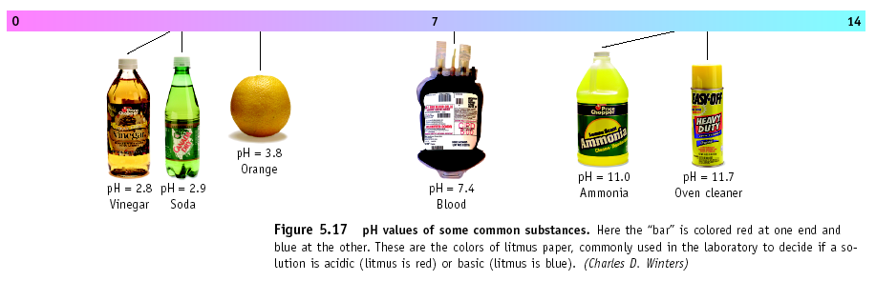
pH of Common Substances

Slide 20
Calculating the pH
pH = - log [H+]
(Remember that the [ ] mean Molarity)
Example: If [H⁺] = 1 X 10⁻¹⁰
pH = - log 1 X 10⁻¹⁰
pH = - (- 10)
pH = 10
Example: If [H⁺] = 1.8 X 10⁻⁵
pH = - log 1.8 X 10⁻⁵
pH = - (- 4.7)
pH = 4.7

Slide 21
Try These!
Find the pH of these:
1) A 0.15 M solution of Hydrochloric acid
2) A 3.00 X 10⁻⁶ M solution of Nitric acid
pH = - log [H⁺]
pH = - log 0.15
pH = - (- 0.82)
pH = 0.82
pH = - log 3.00 X 10⁻⁶
pH = - (- 5.52)
pH = 5.52

Slide 22
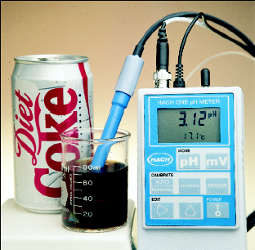
pH calculations – Solving for H+
If the pH of Coke is 3.12, [H⁺] = ???
Because pH = - log [H⁺] then
- pH = log [H⁺]
Take antilog (10^{x}) of both
sides and get
10^{-pH} = [H⁺]
[H⁺] = 10^{-3.12} = 7.59 x 10⁻⁴ M
*** to find antilog on your calculator, look for “Shift” or “2nd function” and then the log button

Slide 23
pH calculations – Solving for H+
A solution has a pH of 8.5. What is the Molarity of hydrogen ions in the solution?
pH = - log [H⁺]
8.5 = - log [H⁺]
-8.5 = log [H⁺]
Antilog -8.5 = antilog (log [H⁺])
10^{-8.5} = [H⁺]
3.2 X 10⁻⁹ = [H⁺]

Slide 24
pOH
Since acids and bases are opposites, pH and pOH are opposites!
pOH does not really exist, but it is useful for changing bases to pH.
pOH looks at the perspective of a base
pOH = - log [OH⁻]
Since pH and pOH are on opposite ends,
      pH + pOH = 14

Slide 25
[H₃O⁺], [OH⁻] and pH
What is the pH of the 0.0010 M NaOH solution?
[OH-] = 0.0010 (or 1.0 X 10⁻³ M)
pOH = - log 0.0010
pOH = 3.0
pH = 14.00 – 3.0 = 11.0
Equations to use:
pH = - log [H+]
pOH = - log [OH⁻]
pH + pOH = 14

Slide 26
The pH of rainwater collected in a certain region of the northeastern United States on a particular day was 4.82. What is the H⁺ ion concentration of the rainwater?
pH = -log [H⁺]
[H⁺] = 10^{-pH}
= 10^{-4.82}
= 1.5 x 10⁻⁵ M
The OH⁻ ion concentration of a blood sample is
2.5 x 10⁻⁷ M. What is the pH of the blood?
pOH = -log [OH⁻]
= -log (2.5 x 10⁻⁷)
= 6.6
pH = 14.00 – pOH = 14.00 – 6.6 = 7.4

Slide 27
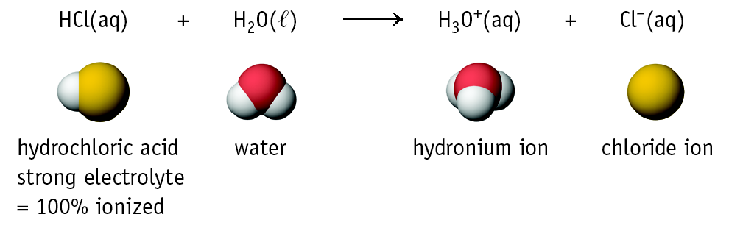
HONORS ONLY!
Strong and Weak Acids/Bases
The strength of an acid (or base) is determined by the amount of IONIZATION.
HClO₄, H₂SO₄, HNO₃, HCl, HBr, and HI are among the only known strong acids.

Slide 28
pH testing
There are several ways to test pH
  Blue litmus paper (red = acid)
  Red litmus paper (blue = basic)
  pH paper (multi-colored)
  pH meter (7 is neutral, <7 acid, >7 base)
  Universal indicator (multi-colored)
  Indicators like phenolphthalein
  Natural indicators like red cabbage, radishes

Slide 29
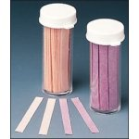
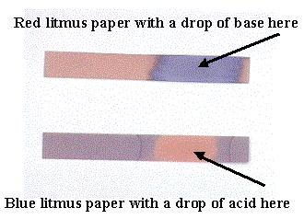
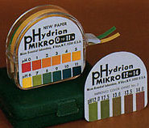
Paper testing
Paper tests like litmus paper and pH paper
  Put a stirring rod into the solution and stir.
  Take the stirring rod out, and place a drop of the solution from the end of the stirring rod onto a piece of the paper
  Read and record the color change. Note what the color indicates.
  You should only use a small portion of the paper. You can use one piece of paper for several tests.

Slide 30
pH meter
Tests the voltage of the electrolyte
Converts the voltage to pH
Very cheap, accurate
Must be calibrated with a buffer solution

Slide 31
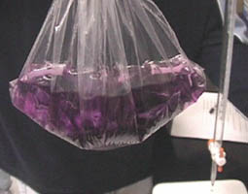
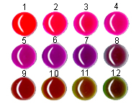

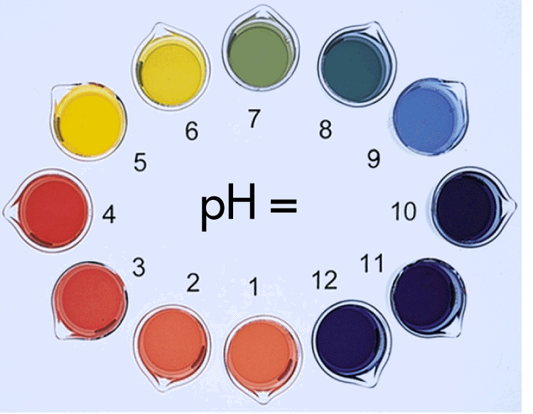
pH indicators
Indicators are dyes that can be added that will change color in the presence of an acid or base.
Some indicators only work in a specific range of pH
Once the drops are added, the sample is ruined
Some dyes are natural, like radish skin or red cabbage

Slide 32
PROBLEM: You have 50.0 mL of 3.0 M NaOH and you want 0.50 M NaOH. What do you do?
Add water to the 3.0 M solution to lower its concentration to 0.50 M
Dilute the solution!

Slide 33
PROBLEM: You have 50.0 mL of 3.0 M NaOH and you want 0.50 M NaOH. What do you do?
But how much water
do we add?

Slide 34
PROBLEM: You have 50.0 mL of 3.0 M NaOH and you want 0.50 M NaOH. What do you do?
How much water is added?
The important point is that --->
moles of NaOH in ORIGINAL solution =
moles of NaOH in FINAL solution

Slide 35
Preparing Solutions by Dilution
A shortcut
M₁ • V₁ = M₂ • V₂

Slide 36
PROBLEM: You have 50.0 mL of 3.0 M NaOH and you want 0.50 M NaOH. What do you do?
Amount of NaOH in original solution =
M • V = M • V
(3.0 mol/L)(0.050 L) = 0.5 M NaOH X V
Amount of NaOH in final solution must also = 0.15 mol NaOH
Volume of final solution =
(0.15 mol NaOH) / (0.50 M) = 0.30 L
or 300 mL

Slide 37
PROBLEM: You have 50.0 mL of 3.0 M NaOH and you want 0.50 M NaOH. What do you do?
Conclusion:
add 250 mL of water to 50.0 mL of 3.0 M NaOH to make 300 mL of 0.50 M NaOH.

Slide 38
You try this dilution problem
You have a stock bottle of hydrochloric acid, which is 12.1 M. You need 400. mL of 0.10 M HCl. How much of the acid and how much water will you need?
M₁ V₁ = M₂ V₂
M₁ = 12.1 M
V₁ = ??? L
M₂ = 0.10 M
V₂ = 400 mL → 0.400 L
V₁ = 0.0033 L (or 3.3 mL HCl)
Then add enough water so that the total volume is 400 mL.
It should be ABOUT 396.7 mL (400 – 3.3), but it will be off slightly due to the density of the HCl not being 1.00 g/mL

Slide 39
ACID-BASE REACTIONS
Titrations
H₂C₂O₄(aq) + 2 NaOH(aq) --->
acid base
Na₂C₂O₄(aq) + 2 H₂O(liq)
Carry out this reaction using a TITRATION.
Oxalic acid,
H₂C₂O₄

Slide 40
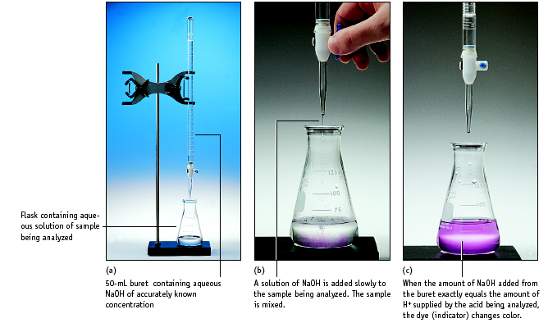
Setup for titrating an acid with a base

Slide 41
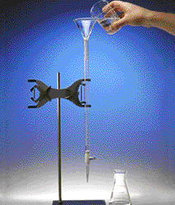
Titration
1. Add solution from the buret.
2. Reagent (base) reacts with compound (acid) in solution in the flask.
Indicator shows when exact stoichiometric reaction has occurred. (Acid = Base)
This is called NEUTRALIZATION.

Slide 42
LAB PROBLEM #1: Standardize a solution of NaOH — i.e., accurately determine its concentration.
35.62 mL of NaOH is neutralized with 25.2 mL of 0.0998 M HCl by titration to an equivalence point. What is the concentration of the NaOH?

Slide 43
35.62 mL of NaOH is neutralized with 25.2 mL of 0.0998 M HCl by titration to an equivalence point. What is the concentration of the NaOH?
M_{a} V_{a} = M_{b} V_{b}
M_{a} V_{a}
= M_{b}
V_{b}
(0.0998 M) (25.2 mL)
= 0.0706 M
(35.62 mL)

