Slide 1
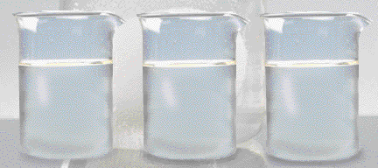
Solutions
Chemistry I – Chapters 15 & 16
Chemistry I HD – Chapter 13
ICP – Chapter 22
Why does a raw egg swell or shrink when placed in different solutions?
Notes:
To play the movies and simulations included, view the presentation in Slide Show Mode.

Slide 2
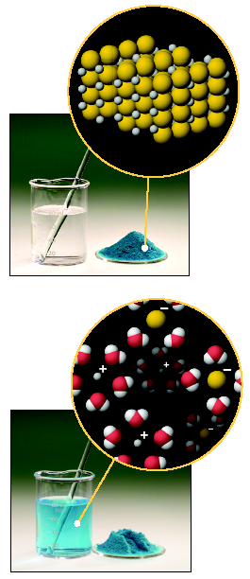
Some Definitions
A solution is a HOMOGENEOUS mixture of 2 or more substances in a single phase.
One constituent is usually regarded as the SOLVENT and the others as SOLUTES.

Slide 3
Parts of a Solution
SOLUTE – the part of a solution that is being dissolved (usually the lesser amount)
SOLVENT – the part of a solution that dissolves the solute (usually the greater amount)
Solute + Solvent = Solution
Solute | Solvent | Example
solid | solid | Alloys (brass, steel)
solid | liquid | Salt water
gas | solid | Air bubbles in ice cubes
liquid | liquid | “suicides” (mixed drinks)
gas | liquid | Soft drinks
gas | gas | Air

Slide 4
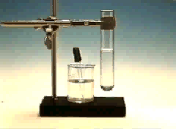
Definitions
Solutions can be classified as saturated or unsaturated.
A saturated solution contains the maximum quantity of solute that dissolves at that temperature.
An unsaturated solution contains less than the maximum amount of solute that can dissolve at a particular temperature

Slide 5
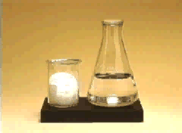
Definitions
SUPERSATURATED SOLUTIONS contain more solute than is possible to be dissolved
Supersaturated solutions are unstable. The supersaturation is only temporary, and usually accomplished in one of two ways:
Warm the solvent so that it will dissolve more, then cool the solution
Evaporate some of the solvent carefully so that the solute does not solidify and come out of solution.

Slide 6
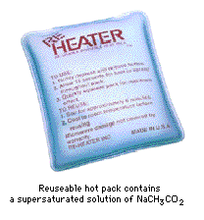
Supersaturated Sodium Acetate
One application of a supersaturated solution is the sodium acetate “heat pack.”

Slide 7
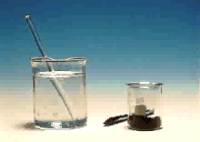
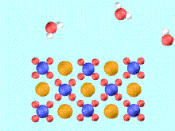
IONIC COMPOUNDS
Compounds in Aqueous Solution
Many reactions involve ionic compounds, especially reactions in water — aqueous solutions.
KMnO₄ in water
K⁺(aq) + MnO₄⁻(aq)
Notes:
To play the movies and simulations included, view the presentation in Slide Show Mode.

Slide 8
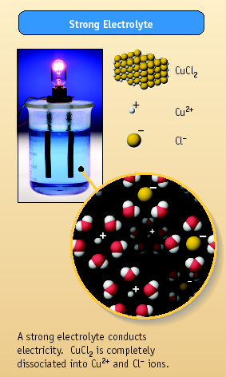
Aqueous Solutions
How do we know ions are present in aqueous solutions?
The solutions conduct electricity!
They are called ELECTROLYTES
HCl, MgCl₂, and NaCl are strong electrolytes. They dissociate completely (or nearly so) into ions.

Slide 9
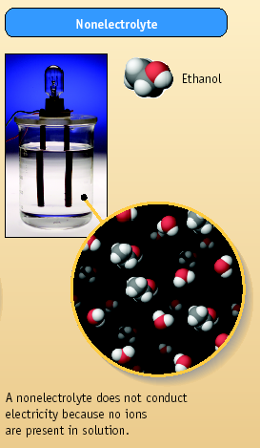
Aqueous Solutions
Some compounds dissolve in water but do not conduct electricity. They are called nonelectrolytes.
Examples include:
sugar
ethanol
ethylene glycol

Slide 10
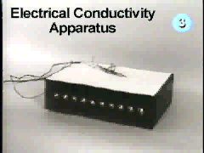
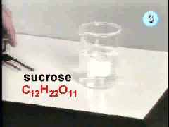
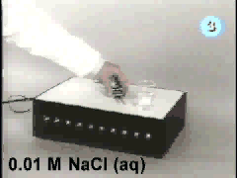

It’s Time to Play Everyone’s Favorite Game Show… Electrolyte or Nonelectrolyte!

Slide 11
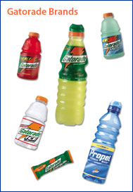
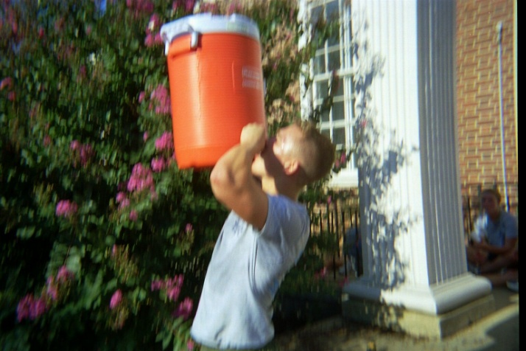
Electrolytes in the Body
Carry messages to and from the brain as electrical signals
Maintain cellular function with the correct concentrations electrolytes
Make your own
50-70 g sugar One liter of warm water Pinch of salt 200ml of sugar free fruit squash Mix, cool and drink

Slide 12
Concentration of Solute
The amount of solute in a solution is given by its concentration.
=
moles solute
Molarity
(
M
)
liters of solution

Slide 13
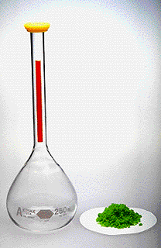
PROBLEM: Dissolve 5.00 g of NiCl₂ in enough water to make 250 mL of solution. Calculate the Molarity.
Step 1: Calculate moles of NiCl₂
Step 2: Calculate Molarity
[NiCl₂] = 0.154 M

Slide 14
USING MOLARITY
What mass of oxalic acid, H₂C₂O₄, is
required to make 250. mL of a 0.0500 M
solution?
moles = M•V
Step 1: Change mL to L.
250 mL * 1L/1000mL = 0.250 L
Step 2: Calculate.
Moles = (0.0500 mol/L) (0.250 L) = 0.0125 moles
Step 3: Convert moles to grams.
(0.0125 mol)(90.00 g/mol) = 1.13 g

Slide 15
Learning Check
How many grams of NaOH are required to prepare 400. mL of 3.0 M NaOH solution?
1) 12 g
2) 48 g
3) 300 g

Slide 16
Solution
M = moles of solute
Liters of solution
M * V = moles
3.0 mol/L * 0.400 L = 1.2 mol NaOH
1.2 mole NaOH x 40.0 g NaOH 1 mole NaOH
= 48 g NaOH

Slide 17
% by mass
grams solute
grams solution
% by mass =

Slide 18
Calculating Concentrations
Dissolve 62.1 g (1.00 mol) of ethylene glycol in 250. g of H₂O. Calculate the percent by mass of ethylene glycol.

Slide 19
Calculating Concentrations
Dissolve 62.1 g (1.00 mol) of ethylene glycol in 250. g of H₂O. Calculate the % of ethylene glycol (by mass).
Calculate mass %

Slide 20

Learning Check
A solution contains 15 g Na₂CO₃ and 235 g of H₂O. What is the mass % of the solution?
1) 15% Na₂CO₃
2) 6.4% Na₂CO₃
3) 6.0% Na₂CO₃

Slide 21
Solution
mass solute = 15 g Na₂CO₃
mass solution = 15 g + 235 g = 250 g
%(by mass) = 15 g Na₂CO₃ x 100 250 g solution
= 6.0% Na₂CO₃ solution

Slide 22
Using mass %
How many grams of NaCl are needed to prepare 250 g of a 10.0% (by mass) NaCl solution?
250 g NaCl soln x 10.0 g NaCl = 25 g NaCl 100 g NaCl soln
(10%)

Slide 23
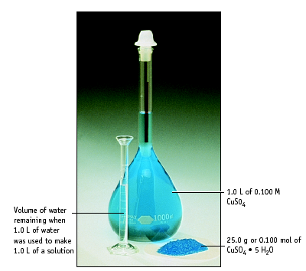
1.0 L of water was used to make 1.0 L of solution. Notice the water left over.

Slide 24
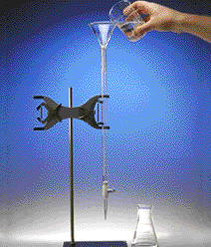
Titration
1. Add solution from the buret.
2. Reagent (base) reacts with compound (acid) in solution in the flask.
Indicator shows when exact stoichiometric reaction has occurred. (Acid = Base)
This is called NEUTRALIZATION.

Slide 25
Colligative Properties
On adding a solute to a solvent, the properties of the solvent are modified.
Vapor pressure decreases
Melting point decreases
Boiling point increases
Osmosis is possible (osmotic pressure)
These changes are called COLLIGATIVE PROPERTIES.
They depend only on the NUMBER of solute particles relative to solvent particles, not on the KIND of solute particles.

Slide 26
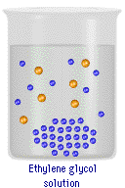
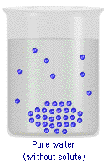
Change in Freezing Point
Ethylene glycol/water
solution
Pure water
The freezing point of a solution is LOWER than that of the pure solvent

Slide 27
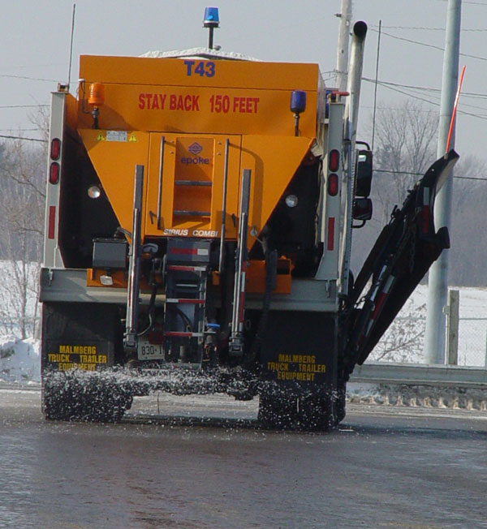
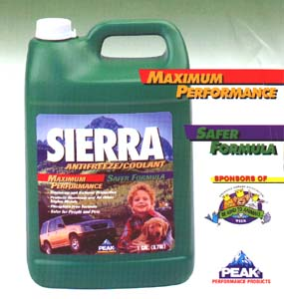
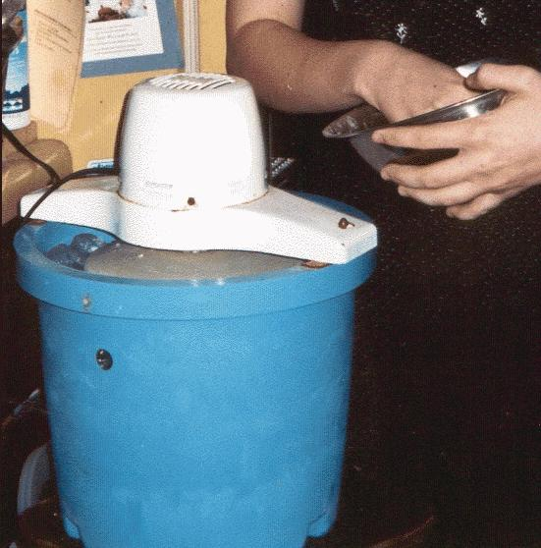
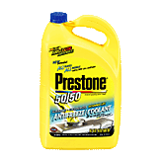
Change in Freezing Point
Common Applications of Freezing Point Depression
Ethylene glycol – deadly to small animals
Propylene glycol

Slide 28
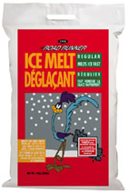
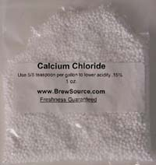

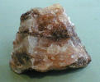
Change in Freezing Point
Common Applications of Freezing Point Depression
Which would you use for the streets of Bloomington to lower the freezing point of ice and why? Would the temperature make any difference in your decision?
sand, SiO₂
Rock salt, NaCl
Ice Melt, CaCl₂

Slide 29
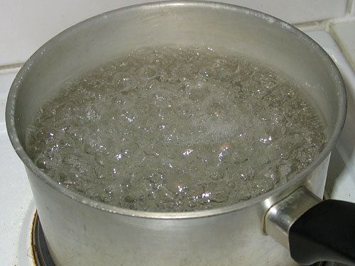
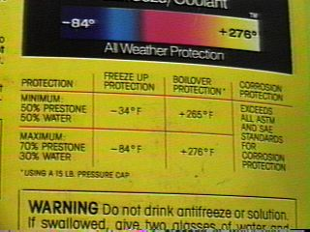
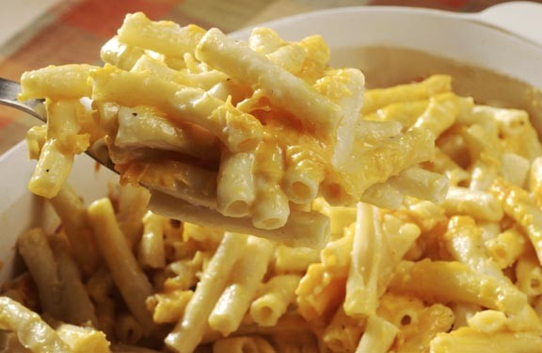
Change in Boiling Point
Common Applications of Boiling Point Elevation

