Slide 1
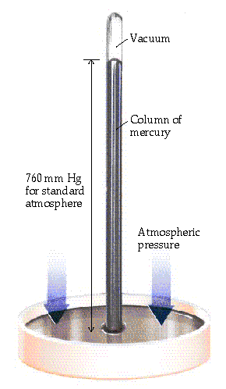
Pressure
Column height measures Pressure of atmosphere
1 standard atmosphere (atm) *
= 760 mm Hg (or torr) *
= 29.92 inches Hg *
= 14.7 pounds/in² (psi) *HD only
= 101.3 kPa (SI unit is PASCAL) * HD only
= about 34 feet of water!
* Memorize these!

Slide 2
Pressure Conversions
A. What is 2 atm expressed in torr?
760 torr
1 atm
B. The pressure of a tire is measured as 32.0 psi.
What is this pressure in kPa?
101.3 kPa
14.7 psi
2 atm x
= 1520 torr
32.0 psi x
= 221 kPa

Slide 3
Combined Gas Law
The good news is that you don’t have to remember all three gas laws! Since they are all related to each other, we can combine them into a single equation. BE SURE YOU KNOW THIS EQUATION!
P₁ V₁ P₂ V₂
=
T₁ T₂
No, it’s not related to R2D2

Slide 4
One More Practice Problem
A balloon has a volume of 785 mL on a fall day when the temperature is 21°C. In the winter, the gas cools to 0°C. What is the new volume of the balloon?

Slide 5
Solution
Complete the following setup:
Initial conditions Final conditions
V₁ = 785 mL V₂ = ?
T₁ = 21°C = 294 K T₂ = 0°C = 273 K
Since P is constant, P cancels out of the equation.
V₁ V₂ V₁ T₂
= V₁T₂ = T₁V₂ = V₂
T₁ T₂ T₁
= 728 mL
Check your answer: If temperature decreases,
V should decrease.

Slide 6
Try This One
A sample of neon gas used in a neon sign has a volume of 15 L at STP. What is the volume (L) of the neon gas at 2.0 atm and –25°C?
P₁ = 1.0 atm V₁ = 15 L T₁ = 273 K
P₂ = 2.0 atm V₂ = ?? T₂ = 248 K
V₂ = 15 L x 1.0 atm x 248 K = 6.8 L
2.0 atm 273 K

