Slide 1

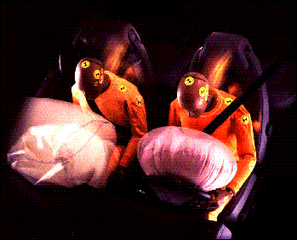
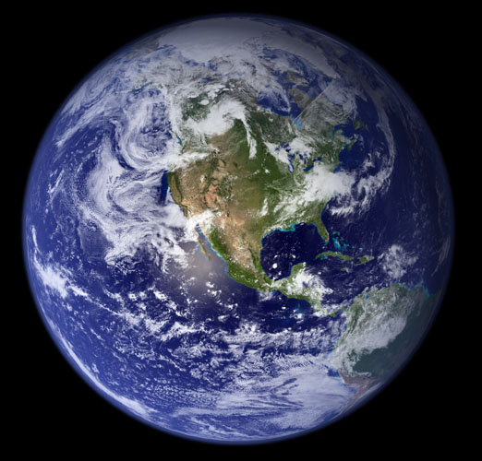
GASES
Chemistry I – Chapter 14
Chemistry I Honors – Chapter 13

Slide 2
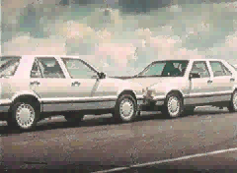
Importance of Gases
Airbags fill with N₂ gas in an accident.
Gas is generated by the decomposition of sodium azide, NaN₃.
2 NaN₃ ---> 2 Na + 3 N₂

Slide 3
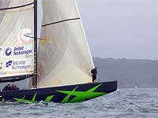
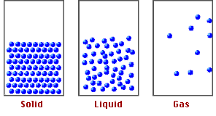
THREE STATES OF MATTER

Slide 4
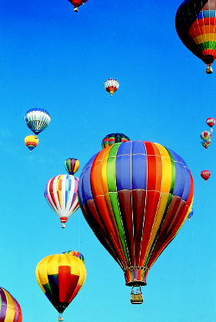
General Properties of Gases
There is a lot of “free” space in a gas.
Gases can be expanded infinitely.
Gases fill containers uniformly and completely.
Gases diffuse and mix rapidly.

Slide 5
Properties of Gases
Gas properties can be modeled using math. Model depends on—
V = volume of the gas (L)
T = temperature (K)
  ALL temperatures in the entire chapter MUST be in Kelvin!!! No Exceptions!
n = amount (moles)
P = pressure
(atmospheres)

Slide 6
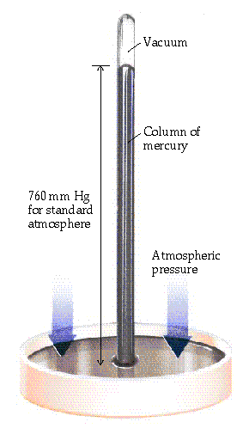
Pressure
Pressure of air is measured with a BAROMETER (developed by Torricelli in 1643)
Hg rises in tube until force of Hg (down) balances the force of atmosphere (pushing up). (Just like a straw in a soft drink)
P of Hg pushing down related to
Hg density
column height

Slide 7
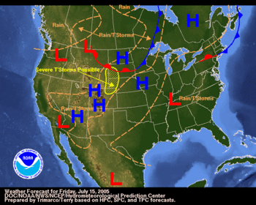

Slide 8
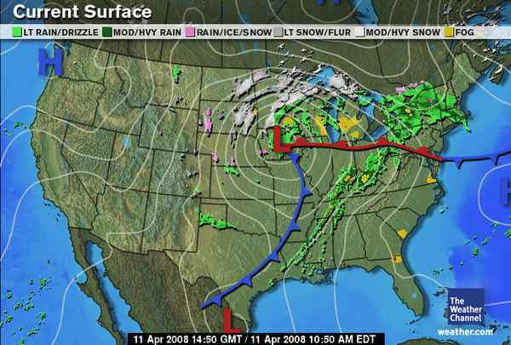
Can You Forecast???
The Answer

Slide 9
Pressure
Column height measures Pressure of atmosphere
1 standard atmosphere (atm) *
= 760 mm Hg (or torr) *
= 29.92 inches Hg *
= 14.7 pounds/in² (psi)
*HD only
= 101.3 kPa (SI unit is PASCAL) * HD only
= about 34 feet of water!
* Memorize these!

Slide 10
Pressure Conversions
A. What is 475 mm Hg expressed in atm?
1 atm
760 mm Hg
B. The pressure of a tire is measured as 29.4 psi.
What is this pressure in mm Hg?
760 mm Hg
14.7 psi
475 mm Hg x
= 0.625 atm
29.4 psi x
= 1.52 x 10³ mm Hg

Slide 11
Pressure Conversions
A. What is 2 atm expressed in torr?
760 torr
1 atm
B. The pressure of a tire is measured as 32.0 psi.
What is this pressure in kPa?
101.3 kPa
14.7 psi
2 atm x
= 1520 torr
32.0 psi x
= 221 kPa

Slide 12
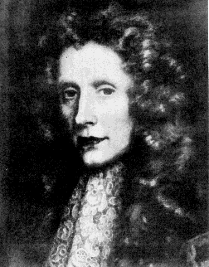
Boyle’s Law
P α 1/V
This means Pressure and Volume are INVERSELY PROPORTIONAL if moles and temperature are constant (do not change). For example, P goes up as V goes down.
P₁V₁ = P₂ V₂
Robert Boyle (1627-1691). Son of Earl of Cork, Ireland.

Slide 13
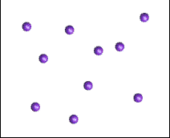
Boyle’s Law and Kinetic Molecular Theory
P proportional to 1/V

Slide 14
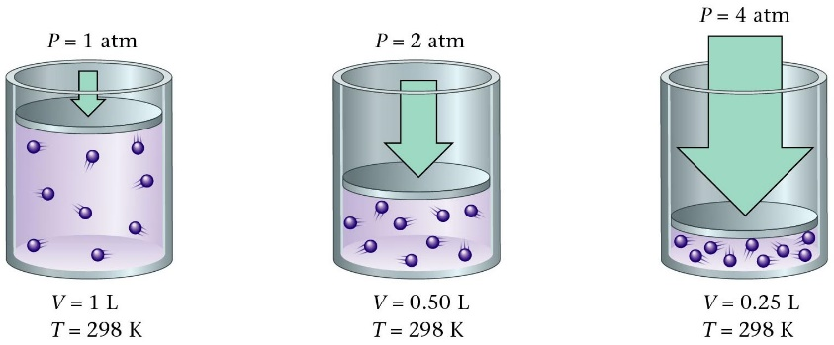
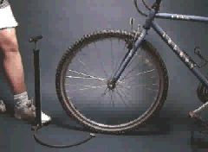
Boyle’s Law
A bicycle pump is a good example of Boyle’s law.
As the volume of the air trapped in the pump is reduced, its pressure goes up, and air is forced into the tire.

Slide 15
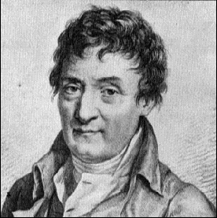
Charles’s Law
If n and P are constant,
then V α T
V and T are directly proportional.
V₁ V₂
₌
T₁ T₂
If one temperature goes up, the volume goes up!
Jacques Charles (1746-1823). Isolated boron and studied gases. Balloonist.

Slide 16
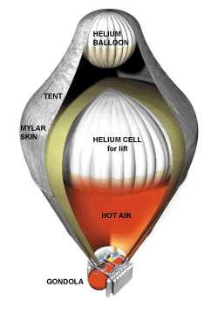
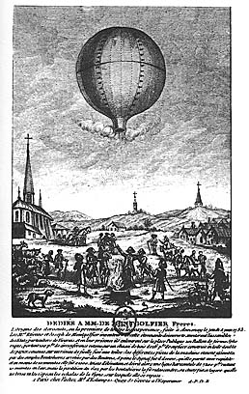
Charles’s original balloon
Modern long-distance balloon

Slide 17
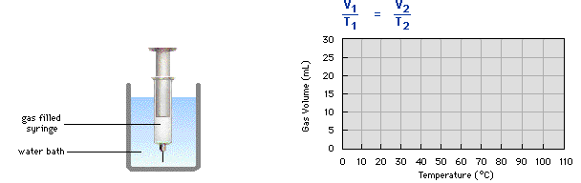
Charles’s Law

Slide 18
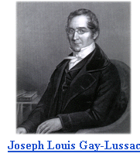
Gay-Lussac’s Law
If n and V are constant,
then P α T
P and T are directly proportional.
P₁ P₂
₌
T₁ T₂
If one temperature goes up, the pressure goes up!
Joseph Louis Gay-Lussac (1778-1850)

Slide 19
Gas Pressure, Temperature, and Kinetic Molecular Theory
P proportional to T

Slide 20

Combined Gas Law
The good news is that you don’t have to remember all three gas laws! Since they are all related to each other, we can combine them into a single equation. BE SURE YOU KNOW THIS EQUATION!
P₁ V₁ P₂ V₂
=
T₁ T₂
No, it’s not related to R2D2

Slide 21
Combined Gas Law
If you should only need one of the other gas laws, you can cover up the item that is constant and you will get that gas law!
=
P₁
V₁
P₂
V₂
Boyle’s Law
Charles’ Law
Gay-Lussac’s Law
T₁
T₂

Slide 22
Combined Gas Law Problem
A sample of helium gas has a volume of 0.180 L, a pressure of 0.800 atm and a temperature of 29°C. What is the new temperature(°C) of the gas at a volume of 90.0 mL and a pressure of 3.20 atm?
Set up Data Table
P₁ = 0.800 atm V₁ = 180 mL T₁ = 302 K
P₂ = 3.20 atm V₂= 90 mL T₂ = ??

Slide 23
Calculation
P₁ = 0.800 atm V₁ = 180 mL T₁ = 302 K
P₂ = 3.20 atm V₂= 90 mL T₂ = ??
P₁ V₁ P₂ V₂
= P₁ V₁ T₂ = P₂ V₂ T₁
T₁ T₂
T₂ = P₂ V₂ T₁
P₁ V₁
T₂ = 3.20 atm x 90.0 mL x 302 K
0.800 atm x 180.0 mL
T₂ = 604 K - 273 = 331 °C
= 604 K

Slide 24
Learning Check
A gas has a volume of 675 mL at 35°C and 0.850 atm pressure. What is the temperature in °C when the gas has a volume of 0.315 L and a pressure of 802 mm Hg?

Slide 25
Solution
T₁ = 308 K T₂ = ?
V₁ = 675 mL V₂ = 0.315 L = 315 mL
P₁ = 0.850 atm P₂ = 802 mm Hg
= 646 mm Hg
T₂ = 308 K x 802 mm Hg x 315 mL
646 mm Hg 675 mL
= 178 K - 273 = - 95°C

Slide 26
One More Practice Problem
A balloon has a volume of 785 mL on a fall day when the temperature is 21°C. In the winter, the gas cools to 0°C. What is the new volume of the balloon?

Slide 27
Solution
Complete the following setup:
Initial conditions Final conditions
V₁ = 785 mL V₂ = ?
T₁ = 21°C = 294 K T₂ = 0°C = 273 K
Since P is constant, P cancels out of the equation.
V₁ V₂ V₁ T₂
= V₁T₂ = T₁V₂ = V₂
T₁ T₂ T₁
= 728 mL
Check your answer: If temperature decreases,
V should decrease.

Slide 28


And now, we pause for this commercial message from STP
OK, so it’s really not THIS kind of STP…
STP in chemistry stands for Standard Temperature and Pressure
Standard Pressure = 1 atm (or an equivalent)
Standard Temperature = 0 deg C (273 K)
STP allows us to compare amounts of gases between different pressures and temperatures

Slide 29
Try This One
A sample of neon gas used in a neon sign has a volume of 15 L at STP. What is the volume (L) of the neon gas at 2.0 atm and –25°C?
P₁ = 1.0 atm V₁ = 15 L T₁ = 273 K
P₂ = 2.0 atm V₂ = ?? T₂ = 248 K
V₂ = 15 L x 1.0 atm x 248 K = 6.8 L
2.0 atm 273 K

Slide 30
Avogadro’s Hypothesis
Equal volumes of gases at the same T and P have the same number of molecules.
V = n (RT/P) = kn
V and n are directly related.
twice as many molecules

Slide 31
Avogadro’s Hypothesis and Kinetic Molecular Theory
The gases in this experiment are all measured at the same T and V.
P proportional to n

Slide 32
IDEAL GAS LAW
P V = n R T
Brings together gas properties.
Can be derived from experiment and theory.
BE SURE YOU KNOW THIS EQUATION!

Slide 33
Using PV = nRT
P = Pressure
V = Volume
T = Temperature
N = number of moles
R is a constant, called the Ideal Gas Constant
Instead of learning a different value for R for all the possible unit combinations, we can just memorize one value and convert the units to match R.
R = 0.0821
L • atm
Mol • K

Slide 34
Using PV = nRT
How much N₂ is required to fill a small room with a volume of 960 cubic feet (27,000 L) to 745 mm Hg at 25 ºC?
Solution
1. Get all data into proper units
V = 27,000 L
T = 25 ºC + 273 = 298 K
P = 745 mm Hg (1 atm/760 mm Hg)
= 0.98 atm
And we always know R, 0.0821 L atm / mol K

Slide 35
Using PV = nRT
How much N₂ is req’d to fill a small room with a volume of 960 cubic feet (27,000 L) to P = 745 mm Hg at 25 ºC?
Solution
2. Now plug in those values and solve for the unknown.
PV = nRT
RT RT
n = 1.1 x 10³ mol (or about 30 kg of gas)

Slide 36
Learning Check
Dinitrogen monoxide (N₂O), laughing gas, is used by dentists as an anesthetic. If 2.86 mol of gas occupies a 20.0 L tank at 23°C, what is the pressure (mm Hg) in the tank in the dentist office?

Slide 37
Solution
Set up data for 3 of the 4 gas variables
Adjust to match the units of R
V = 20.0 L
T = 23°C + 273 = 296 K
n = 2.86 mol
P = ?
PV = nRT
Rearrange ideal gas law for unknown P
P = nRT
V
Substitute values of n, R, T and V and solve for P

Slide 38
P = (2.86 mol)(0.0821 L atm/mol K)(296 K)
(20.0 L)
= 3.48 atm
3.48 atm 760 mm Hg
1 atm
= 2.64 x 10³ mm Hg

Slide 39
Learning Check
A 5.0 L cylinder contains oxygen gas at 20.0°C and 735 mm Hg. How many grams of oxygen are in the cylinder?

Slide 40
Solution
Solve ideal gas equation for n (moles)
n = PV
RT
= (0.967 atm) (5.0 L)
(0.0821 L atm/mol K)(293 K)
= 0. 20 mol O₂ x 32.0 g O₂ = 6.4 g O₂
1 mol O₂

Slide 41
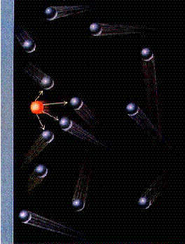
Deviations from
Ideal Gas Law
Real molecules have volume.
The ideal gas consumes the entire amount of available volume. It does not account for the volume of the molecules themselves.
There are intermolecular forces.
An ideal gas assumes there are no attractions between molecules. Attractions slow down the molecules and reduce the amount of collisions.
  Otherwise a gas could not condense to become a liquid.

Slide 42
Gases in the Air
The % of gases in air Partial pressure (STP)
78.08% N₂ 593.4 mm Hg
20.95% O₂ 159.2 mm Hg
0.94% Ar 7.1 mm Hg
0.03% CO₂ 0.2 mm Hg
P_{AIR} = P_{N} + P_{O} + P_{Ar} + P_{CO} = 760 mm Hg
2 2 2
Total Pressure 760 mm Hg

Slide 43
Dalton’s Law of Partial Pressures
2 H₂O₂ (l) ---> 2 H₂O (g) + O₂ (g)
        0.32 atm 0.16 atm
What is the total pressure in the flask?
P_{total} in gas mixture = P_{A} + P_{B} + ...
Therefore,
P_{total} = P_{H2O} + P_{O2} = 0.48 atm
Dalton’s Law: total P is sum of PARTIAL pressures.

Slide 44
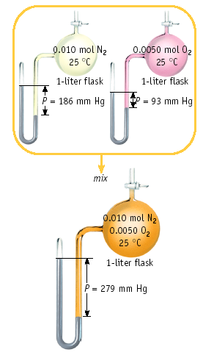
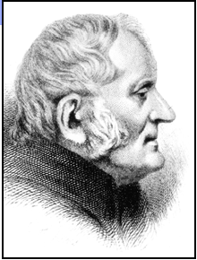
Dalton’s Law
John Dalton
1766-1844

Slide 45
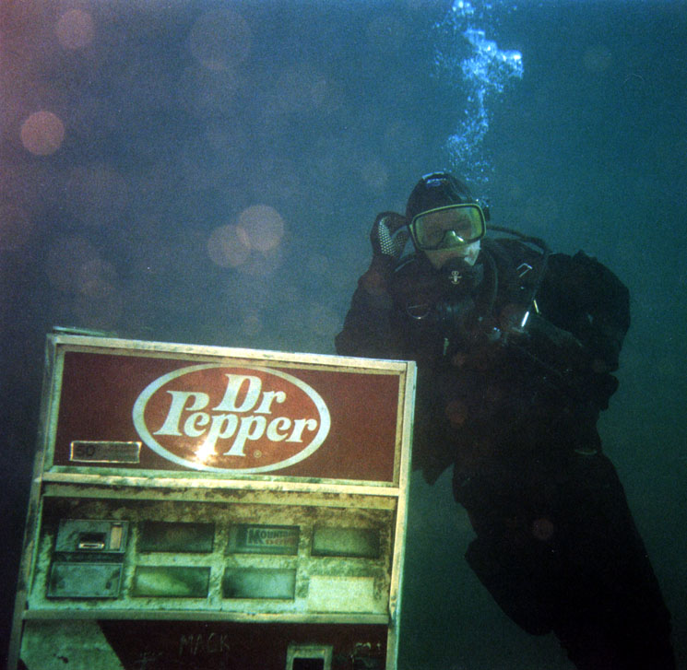
Health Note
When a scuba diver is several hundred feet under water, the high pressures cause N₂ from the tank air to dissolve in the blood. If the diver rises too fast, the dissolved N₂ will form bubbles in the blood, a dangerous and painful condition called "the bends". Helium, which is inert, less dense, and does not dissolve in the blood, is mixed with O₂ in scuba tanks used for deep descents.

Slide 46
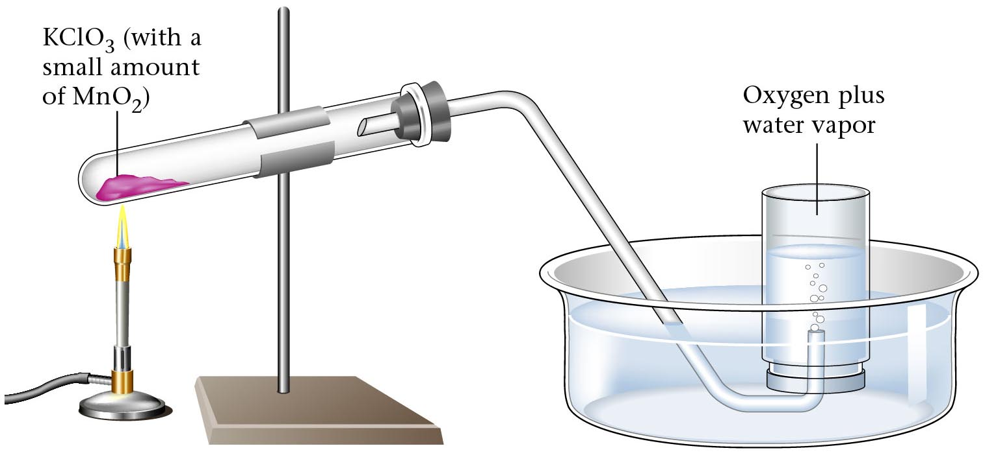
Collecting a gas “over water”
Gases, since they mix with other gases readily, must be collected in an environment where mixing can not occur. The easiest way to do this is under water because water displaces the air. So when a gas is collected “over water”, that means the container is filled with water and the gas is bubbled through the water into the container. Thus, the pressure inside the container is from the gas AND the water vapor. This is where Dalton’s Law of Partial Pressures becomes useful.

Slide 47
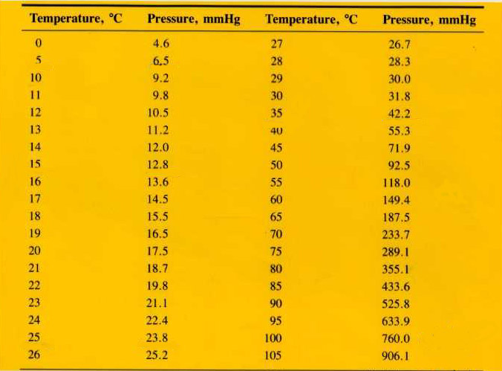
Table of Vapor Pressures for Water

Slide 48
Solve This!
A student collects some hydrogen gas over water at 20 degrees C and 768 torr. What is the pressure of the gas?
768 torr – 17.5 torr = 750.5 torr

Slide 49
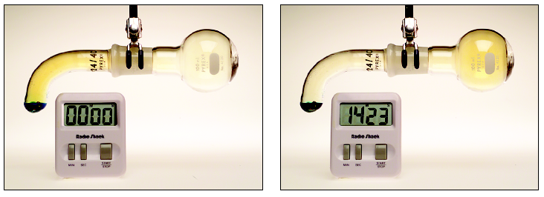
GAS DIFFUSION AND EFFUSION
HONORS only
diffusion is the gradual mixing of molecules of different gases.
effusion is the movement of molecules through a small hole into an empty container.

Slide 50
GAS DIFFUSION AND EFFUSION
HONORS only
Graham’s law governs effusion and diffusion of gas molecules.
Rate of effusion is inversely proportional to its molar mass.
Thomas Graham, 1805-1869. Professor in Glasgow and London.

Slide 51
GAS DIFFUSION AND EFFUSION
HONORS only
Molecules effuse thru holes in a rubber balloon, for example, at a rate (= moles/time) that is
proportional to T
inversely proportional to M.
Therefore, He effuses more rapidly than O₂ at same T.
He

Slide 52
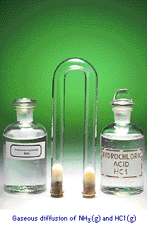
Gas Diffusion relation of mass to rate of diffusion
HONORS only
HCl and NH₃ diffuse from opposite ends of tube.
Gases meet to form NH₄Cl
HCl heavier than NH₃
Therefore, NH₄Cl forms closer to HCl end of tube.

Slide 53

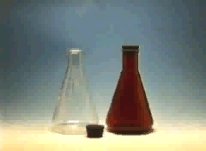
GAS DENSITY
Low
density
22.4 L of ANY gas AT STP = 1 mole
High
density

Slide 54
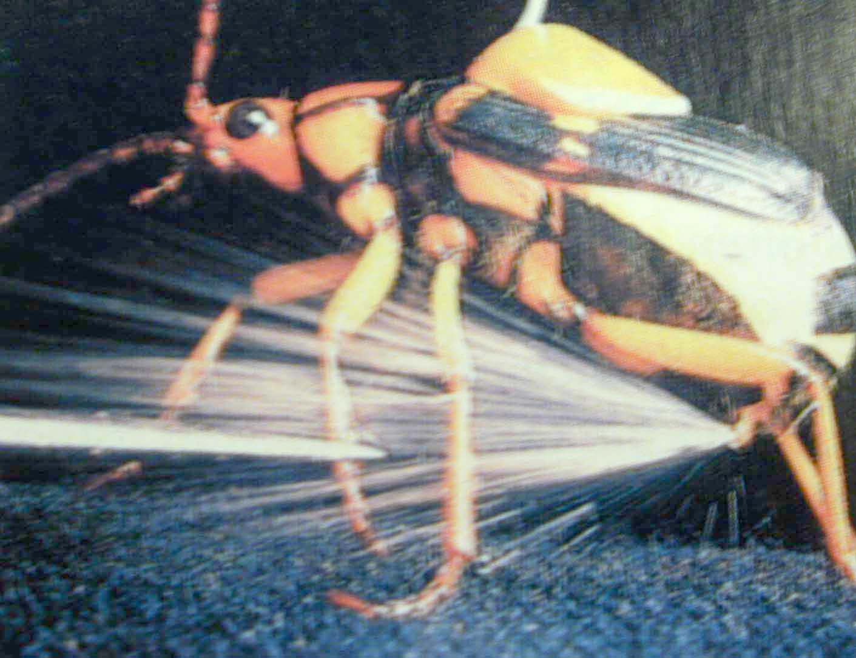
Gases and Stoichiometry
2 H₂O₂ (l) ---> 2 H₂O (g) + O₂ (g)
Decompose 1.1 g of H₂O₂ in a flask with a volume of 2.50 L. What is the volume of O₂ at STP?
Bombardier beetle uses decomposition of hydrogen peroxide to defend itself.

Slide 55
Gases and Stoichiometry
2 H₂O₂ (l) ---> 2 H₂O (g) + O₂ (g)
Decompose 1.1 g of H₂O₂ in a flask with a volume of 2.50 L. What is the volume of O₂ at STP?
Solution
1.1 g H₂O₂ 1 mol H₂O₂ 1 mol O₂ 22.4 L O₂
34 g H₂O₂ 2 mol H₂O₂ 1 mol O₂
= 0.36 L O₂ at STP

Slide 56
What if it’s NOT at STP?
1. Do the problem like it was at STP. (V₁)
2. Convert from STP (V₁, P₁, T₁) to the stated conditions (P₂, T₂)

Slide 57
Try this one!
How many L of O₂ are needed to react 28.0 g NH₃ at 24°C and 0.950 atm?
4 NH₃(g) + 5 O₂(g) 4 NO(g) + 6 H₂O(g)

Slide 58
How many L of O₂ are needed to react 28.0 g NH₃ at 24°C and 0.950 atm?
4 NH₃(g) + 5 O₂(g) 4 NO(g) + 6 H₂O(g)
Find mole of O₂
28.0 g NH₃ x 1 mol NH₃ x 5 mol O₂ x 22.4 L O₂
17.0 g NH₃ 4 mol NH₃ 1 mol O₂
At STP, V = 46.1 L ← V₁, P₁, and T₁
P₁ V₁ P₂ V₂
= P₁ V₁ T₂ = P₂ V₂ T₁
T₁ T₂
V₂ = P₁ V₁ T₂ (1 atm) (46.1 L) (297K)
P₂ T₁ (0.950 atm) (273 K)
= 46.1 L
AT STP
= 52.8 L

