Slide 1

CHEMICAL BONDING
Chemistry I – Chapter 8
Chemistry I Honors – Chapter 6
Cocaine
Notes:
To play the movies and simulations included, view the presentation in Slide Show Mode.

Slide 2
Chemical Bonding
Problems and questions —
How is a molecule or polyatomic ion held together?
Why are atoms distributed at strange angles?
Why are molecules not flat?
Can we predict the structure?
How is structure related to chemical and physical properties?

Slide 3

Review of Chemical Bonds
There are 3 forms of bonding:
Ionic—complete transfer of 1 or more electrons from one atom to another (one loses, the other gains) forming oppositely charged ions that attract one another
Covalent—some valence electrons shared between atoms
Metallic – holds atoms of a metal together
Most bonds are somewhere in between ionic and covalent.

Slide 4
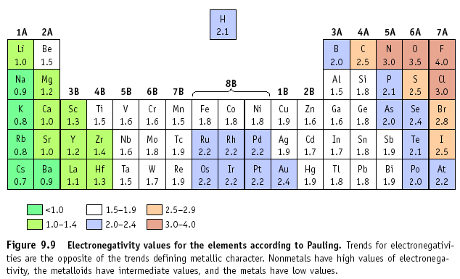
The type of bond can usually be calculated by finding the difference in electronegativity of the two atoms that are going together.

Slide 5
Electronegativity Difference
If the difference in electronegativities is between:
  2.0 to 4.0: Ionic
  0.3 to 2.0: Polar Covalent
  0.0 to 0.3: Non-Polar Covalent
  Example: NaCl
  Na = 0.9, Cl = 3.0
  Difference is 2.1, so
  this is an ionic bond!

Slide 6
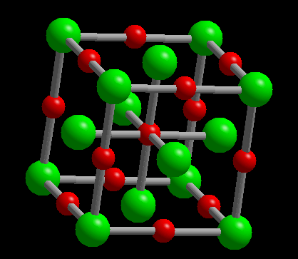

Ionic Bonds
All those ionic compounds were made from ionic bonds. Positive cations and the negative anions are attracted to one another (Paula Abdul Principle of Chemistry: Opposites Attract!)
Therefore, ionic compounds are usually between metals and nonmetals (opposite ends of the periodic table).

Slide 7
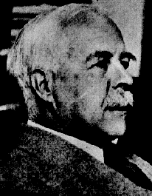
Electron Distribution in Molecules
Electron distribution is depicted with Lewis (electron dot) structures
This is how you decide how many atoms will bond covalently!
(In ionic bonds, it was decided with charges)
G. N. Lewis
1875 - 1946

Slide 8
Bond and Lone Pairs
Valence electrons are distributed as shared or BOND PAIRS and unshared or LONE PAIRS.
••
H
Cl
•
•
••
lone pair (LP)
shared or
bond pair
This is called a LEWIS structure.

Slide 9
Bond Formation
A bond can result from an overlap of atomic orbitals on neighboring atoms.
••
••
H
+
Cl
•
H
Cl
•
•
•
••
••
Overlap of H (1s) and Cl (2p)
Note that each atom has a single, unpaired electron.

Slide 10
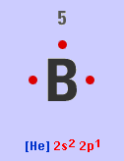
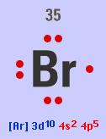
Review of Valence Electrons
Remember valence electrons are the electrons in the OUTERMOST energy level… that’s why we did all those electron configurations!
B is 1s² 2s² 2p¹; so the outer energy level is 2, and there are 2+1 = 3 electrons in level 2. These are the valence electrons!
Br is [Ar] 4s² 3d¹⁰ 4p⁵
How many valence electrons are present?

Slide 11
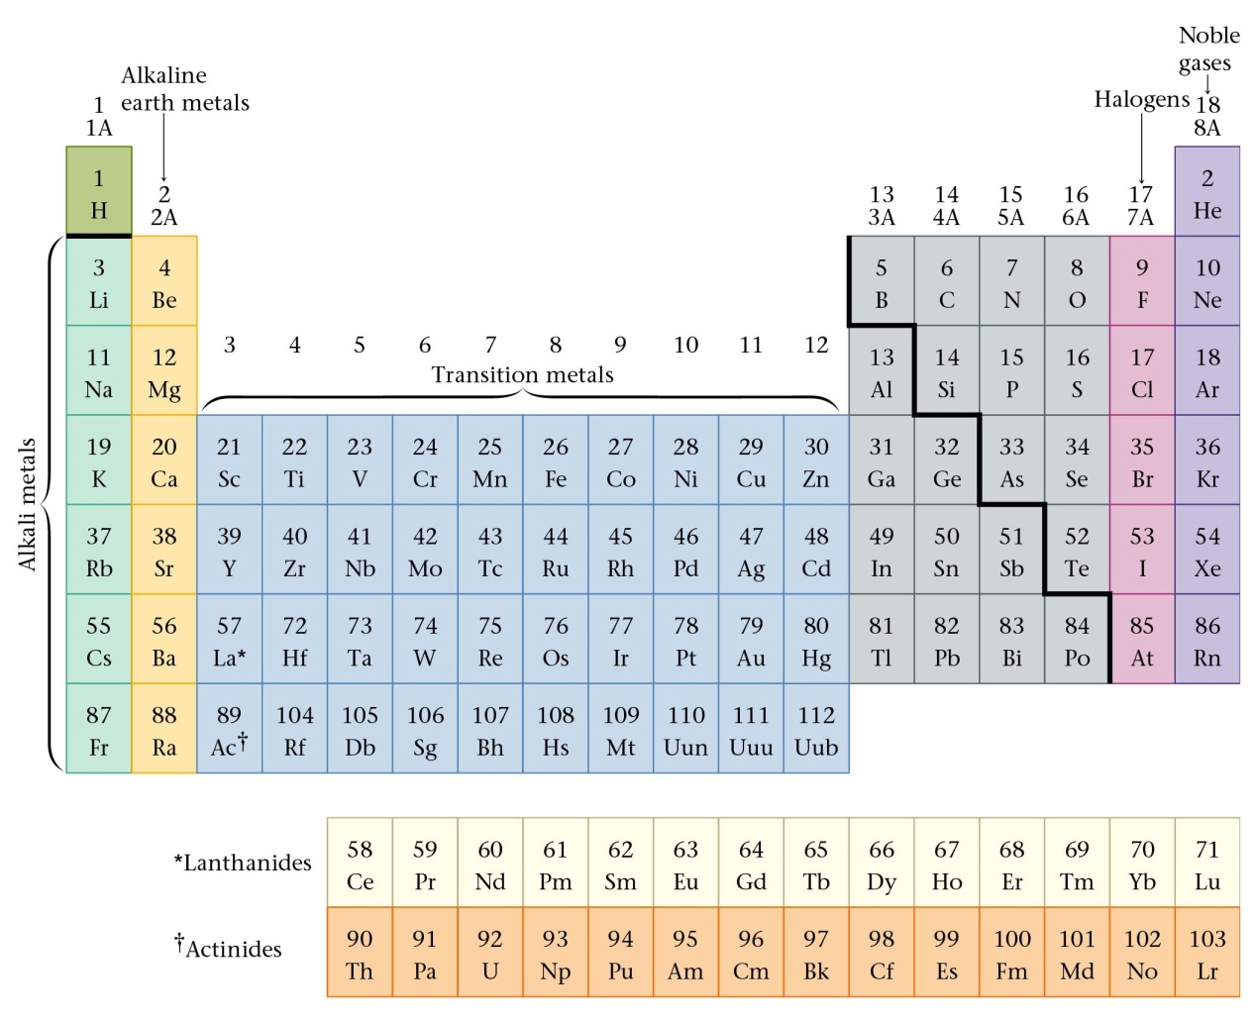
Review of Valence Electrons
Number of valence electrons of a main (A) group atom = Group number

Slide 12
Steps for Building a Dot Structure
Ammonia, NH₃
1. Decide on the central atom; never H. Why?
If there is a choice, the central atom is atom of lowest affinity for electrons. (Most of the time, this is the least electronegative atom…in AP Chemistry we use a thing called formal charge to determine the central atom. But that’s another story!)
Therefore, N is central on this one
2. Add up the number of valence electrons that can be used.
H = 1 and N = 5
Total = (3 x 1) + 5
= 8 electrons / 4 pairs

Slide 13
Building a Dot Structure
3. Form a single bond between the central atom and each surrounding atom (each bond takes 2 electrons!)
H
N
H
H
4. Remaining electrons form LONE PAIRS to complete the octet as needed (or duet in the case of H).
H
••
H
N
H
3 BOND PAIRS and 1 LONE PAIR.
Note that N has a share in 4 pairs (8 electrons), while H shares 1 pair.

Slide 14
Building a Dot Structure
Check to make sure there are 8 electrons around each atom except H. H should only have 2 electrons. This includes SHARED pairs.
H
••
H
N
H
6. Also, check the number of electrons in your drawing with the number of electrons from step 2. If you have more electrons in the drawing than in step 2, you must make double or triple bonds. If you have less electrons in the drawing than in step 2, you made a mistake!

Slide 15
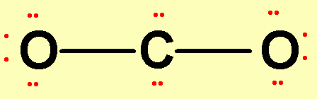
Carbon Dioxide, CO₂
1. Central atom =
2. Valence electrons =
3. Form bonds.
C 4 e-
O 6 e- X 2 O’s = 12 e-
Total: 16 valence electrons
This leaves 12 electrons (6 pair).
4. Place lone pairs on outer atoms.
5. Check to see that all atoms have 8 electrons around it except for H, which can have 2.

Slide 16
Carbon Dioxide, CO₂
C 4 e-
O 6 e- X 2 O’s = 12 e-
Total: 16 valence electrons
How many are in the drawing?
6. There are too many electrons in our drawing. We must form DOUBLE BONDS between C and O. Instead of sharing only 1 pair, a double bond shares 2 pairs. So one pair is taken away from each atom and replaced with another bond.

Slide 17
Double and even triple bonds are commonly observed for C, N, P, O, and S
H₂CO
SO₃
C₂F₄

Slide 18
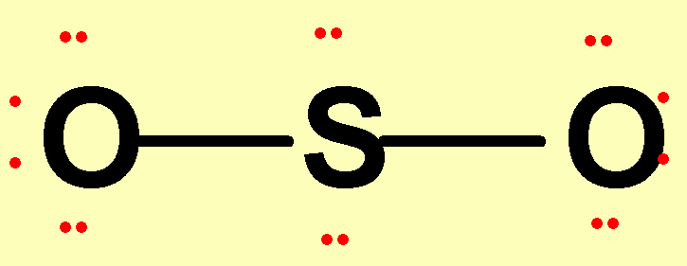
Now You Try One!
Draw Sulfur Dioxide, SO₂
1. Central atom = S
Valence electrons = 18
Put bonds between the atoms.
Put the lone dots in so that every atom has 8 electrons around it (except H).
Check for 8 dots
(or 2 for H)

Slide 19
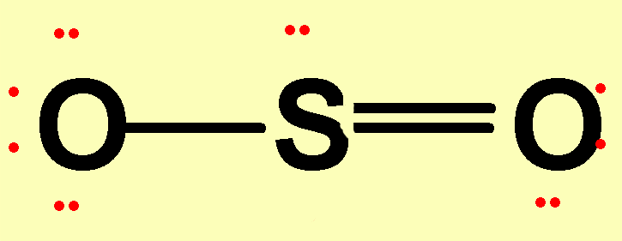
Try One!
Sulfur Dioxide, SO₂
6. Form a double bond so that S has an octet — but note that there are two ways of doing this. Either side is fine.
bring in
OR bring in
left pair
right pair
••
••
••
O
S
O
•
•
•
•
••
••
Final Answer:

Slide 20
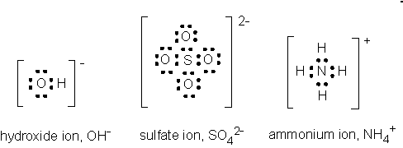
Keep an Eye on the Ions!
Anions – add the electrons gained from the charge to the valence (step 2)
Cations – subtract the electrons lost from the charge to the valence (step 2)
Put [ ] around the entire structure, and indicate the charge at the top right

Slide 21
Violations of the Octet Rule
(Honors only)
Usually occurs with B and elements of higher periods. Common exceptions are: Be, B, P, S, and Xe.
Be: 4
B: 6
P: 8 OR 10
S: 8, 10, OR 12
Xe: 8, 10, OR 12
SF₄
BF₃

Slide 22
MOLECULAR GEOMETRY

Slide 23
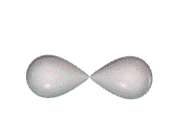
MOLECULAR GEOMETRY
Molecule adopts the shape that minimizes the electron pair repulsions.
VSEPR
Valence Shell Electron Pair Repulsion theory.
Most important factor in determining geometry is relative repulsion between electron pairs.

Slide 24
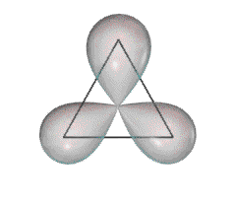
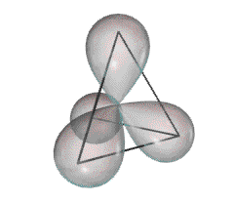
Some Common Geometries
Linear
Trigonal Planar
Tetrahedral

Slide 25
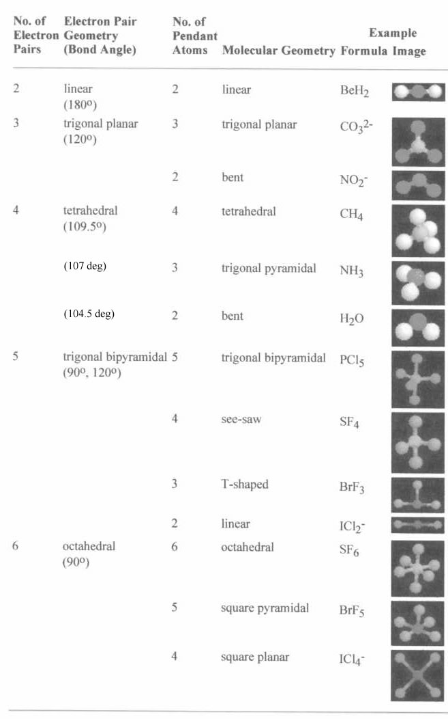
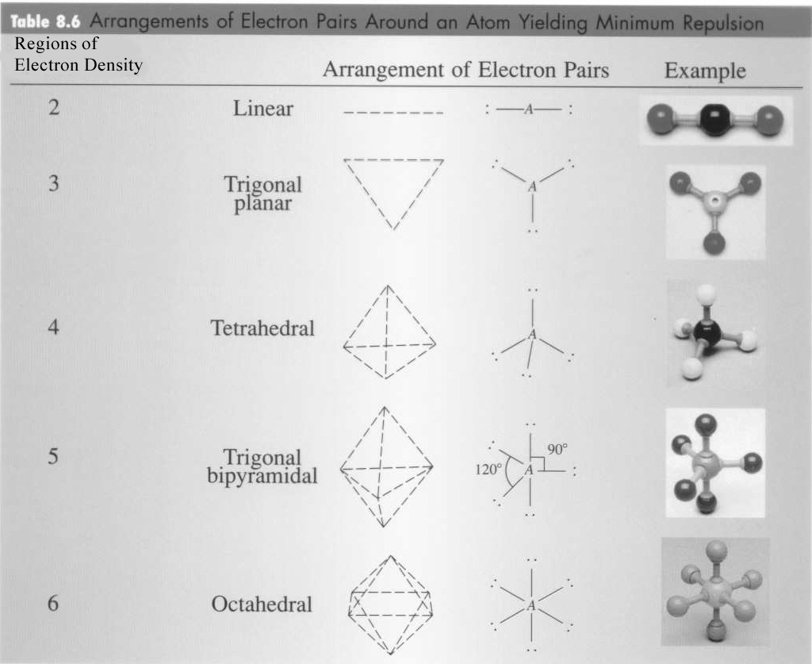
VSEPR charts

Slide 26
VSEPR charts
Use the Lewis structure to determine the geometry of the molecule
Electron arrangement establishes the bond angles
Molecule takes the shape of that portion of the electron arrangement
Charts look at the CENTRAL atom for all data!
Think REGIONS OF ELECTRON DENSITY rather than bonds (for instance, a double bond would only be 1 region)

Slide 27
VSEPR

Slide 28
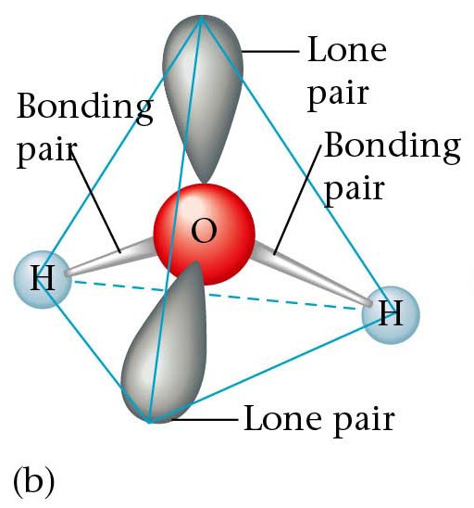
Structure Determination by VSEPR
Water, H₂O
The electron pair geometry is TETRAHEDRAL
2 bond pairs
2 lone pairs
The molecular geometry is BENT.

Slide 29
Structure Determination by VSEPR
Ammonia, NH₃
The electron pair geometry is tetrahedral.
The MOLECULAR GEOMETRY — the positions of the atoms — is TRIGONAL PYRAMID.

Slide 30
Bond Polarity
HCl is POLAR because it has a positive end and a negative end. (difference in electronegativity)
Cl has a greater share in bonding electrons than does H.
Cl has slight negative charge (-δ) and H has slight positive charge (+ δ)

Slide 31
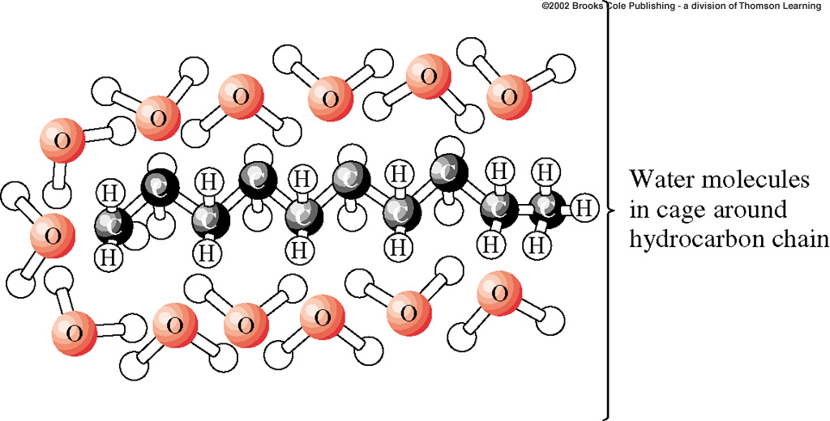
Bond Polarity
This is why oil and water will not mix! Oil is nonpolar, and water is polar.
The two will repel each other, and so you can not dissolve one in the other

Slide 32

Bond Polarity
“Like Dissolves Like”
  Polar dissolves Polar
  Nonpolar dissolves Nonpolar

Slide 33
Diatomic Elements
These elements do not exist as a single atom; they always appear as pairs
When atoms turn into ions, this NO LONGER HAPPENS!
  Hydrogen
  Nitrogen
  Oxygen
  Fluorine
  Chlorine
  Bromine
  Iodine
Remember: BrINClHOF

