Slide 1

Welcome to the World of
Chemistry
Honors: Ch. 1 and 5
Regular: Ch. 1 and 3
ICP: Ch. 1

Slide 2
Stating a Measurement
In every measurement there is a
Number followed by a
Unit from a measuring device
The number should also be as precise as the measurement!

Slide 3
UNITS OF MEASUREMENT
Use SI units — based on the metric system
Length
Mass
Volume
Time
Temperature
Meter, m
Kilogram, kg
Liter, L
Seconds, s
Celsius degrees, ˚C
kelvins, K

Slide 4
Metric Prefixes
Kilo- means 1000 of that unit
  1 kilometer (km) = 1000 meters (m)
Centi- means 1/100 of that unit
  1 meter (m) = 100 centimeters (cm)
  1 dollar = 100 cents
Milli- means 1/1000 of that unit
  1 Liter (L) = 1000 milliliters (mL)

Slide 5
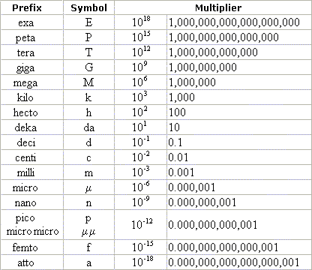
Metric Prefixes

Slide 6
Conversion Factors
Fractions in which the numerator and denominator are EQUAL quantities expressed in different units
Example: 1 in. = 2.54 cm
Factors: 1 in. and 2.54 cm
2.54 cm 1 in.

Slide 7
Learning Check
Write conversion factors that relate each of the following pairs of units:
1. Liters and mL
2. Hours and minutes
3. Meters and kilometers

Slide 8
Solution
1. Liters and mL 1 L = 1000 mL
1 L and 1000 mL
1000 mL 1 L
2. hours and minutes 1 hr = 60 min
1 hr and 60 min
60 min 1 hr
3. meters and kilometers 1 km = 1000 m
1 km and 1000 m
1000 m 1 km

Slide 9
How many minutes are in 2.5 hours?
Conversion factor
2.5 hr x 60 min = 150 min
1 hr
cancel
By using dimensional analysis / factor-label method, the UNITS ensure that you have the conversion right side up, and the UNITS are calculated as well as the numbers!

Slide 10
Steps to Problem Solving
Write down the given amount. Don’t forget the units!
Multiply by a fraction.
Use the fraction as a conversion factor. Determine if the top or the bottom should be the same unit as the given so that it will cancel.
Put a unit on the opposite side that will be the new unit. If you don’t know a conversion between those units directly, use one that you do know that is a step toward the one you want at the end.
Insert the numbers on the conversion so that the top and the bottom amounts are EQUAL, but in different units.
Multiply and divide the units (Cancel).
If the units are not the ones you want for your answer, make more conversions until you reach that point.
Multiply and divide the numbers. Don’t forget “Please Excuse My Dear Aunt Sally”! (order of operations)

Slide 11
Sample Problem
You have $7.25 in your pocket in quarters. How many quarters do you have?
7.25 dollars 4 quarters
1 dollar
X
= 29 quarters

Slide 12
You Try This One!
If Jacob stands on Spencer’s shoulders, they are two and a half yards high. How many feet is that?

Slide 13


Slide 14
Learning Check
A rattlesnake is 2.44 m long. How long is the snake in cm?
a) 2440 cm
b) 244 cm
c) 24.4 cm

Slide 15
Solution
A rattlesnake is 2.44 m long. How long is the snake in cm?
b) 244 cm
2.44 m x 100 cm = 244 cm
1 m

Slide 16
Wait a minute!
What is wrong with the following setup?
1.4 day x 1 day x 60 min x 60 sec
24 hr 1 hr 1 min

Slide 17
Learning Check
How many seconds are in 1.4 days?
Unit plan: days hr min seconds
1.4 days x 24 hr x ??
1 day

Slide 18
Solution
Unit plan: days hr min seconds
1.4 day x 24 hr x 60 min x 60 sec
1 day 1 hr 1 min
= 1.2 x 10⁵ sec

