Slide 1

Welcome to the World of
Chemistry
Honors: Ch. 1 and 2

Slide 2
The Language of Chemistry
CHEMICAL ELEMENTS -
  pure substances that cannot be decomposed by ordinary means to other substances.
Aluminum
Bromine
Sodium

Slide 3

The Language of Chemistry
The elements, their names, and symbols are given on the PERIODIC TABLE
How many elements are there?
  118 elements have been identified
  90 elements occur naturally on Earth
      Examples: gold, aluminum, lead, oxygen, carbon
    38 elements have been created by scientists
      Examples: technetium, americium, seaborgium

Slide 4
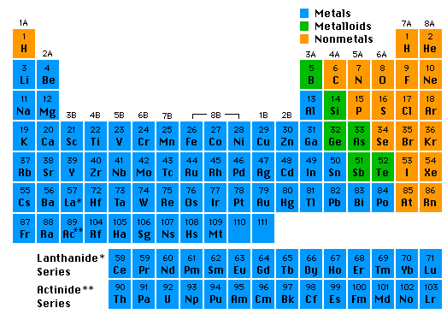
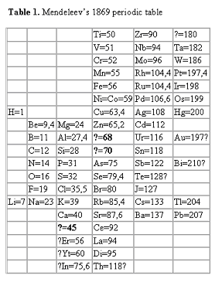
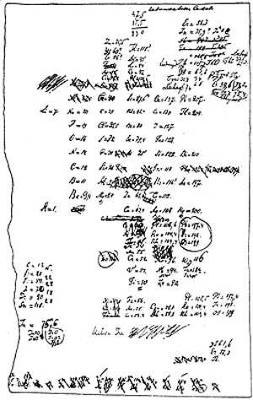
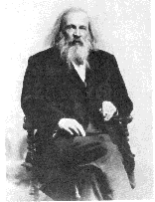
The Periodic Table
Dmitri Mendeleev (1834 - 1907)
Arranged by atomic masses

Slide 5
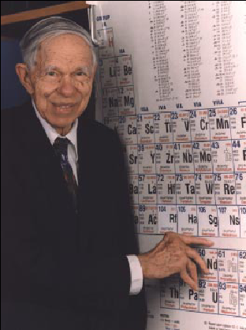
Glenn Seaborg
(1912-1999)
Discovered 8 new elements.
Only living person for whom an element was named.

Slide 6
Branches of Chemistry
Many major areas of study for specialization
Several career opportunities
Also used in many other jobs

Slide 7
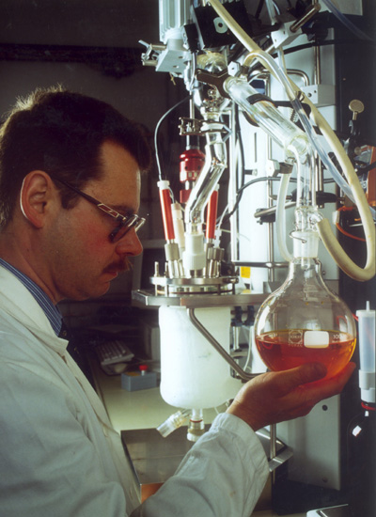
1. Organic Chemistry
Organic is the study of matter that contains carbon
Organic chemists study the structure, function, synthesis, and identity of carbon compounds
Useful in petroleum industry, pharmaceuticals, polymers

Slide 8
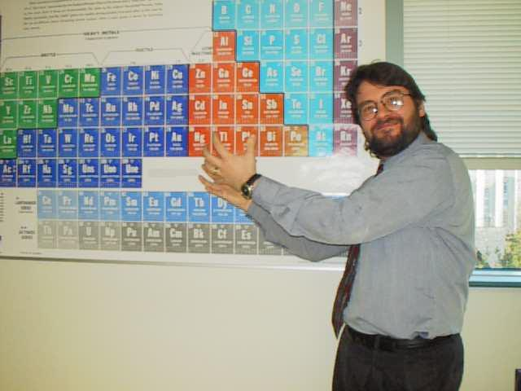
2. Inorganic Chemistry
Inorganic is the study of matter that does NOT contain carbon
Inorganic chemists study the structure, function, synthesis, and identity of non-carbon compounds
Polymers, Metallurgy

Slide 9
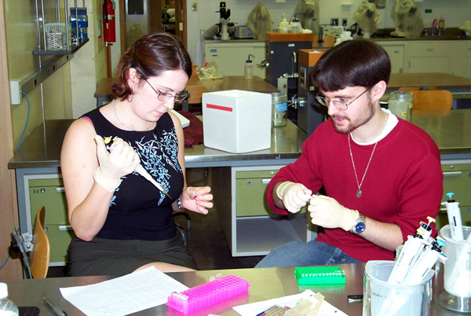
3. Biochemistry
Biochemistry is the study of chemistry in living things
Cross between biology and chemistry
Pharmaceuticals and genetics

Slide 10
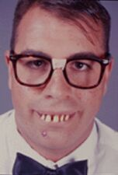
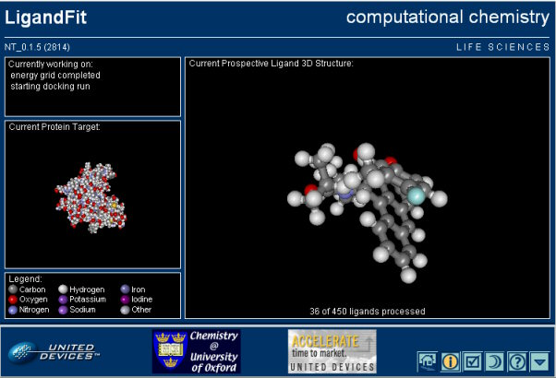
4. Physical Chemistry
HONK if you passed p-chem
Physical chemistry is the physics of chemistry… the forces of matter
Much of p-chem is computational
Develop theoretical ideas for new compounds

Slide 11
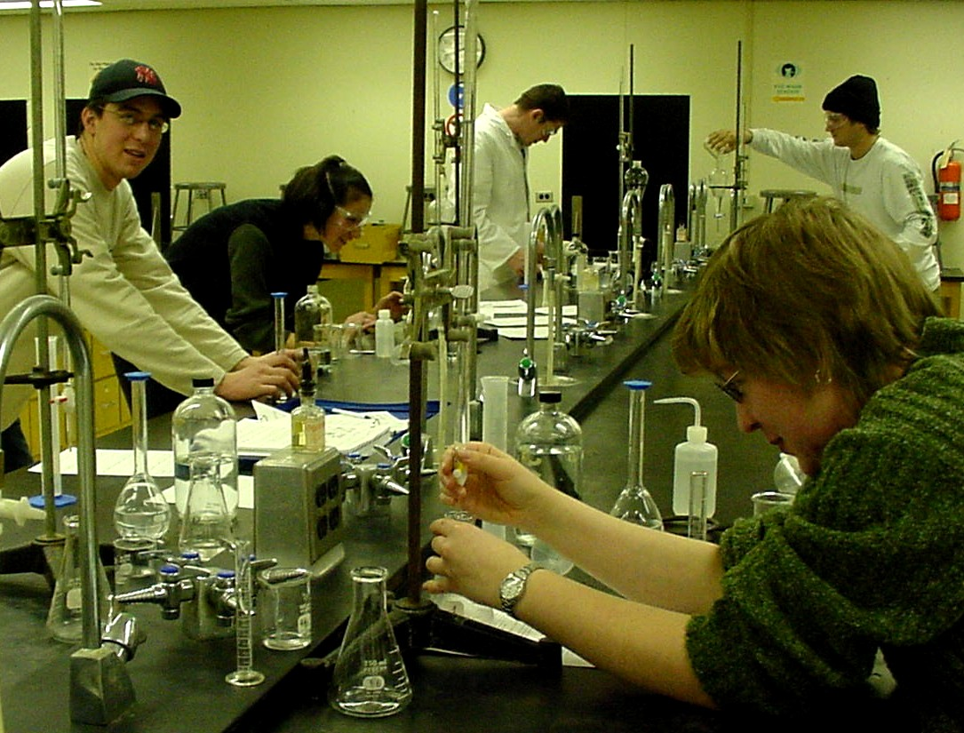
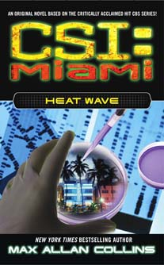
5. Analytical Chemistry
Analytical chemistry is the study of high precision measurement
Find composition and identity of chemicals
Forensics, quality control, medical tests

Slide 12
Types of Observations and Measurements
We make QUALITATIVE observations of reactions — changes in color and physical state.
We also make QUANTITATIVE MEASUREMENTS, which involve numbers.
  Use SI units — based on the metric system

Slide 13
What is Scientific Notation?
Scientific notation is a way of expressing really big numbers or really small numbers.
For very large and very small numbers, scientific notation is more concise.

Slide 14
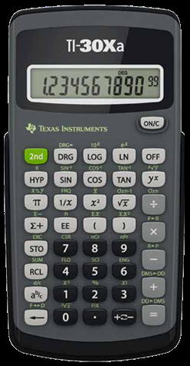
Scientific notation consists of two parts:
A number between 1 and 10
A power of 10
N x 10^{x}

Slide 15
Examples
Given: 289,800,000
Use: 2.898 (moved 8 places)
Answer: 2.898 x 10⁸
Given: 0.000567
Use: 5.67 (moved 4 places)
Answer: 5.67 x 10⁻⁴

Slide 16
Example
Given: 5.093 x 10⁶
Answer: 5,093,000 (moved 6 places to the right)
Given: 1.976 x 10⁻⁴
Answer: 0.0001976 (moved 4 places to the left)

Slide 17
Stating a Measurement
In every measurement there is a
Number followed by a
Unit from a measuring device
The number should also be as precise as the measurement!

Slide 18
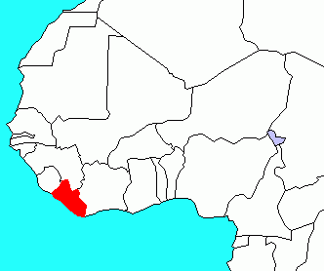
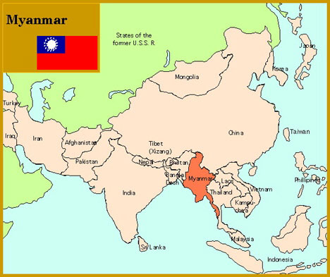
SI measurement
Le Système international d'unités
The only countries that have not officially adopted SI are Liberia (in western Africa) and Myanmar (a.k.a. Burma, in SE Asia), but now these are reportedly using metric regularly
Metrication is a process that happens over time.
Among countries with non-metric usage, the U.S. is the only country significantly holding out. The U.S. officially adopted SI in 1866.
Information from U.S. Metric Association

Slide 19
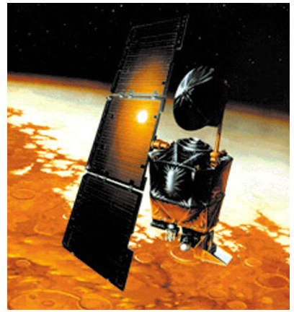
Chemistry In Action
On 9/23/99, $125,000,000 Mars Climate Orbiter entered Mars’ atmosphere 100 km lower than planned and was destroyed by heat.
1 lb = 1 N
1 lb = 4.45 N
“This is going to be the cautionary tale that will be embedded into introduction to the metric system in elementary school, high school, and college science courses till the end of time.”

Slide 20
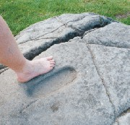
Standards of Measurement
When we measure, we use a measuring tool to compare some dimension of an object to a standard.
For example, at one time the standard for length was the king’s foot. What are some problems with this standard?

Slide 21
UNITS OF MEASUREMENT
Use SI units — based on the metric system
Length
Mass
Volume
Time
Temperature
Meter, m
Kilogram, kg
Liter, L
Seconds, s
Celsius degrees, ˚C
kelvins, K

Slide 22
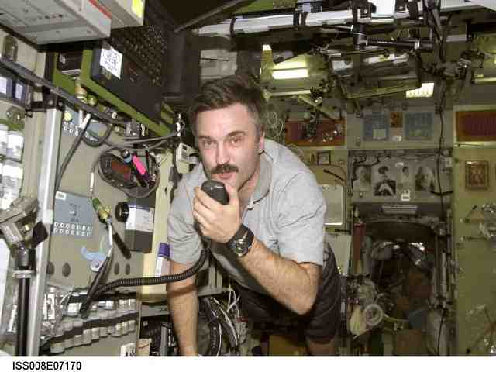
Mass vs. Weight
Mass: Amount of Matter (grams, measured with a BALANCE)
Weight: Force exerted by the mass, only present with gravity (pounds, measured with a SCALE)
Can you hear me now?

Slide 23
Metric Prefixes
Kilo- means 1000 of that unit
  1 kilometer (km) = 1000 meters (m)
Centi- means 1/100 of that unit
  1 meter (m) = 100 centimeters (cm)
  1 dollar = 100 cents
Milli- means 1/1000 of that unit
  1 Liter (L) = 1000 milliliters (mL)

Slide 24
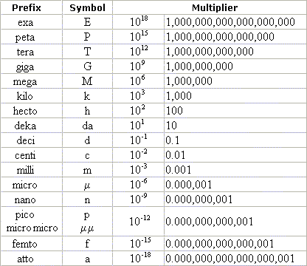
Metric Prefixes

Slide 25
Conversion Factors
Fractions in which the numerator and denominator are EQUAL quantities expressed in different units
Example: 1 in. = 2.54 cm
Factors: 1 in. and 2.54 cm
2.54 cm 1 in.

Slide 26
How many minutes are in 2.5 hours?
Conversion factor
2.5 hr x 60 min = 150 min
1 hr
cancel
By using dimensional analysis / factor-label method, the UNITS ensure that you have the conversion right side up, and the UNITS are calculated as well as the numbers!

Slide 27
Steps to Problem Solving
Write down the given amount. Don’t forget the units!
Multiply by a fraction.
Use the fraction as a conversion factor. Determine if the top or the bottom should be the same unit as the given so that it will cancel.
Put a unit on the opposite side that will be the new unit. If you don’t know a conversion between those units directly, use one that you do know that is a step toward the one you want at the end.
Insert the numbers on the conversion so that the top and the bottom amounts are EQUAL, but in different units.
Multiply and divide the units (Cancel).
If the units are not the ones you want for your answer, make more conversions until you reach that point.
Multiply and divide the numbers. Don’t forget “Please Excuse My Dear Aunt Sally”! (order of operations)
Round to the proper number of “significant digits”

Slide 28
Sample Problem
You have $7.25 in your pocket in quarters. How many quarters do you have?
7.25 dollars 4 quarters
1 dollar
X
= 29 quarters

Slide 29
You Try This One!
If Jacob stands on Spencer’s shoulders, they are two and a half yards high. How many feet is that?

Slide 30


Slide 31
Learning Check
A rattlesnake is 2.44 m long. How long is the snake in cm?
a) 2440 cm
b) 244 cm
c) 24.4 cm

Slide 32
Solution
A rattlesnake is 2.44 m long. How long is the snake in cm?
b) 244 cm
2.44 m x 100 cm = 244 cm
1 m

Slide 33
Learning Check
How many seconds are in 1.4 days?
Unit plan: days hr min seconds
1.4 days x 24 hr x ??
1 day

Slide 34
Solution
Unit plan: days hr min seconds
1.4 day x 24 hr x 60 min x 60 sec
1 day 1 hr 1 min
= 1.2 x 10⁵ sec

Slide 35
Wait a minute!
What is wrong with the following setup?
1.4 day x 1 day x 60 min x 60 sec
24 hr 1 hr 1 min

Slide 36
Imperial and Metric Conversions
If you know ONE conversion for each type of measurement, you can convert anything!
You must memorize and use these conversions:
  Mass: 454 grams = 1 pound
  Length: 2.54 cm = 1 inch
  Volume: 0.946 L = 1 quart

Slide 37
Learning Check
An adult human has 4.65 L of blood. How many gallons of blood is that?
Unit plan: L qt gallon
Equalities: 1 quart = 0.946 L
1 gallon = 4 quarts
Your Setup:

Slide 38
Solution
Unit plan: L qt gallon
Setup:
4.65 L x 1 qt x 1 gal = 1.23 gal
0.946 L 4 qt

Slide 39
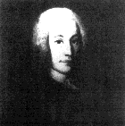
Temperature Scales
Fahrenheit
Celsius
Kelvin
Anders Celsius
1701-1744
Lord Kelvin
(William Thomson)
1824-1907

Slide 40
Calculations Using Temperature
Generally require temp’s in kelvins
T _{(K)} = T_{(˚C)} + 273.15
Body temp = 37 ˚C + 273 = 310 K
Liquid nitrogen = -196 ˚C + 273 = 77 K

Slide 41
Temperature Scales
Fahrenheit
Celsius
Kelvin
Boiling point of water
212 ˚F
100 ˚C
373 K
180˚F
100˚C
100 K
Freezing point of water
32 ˚F
0 ˚C
273 K
Notice that 1 kelvin = 1 degree Celsius

Slide 42
Fahrenheit Formula – Honors Only
Zero point: 0°C = 32°F
°F = 9/5 °C + 32
(°F - 32) * 5/9 = °C

Slide 43

Can you hit the bull's-eye?
Three targets with three arrows each to shoot.
How do they compare?
Both accurate and precise
Precise but not accurate
Neither accurate nor precise
Can you define accuracy and precision?

Slide 44
Significant Figures
The numbers reported in a measurement are limited by the measuring tool
Significant figures in a measurement include the known digits plus one estimated digit

Slide 45
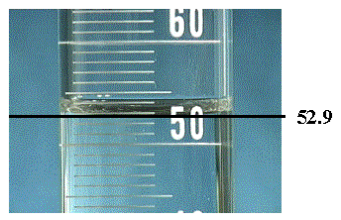
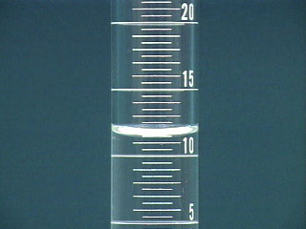
Always estimate ONE place past the smallest mark!

Slide 46
Equalities
State the same measurement in two different units
length
10.0 in.
25.8 cm

Slide 47
Counting Significant Figures
RULE 1. All non-zero digits in a measured number are significant. Only a zero could indicate that rounding occurred.
        Number of Significant Figures
38.15 cm 4
5.6 ft 2
65.6 lb ___
122.55 m ___
3
5

Slide 48
Leading Zeros
RULE 2. Leading zeros in decimal numbers are NOT significant.
Number of Significant Figures
0.008 mm 1
0.0156 oz 3
0.0042 lb ____
0.000262 mL ____
2
3

Slide 49
Sandwiched Zeros
RULE 3. Zeros between nonzero numbers are significant. (They can not be rounded unless they are on an end of a number.)
Number of Significant Figures
50.8 mm 3
2001 min 4
0.702 lb ____
0.00405 m ____
3
3

Slide 50
Trailing Zeros
RULE 4. Trailing zeros in numbers without decimals are NOT significant. They are only serving as place holders.
Number of Significant Figures
25,000 in. 2
200. yr 3
48,600 gal ____
2.8750 g ____
3
5

Slide 51
Learning Check
A. Which answers contain 3 significant figures?
  1) 0.4760 2) 0.00476 3) 4760
B. All the zeros are significant in
1) 0.00307 2) 25.300 3) 2.050 x 10³
C. 534,675 rounded to 3 significant figures is
  1) 535 2) 535,000 3) 5.35 x 10⁵

Slide 52
Solution
A. Which answers contain 3 significant figures?
  1) 0.4760 2) 0.00476 3) 4760
B. All the zeros are significant in
1) 0.00307 2) 25.300 3) 2.050 x 10³
C. 534,675 rounded to 3 significant figures is
  1) 535 2) 535,000 3) 5.35 x 10⁵

Slide 53
Learning Check
State the number of significant figures in each of the following:
A. 0.030 m 1 2 3
B. 4.050 L 2 3 4
C. 0.0008 g 1 2 4
D. 3.00 m 1 2 3
E. 2,080,000 bees 3 5 7

Slide 54
Learning Check
State the number of significant figures in each of the following:
A. 0.030 m 1 2 3
B. 4.050 L 2 3 4
C. 0.0008 g 1 2 4
D. 3.00 m 1 2 3
E. 2,080,000 bees 3 5 7

Slide 55
Significant Numbers in Calculations
A calculated answer’s precision must match the least precise measurement.
Significant figures are needed for final answers from
1) multiplying or dividing
2) adding or subtracting
Exact conversions have an INFINITE number of sig figs (100 cm = 1 m, etc.)

Slide 56
Multiplying and Dividing
Round (or add zeros) to the calculated answer until you have the same number of significant figures as the measurement with the fewest significant figures.

Slide 57
Learning Check
A. 2.19 X 4.2 =
1) 9 2) 9.2 3) 9.198
B. 4.311 ÷ 0.07 =
1) 61.58 2) 62 3) 60
C. 2.54 X 0.0028 =
0.0105 X 0.060
1) 11.3 2) 11 3) 0.041

Slide 58
Learning Check
A. 2.19 X 4.2 =
1) 9 2) 9.2 3) 9.198
B. 4.311 ÷ 0.07 =
1) 61.58 2) 62 3) 60
C. 2.54 X 0.0028 =
0.0105 X 0.060
1) 11.3 2) 11 3) 0.041

Slide 59
Adding and Subtracting
For addition and subtraction, sig figs are based on PLACE VALUES - not the rules for multiply & divide.
The answer has the same number of places as the measurement with the fewest places.
25.2 one decimal place
+ 1.34 two decimal places
26.54
answer 26.5 one decimal place

Slide 60
Learning Check
In each calculation, round the answer to the correct number of significant figures.
A. 235.05 + 19.6 + 2.1 =
1) 256.75 2) 256.8 3) 257
B. 58.925 - 18.2 =
1) 40.725 2) 40.73 3) 40.7

Slide 61
Solution
In each calculation, round the answer to the correct number of significant figures.
A. 235.05 + 19.6 + 2.1 =
1) 256.75 2) 256.8 3) 257
B. 58.925 - 18.2 =
1) 40.725 2) 40.73 3) 40.7

Slide 62

What is Density???

Slide 63
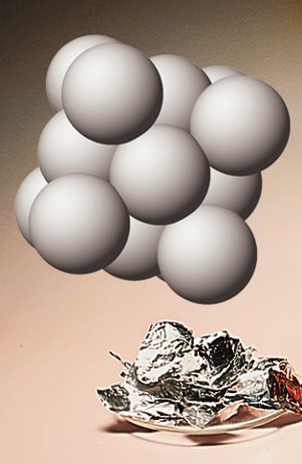
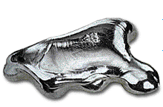
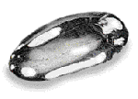
DENSITY - an important and useful physical property
Mercury
Platinum
Aluminum
13.6 g/cm³
21.5 g/cm³
2.7 g/cm³

Slide 64
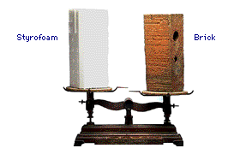
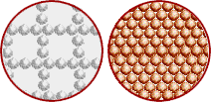
DENSITY
Density is an INTENSIVE property of matter.
  does NOT depend on quantity of matter.
  temperature
Contrast with EXTENSIVE
  depends on quantity of matter.
  mass and volume.
Styrofoam
Brick

Slide 65
Problem A piece of copper has a mass of 57.54 g. It is 9.36 cm long, 7.23 cm wide, and 0.95 mm thick. Calculate density (g/cm³).

Slide 66
SOLUTION
1. Get dimensions in common units.
2. Calculate volume in cubic centimeters.
3. Calculate the density.
(9.36 cm)(7.23 cm)(0.095 cm) = 6.4 cm³
Note only 2 significant figures in the answer!

Slide 67
Learning Check
If blood has a density of 1.05 g/mL, how many liters of blood are donated if 575 g of blood are given?
1) 0.548 L
2) 1.25 L
3) 1.83 L

Slide 68
Learning Check
If blood has a density of 1.05 g/mL, how many liters of blood are donated if 575 g of blood are given?
1) 0.548 L
2) 1.25 L
3) 1.83 L

Slide 69
Scientific Method
State the problem clearly.
Gather information.
Form a hypothesis.
Test the hypothesis.
Evaluate the data to form a conclusion.
  If the conclusion is valid, then it becomes a theory. If the theory is found to be true over along period of time (usually 20+ years) with no counter examples, it may be considered a law.
6. Share the results.

