Slide 1
Spectroscopy for AP Chemistry
Photoelectron Spectroscopy (PES)
Provides data for ionization energy trends and applications
Mass Spectrometry
Provides atomic/molar mass data as it ionizes

Slide 2
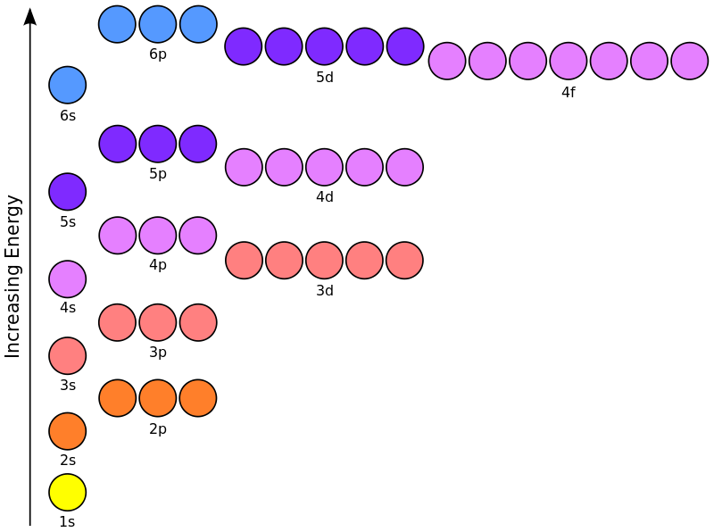
Electron Configuration
Is there any direct evidence that this diagram is accurately showing potential energy of electrons on the atom?

Slide 3
Photoelectron Spectroscopy
Atom
E_{photon} = hv
Monochromatic
Beam of X-Rays
KE = mv²
2
e⁻
IE_{electron} = E_{photon} - KE

Slide 4
Photoelectron Spectrum
Each peak is relative to the others. This indicates the relative number of electrons. If the peak is twice as big, there are twice as many electrons.
Relative Intensity = 2
Relative Intensity = 1
20 MJ/mol
10 MJ/mol
0 MJ/mol

Slide 5
Photoelectron Spectrum
Valence
19.3 MJ/mol
1.36 MJ/mol
RI = 2
RI = 2
Gap is due to increased energy of the orbital (decreased amount of energy to remove the electron)
0.80 MJ/mol
RI = 1
20 MJ/mol
10 MJ/mol
0 MJ/mol

Slide 6
Photoelectron Spectrum
Boron (Z=5)
19.3 MJ/mol
1.36 MJ/mol
Analysis:
Valence has 2 values: sp
RI is 2 to 1 in valence: s²p¹
Closest core has RI 2 not 6: not p^{x}s²p¹
s²s²p¹ must be 1s²2s²2p¹
RI = 2
RI = 2
0.80 MJ/mol
RI = 1
1s²
2s²
2p¹
20 MJ/mol
10 MJ/mol
0 MJ/mol
Inner orbitals require the most energy
Valence orbitals require the least energy

Slide 7
Photoelectron Spectrum
Depending on the size of the table, 1s may be intentionally cut out of view because it’s too far away and makes the graph too long
Remember IE is about REMOVING electrons, which means they are removed from the OUTSIDE to the INSIDE, and NOT in reverse order of energy! For example, 4s is removed BEFORE 3d.

Slide 8
Photoelectron Spectrum
2p⁶
Sodium (Z=11)
3.67 MJ/mol
1s²
2s²
3s¹
104 MJ/mol
6.84 MJ/mol
0.50 MJ/mol
{ }
8 MJ/mol
4 MJ/mol
0 MJ/mol

Slide 9
Online PES Resources
http://www.chem.arizona.edu/chemt/Flash/photoelectron.html
https://www.youtube.com/watch?v=NRIqXeY1R_I
https://www.youtube.com/watch?v=vANbxozsRSA

Slide 10
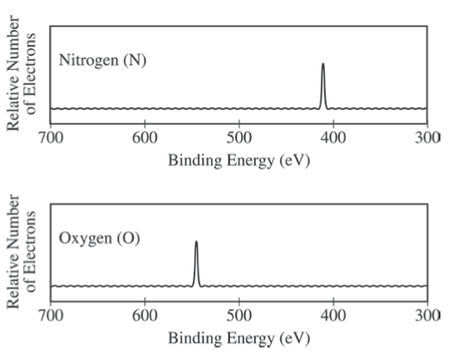
From the AP Sample Questions…

Slide 11
From the AP Sample Questions…
Notes:
D – Ionization energy is the energy required to remove an electron from the attraction of the nucleus. Since this requires less energy, there must be less nuclear charge.

Slide 12
Which peaks in the photoelectron spectrum are representative of the binding energy of p orbital electrons?
C only c. C and E
D only d. B, C and D
Notes:
C – A, B, and D are s orbitals because they all have 2 relative electrons, and the p orbital comes after s orbitals because it takes less energy to remove them.

Slide 13
Mass Spectrometry
Mass spectrometry gives the mass to charge ratio
Like PES, the relative size of the peaks indicates the relative number of particles
Separates isotopes according to mass
Used to find relative abundance and atomic/molar mass of unknown samples

Slide 14
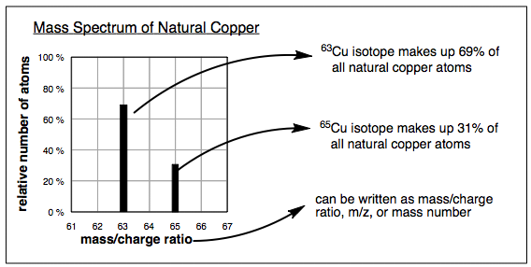
Mass Spectrometry

Slide 15
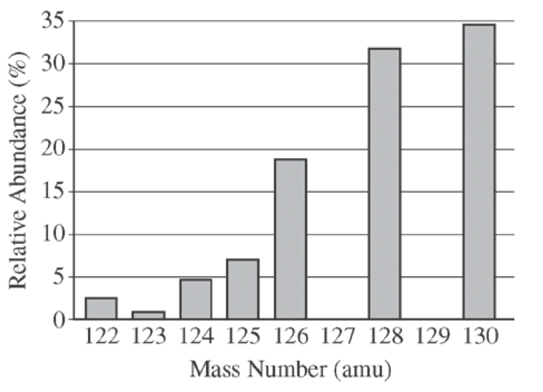
From the AP Sample Questions…
The elements I and Te have similar average atomic masses. A sample that was believed to be a mixture of I and Te was run through a mass spectrometer, resulting in the data above. All of the following statements are true. Which one would be the best basis for concluding that the sample was pure Te?

Slide 16
From the AP Sample Questions…
Te forms ions with a -2 charge, whereas I forms ions with a -1 charge.
Te is more abundant that I in the universe.
I consists of only one naturally occurring isotope with 74 neutrons, whereas Te has more than one isotope.
I has a higher first ionization energy than Te does.
Notes:
C – Since there is not a peak at 127 (the most common isotope for I), there can not be I in the sample.

Slide 17
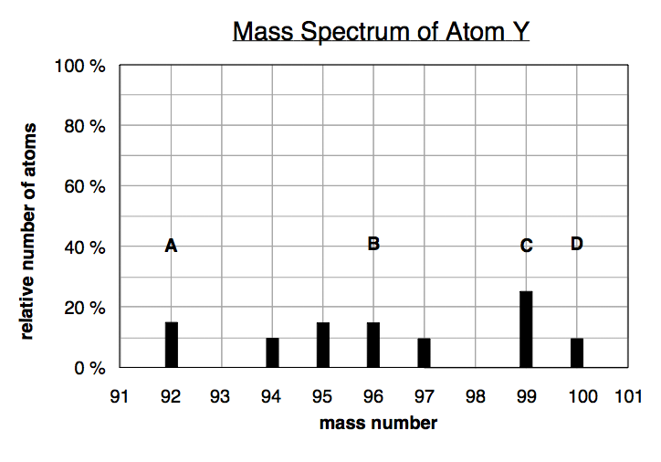
Based on the mass spectrum of atom Y, which of the following statements is false?
a. peak A and peak D come from atoms that have the same number of electrons
b. there are seven isotopes of atom Y
c. peak C comes from the most abundant isotope of atom Y
d. peak D comes from an atom with 4 more protons than the atom that gave peak B
Notes:
D – protons must be the same for atoms of the same element; neutrons make the difference on the spectrum assuming this is a single element

Slide 18
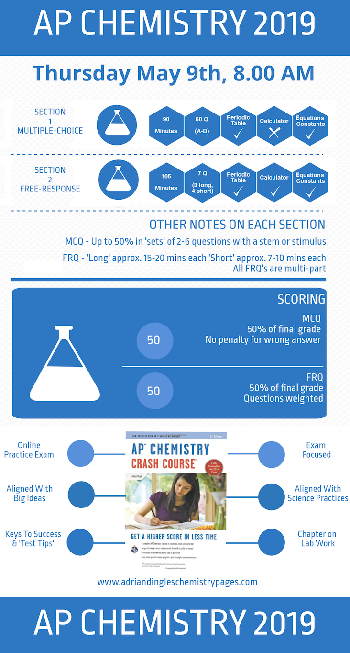

Slide 19
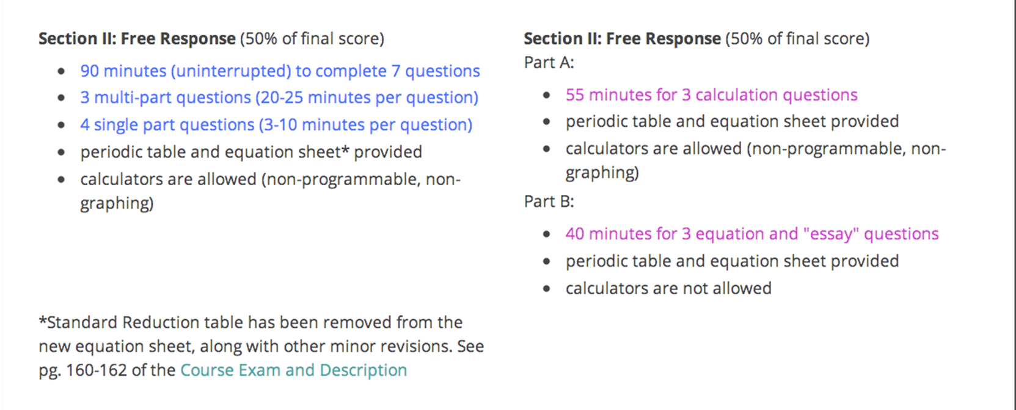
TIME NOW EXTENDED TO 105 MINUTES! (2015)

