Slide 1
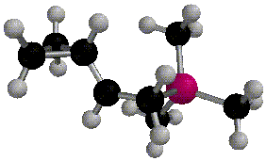
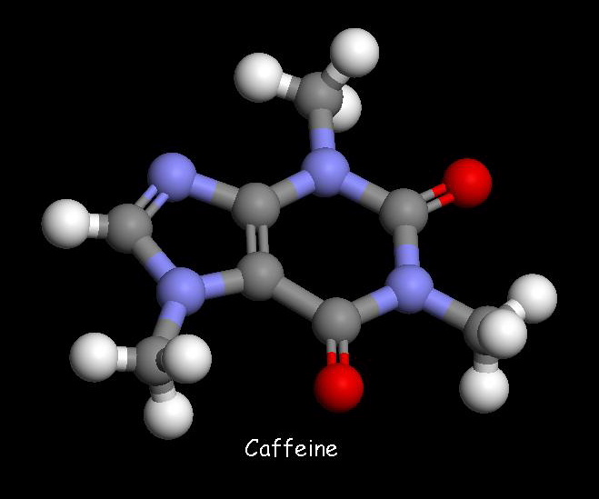
Brief! Organic Chemistry for AP

Slide 2
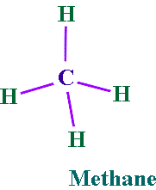
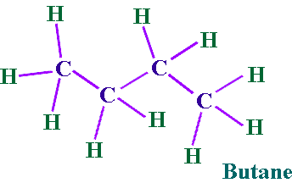
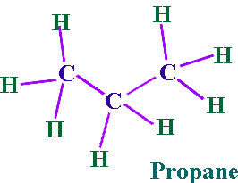
Alkanes
Hydrocarbon chains where all the bonds between carbons are SINGLE bonds
Name uses the ending –ane
Examples: Methane, Propane, Butane, Octane, 2-methylpentane

Slide 3
Prefixes for # of Carbons
1 | Meth | 6 | Hex
2 | Eth | 7 | Hept
3 | Prop | 8 | Oct
4 | But | 9 | Non
5 | Pent | 10 | Dec

Slide 4
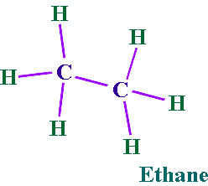
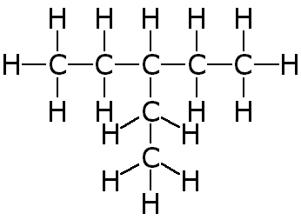
Endings
Alkanes (all C-C single bonded parent chain) end in –ane
Methane CH₄
Ethane C₂H₆
Propane C₃H₈
Attached carbon groups (substituents) end in –yl
Methyl CH₃ -
Ethyl CH₃CH₂-
Propyl CH₃CH₂CH₂ –
3-ethylpentane

Slide 5
Names of other attached groups
Halogens
Fluoro (F-)
Chloro (Cl-)
Bromo (Br-)
Iodo (I-)

Slide 6
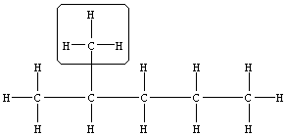
Designate the Location
Designate the location (number of the carbon on the parent chain) for each attached group
2-methyl
1 2 3 4 5

Slide 7
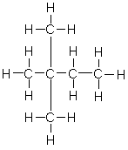
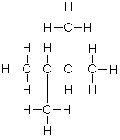
Some Simple Alkanes
2-methylpentane
3-ethylhexane
2,2-dimethylbutane
2,3-dimethylbutane

Slide 8
Structural Formulas
“Lazy” way to write the Hydrogens
Instead of drawing the bonds, just state how many hydrogens are attached
NOTE: The bonds are between CARBONS in a parent chain, and not hydrogens!
Structural Formula
Lewis Structure

Slide 9
Drawing and Naming Cycloalkanes
Cycloalkanes are represented by polygons. A triangle represents cyclopropane, a square represents cyclobutane, a pentagon represents cyclopentane, and so on.

Slide 10
Alkenes and Alkynes
Unsaturated
contain carbon-carbon double and triple bond to which more hydrogen atoms can be added.
Alkenes: carbon-carbon double bonds
Alkynes: carbon-carbon triple bonds.

Slide 11
Naming Alkenes and Alkynes
When the carbon chain has 4 or more C atoms, number the chain to give the lowest number to the double or triple bond.
1 2 3 4
CH₂=CHCH₂CH₃ 1-butene
CH₃CH=CHCH₃ 2-butene CH₃C≡CCH₃ 2-butyne

Slide 12
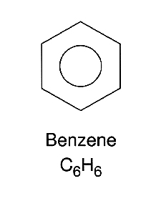
Aromatic Compounds and Benzene
Aromatic compounds contain benzene.
Benzene, C₆H₆ , is represented as a six carbon ring with 3 double bonds.
Two possible resonance structures can be drawn to show benzene in this form.

Slide 13
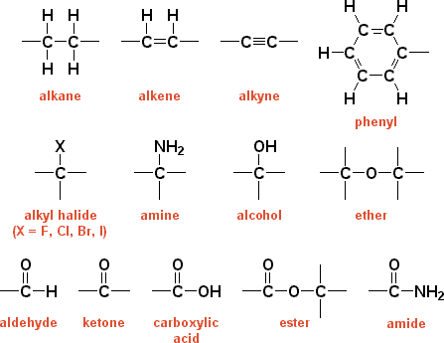
Functional Groups

