Slide 1
Chapter 9
Covalent Bonding:
Orbitals

Slide 2
9.1 Hybridization and the Localized Electron Model
9.2 The Molecular Orbital Model
9.3 Bonding in Homonuclear Diatomic Molecules
9.4 Bonding in Heteronuclear Diatomic Molecules
9.5 Combining the Localized Electron and Molecular Orbital Models

Slide 3
Hybridization – mixing of two or more atomic orbitals to form a new set of hybrid orbitals.
Mix at least 2 nonequivalent atomic orbitals (e.g. s and p). Hybrid orbitals have very different shape from original atomic orbitals.
Number of hybrid orbitals is equal to number of pure atomic orbitals used in the hybridization process.
Covalent bonds are formed by:
  Overlap of hybrid orbitals with atomic orbitals
  Overlap of hybrid orbitals with other hybrid orbitals
10.4

Slide 4
sp³ Hybridization
Combination of one s and three p orbitals.
Whenever a set of equivalent tetrahedral atomic orbitals is required by an atom, the localized electron model assumes that the atom adopts a set of sp³ orbitals; the atom becomes sp³ hybridized.

Slide 5
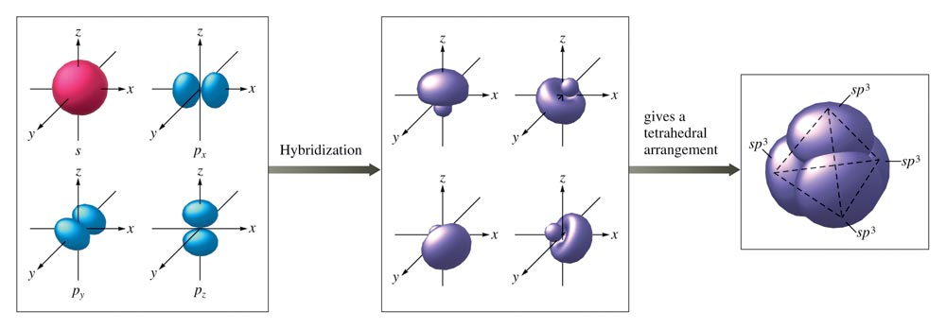
The Formation of sp³ Hybrid Orbitals

Slide 6
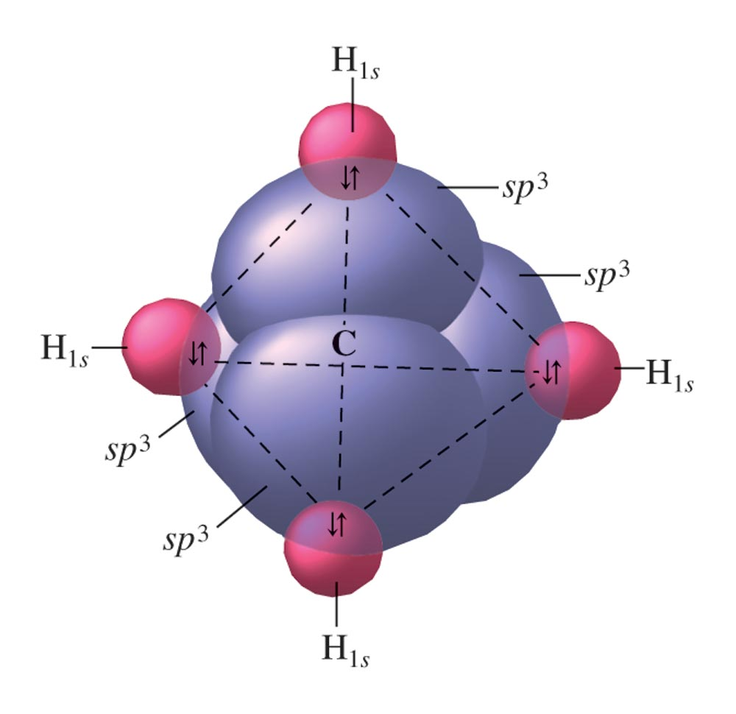
Tetrahedral Set of Four sp³ Orbitals

Slide 7
sp² Hybridization
Combination of one s and two p orbitals.
Gives a trigonal planar arrangement of atomic orbitals.
One p orbital is not used.
  Oriented perpendicular to the plane of the sp² orbitals.

Slide 8
Sigma (σ) Bond
Electron pair is shared in an area centered on a line running between the atoms.

Slide 9
Pi (π) Bond
Forms double and triple bonds by sharing electron pair(s) in the space above and below the σ bond.
Uses the unhybridized p orbitals.

Slide 10
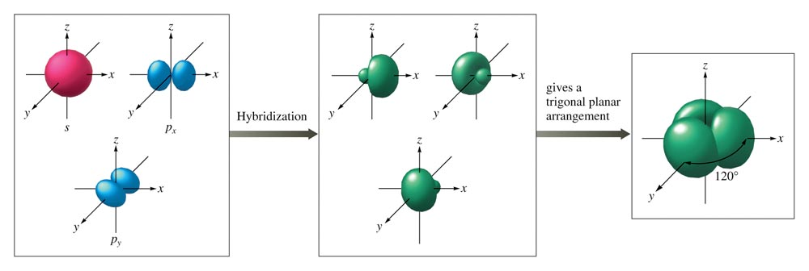
The Hybridization of the s, p_{x}, and p_{y} Atomic Orbitals

Slide 11
Formation of C=C Double Bond in Ethylene

Slide 12
sp Hybridization
Combination of one s and one p orbital.
Gives a linear arrangement of atomic orbitals.
Two p orbitals are not used.
  Needed to form the π bonds.

Slide 13
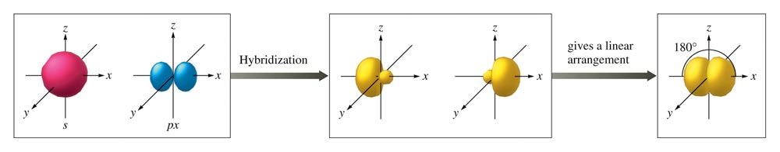
When One s Orbital and One p Orbital are Hybridized, a Set of Two sp Orbitals Oriented at 180 Degrees Results

Slide 14
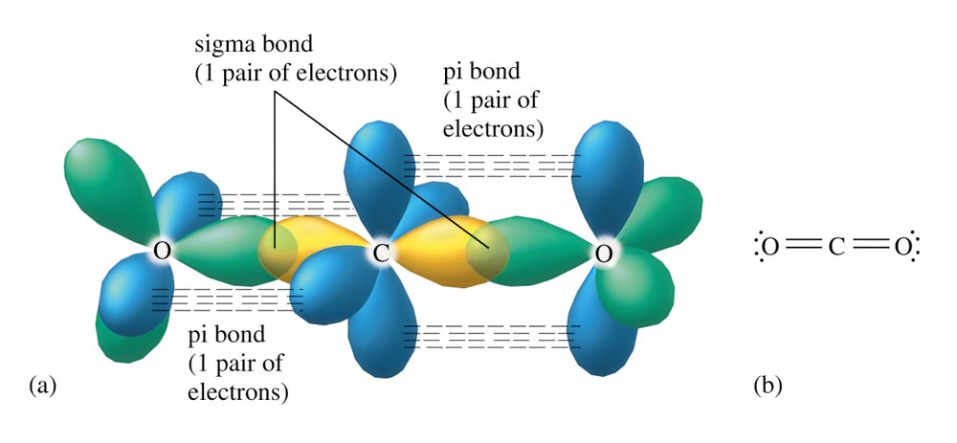
The Orbitals for CO₂

Slide 15
sp³d Hybridization
NO LONGER ON THE AP EXAM – THIS HAS BEEN DISPROVEN

Slide 16
sp³d² Hybridization
NO LONGER ON THE AP EXAM – THIS HAS BEEN DISPROVEN

Slide 17

Concept Check
Draw the Lewis structure for HCN.
Which hybrid orbitals are used?
Draw HCN:
  Showing all bonds between atoms.
  Labeling each bond as σ or π.
Notes:
sp hybrid orbitals are used in the bonding of HCN. Two sigma bonds and two pi bonds are present.

Slide 18
Concept Check
Determine the bond angle and expected hybridization of the central atom for each of the following molecules:
NH₃ SO₂ KrF_{2 * no hybridization}
CO₂ ICl_{5 * no hybridization}
NH₃ – 107º, sp³
SO₂ – 120º, sp²
KrF₂ – 90º, 120º, sp³d
CO₂ – 180º, sp
ICl₅ – 90º, 180º, sp³d²
Notes:
NH₃ – 109.5º, sp³
SO₂ – 120º, sp²
KrF₂ – 90º, 120º, dsp³
CO₂ – 180º, sp
ICl₅ – 90º, 180º, d²sp³

Slide 19
Using the Localized Electron Model
Draw the Lewis structure(s).
Determine the arrangement of electron pairs using the VSEPR model.
Specify the hybrid orbitals needed to accommodate the electron pairs.

Slide 20
Bond Order
1 = sigma bond
2 = sigma bond + pi bond
3 = sigma bond + pi bond + pi bond

Slide 21
MOLECULAR ORBITAL THEORY IS NO LONGER INCLUDED IN THE AP CURRICULUM!
Regards a molecule as a collection of nuclei and electrons, where the electrons are assumed to occupy orbitals much as they do in atoms, but having the orbitals extend over the entire molecule.
The electrons are assumed to be delocalized rather than always located between a given pair of atoms.

Slide 22
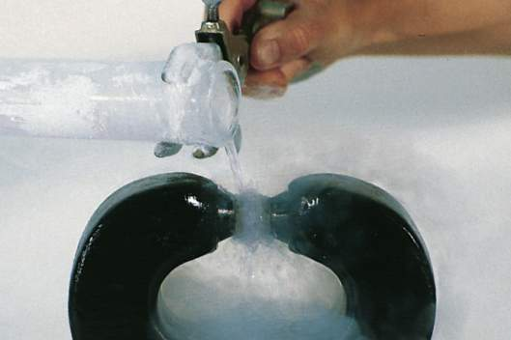
Experiments show O₂ is paramagnetic
(has UNPAIRED e-)
O
O
No unpaired e-
Should be diamagnetic
Molecular orbital theory – bonds are formed from interaction of atomic orbitals to form molecular orbitals.
https://www.youtube.com/watch?v=Lt4P6ctf06Q
10.6

Slide 23
The electron probability of both molecular orbitals is centered along the line passing through the two nuclei.
  Sigma (σ) molecular orbitals (MOs)
In the molecule only the molecular orbitals are available for occupation by electrons.

Slide 24
Combination of Hydrogen 1s Atomic Orbitals to form MOs

Slide 25
MO is lower in energy than the s orbitals of free atoms, while MO* is higher in energy than the s orbitals.
  Bonding molecular orbital – lower in energy
  Antibonding molecular orbital – higher in energy

Slide 26
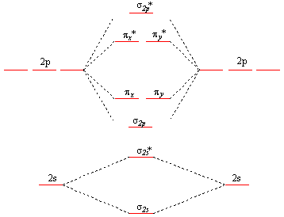

Slide 27
MO Energy-Level Diagram for the H₂ Molecule

Slide 28
Molecular electron configurations can be written similar to atomic electron configurations.
Each molecular orbital can hold 2 electrons with opposite spins.
The number of orbitals are conserved.

Slide 29
Bonding in H₂

Slide 30
Sigma Bonding and Antibonding Orbitals

Slide 31
Bond Order
Larger bond order means greater bond strength.

Slide 32
Example: H₂

Slide 33
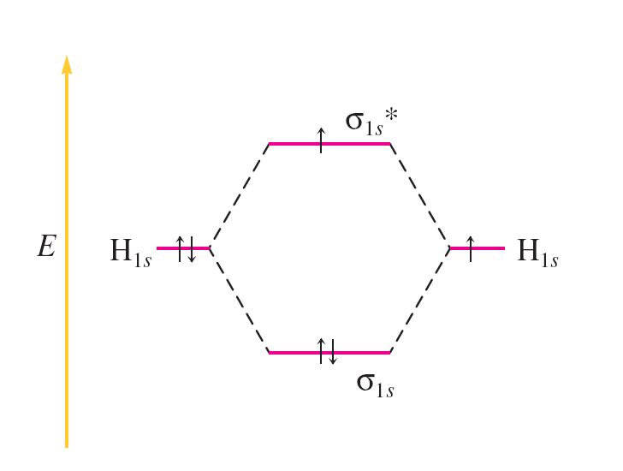
Example: H₂–

Slide 34
Pi Bonding and Antibonding Orbitals

Slide 35
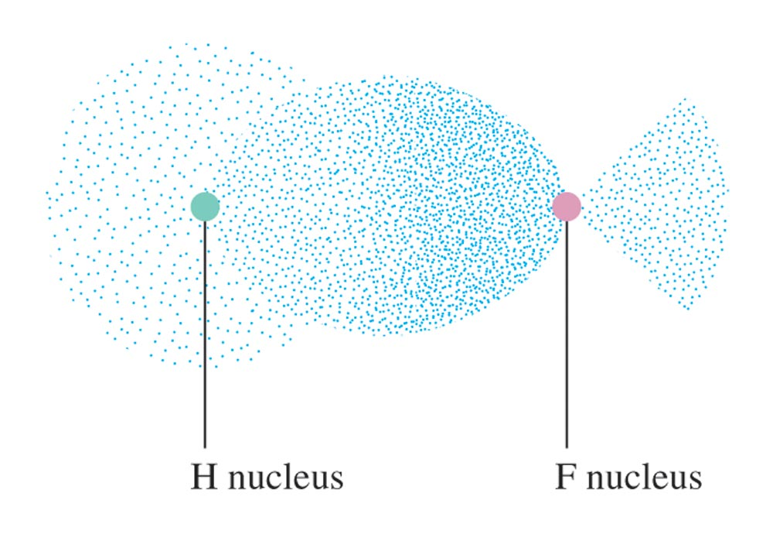
The Electron Probability Distribution in the Bonding Molecular Orbital of the HF Molecule

Slide 36
Delocalization
Describes molecules that require resonance.
In molecules that require resonance, it is the π bonding that is most clearly delocalized, the σ bonds are localized.
p orbitals perpendicular to the plane of the molecule are used to form π molecular orbitals.
The electrons in the π molecular orbitals are delocalized above and below the plane of the molecule.

Slide 37
Resonance in Benzene

Slide 38
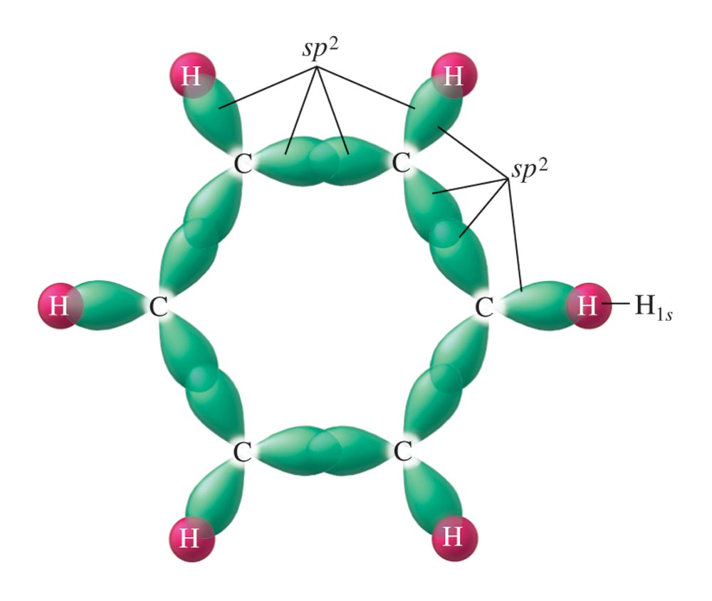
The Sigma System for Benzene

Slide 39
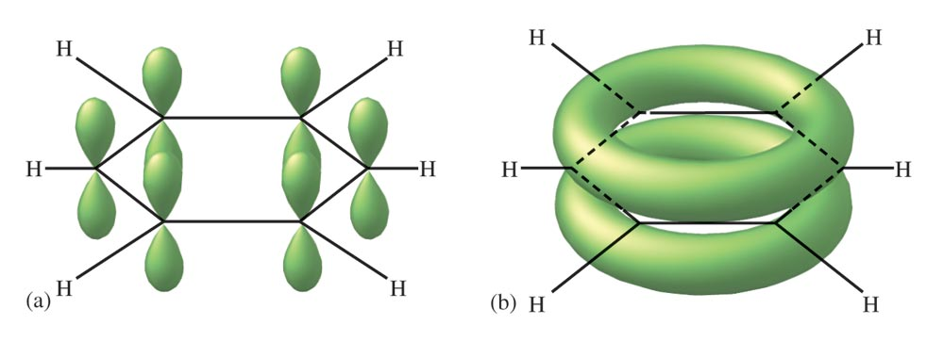
The Pi System for Benzene

