Slide 1
Chapter 7
Atomic Structure
and Periodicity

Slide 2
7.1 Electromagnetic Radiation
7.2 The Nature of Matter
7.3 The Atomic Spectrum of Hydrogen
7.4 The Bohr Model
7.5 The Quantum Mechanical Model of the Atom
7.7 Orbital Shapes and Energies
7.8 Electron Spin and the Pauli Principle
7.10 The History of the Periodic Table
7.11 The Aufbau Principle and the Periodic Table
7.12 Periodic Trends in Atomic Properties
7.13 The Properties of a Group: The Alkali Metals
8.2 Electronegativity
8.4 Ions: Electron Configurations and Sizes

Slide 3
Different Colored Fireworks

Slide 4
Questions to Consider
Why do we get colors?
Why do different chemicals give us different colors?

Slide 5
Electromagnetic Radiation
One of the ways that energy travels through space.
Three characteristics:
  Wavelength
  Frequency
  Speed

Slide 6
Characteristics
Wavelength ( ) – distance between two peaks or troughs in a wave.
Frequency ( ) – number of waves (cycles) per second that pass a given point in space
Speed (c) – speed of light (2.9979×10⁸ m/s)

Slide 7
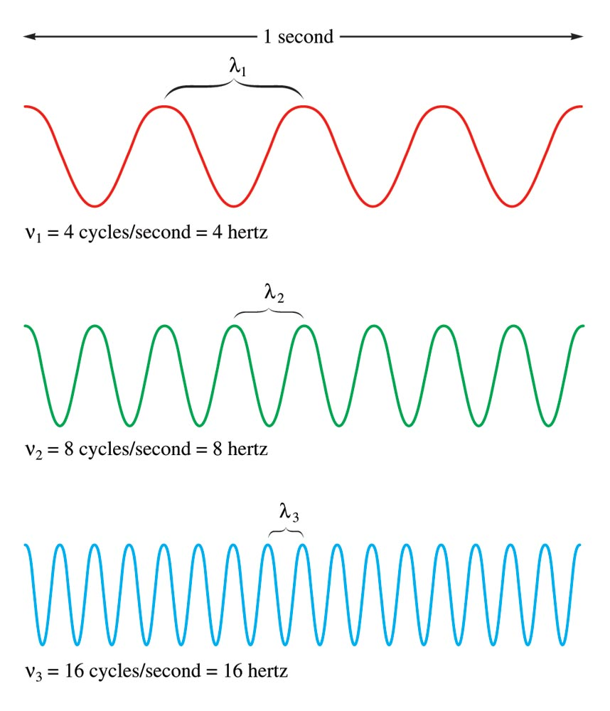
The Nature of Waves

Slide 8
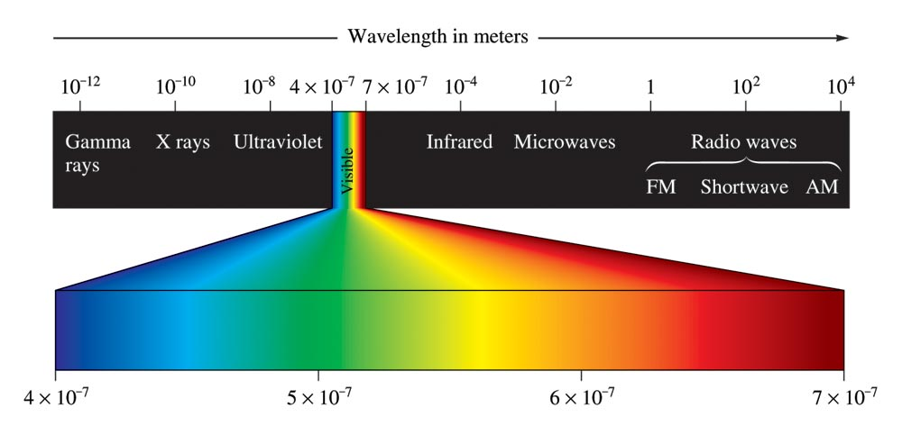
Classification of Electromagnetic Radiation

Slide 9
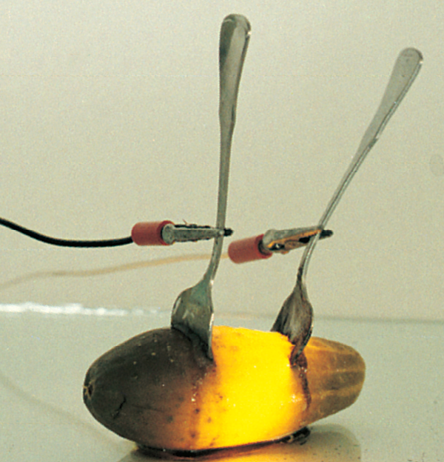

Pickle Light

Slide 10
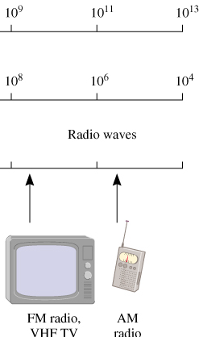
A photon has a frequency of 6.0 x 104 Hz. Convert
this frequency into wavelength (nm). Does this frequency
fall in the visible region?
λ
λ x ν = c
λ = c/ν
ν
λ = 3.00 x 108 m/s / 6.0 x 104 Hz
λ = 5.0 x 103 m
λ = 5.0 x 1012 nm
Radio wave
7.1

Slide 11
Energy can be gained or lost only in integer multiples of .
A system can transfer energy only in whole quanta (or “packets”).
Energy seems to have particulate properties too.

Slide 12
Energy is quantized.
Electromagnetic radiation is a stream of “particles” called photons.
Planck’s constant (h)
h = 6.63 x 10-34 J•s

Slide 13
The Photoelectric Effect

Slide 14
Energy has mass E = mc²
Dual nature of light:
  Electromagnetic radiation (and all matter) exhibits wave properties and particulate properties.

Slide 15
Continuous spectrum (when white light is passed through a prism) – contains all the wavelengths of visible light
Line spectrum – each line corresponds to a discrete wavelength:
  Hydrogen emission spectrum

Slide 16
Refraction of White Light

Slide 17
The Line Spectrum of Hydrogen

Slide 18
Significance
Only certain energies are allowed for the electron in the hydrogen atom.
Energy of the electron in the hydrogen atom is quantized.

Slide 19

Concept Check
Why is it significant that the color emitted from the hydrogen emission spectrum is not white?
How does the emission spectrum support the idea of quantized energy levels?
Notes:
If the levels were not quantized, we’d probably see white light. This is because all possible value of energy could be released, meaning all possible colors would be emitted. All the colors combined make white light. Since only certain colors are observed, this means that only certain energy levels are allowed. An electron can exist at one level or another, and there are regions of zero probability in between.

Slide 20
Electron in a hydrogen atom moves around the nucleus only in certain allowed circular orbits.
Bohr’s model gave hydrogen atom energy levels consistent with the hydrogen emission spectrum.
Ground state – lowest possible energy state (n = 1)

Slide 21
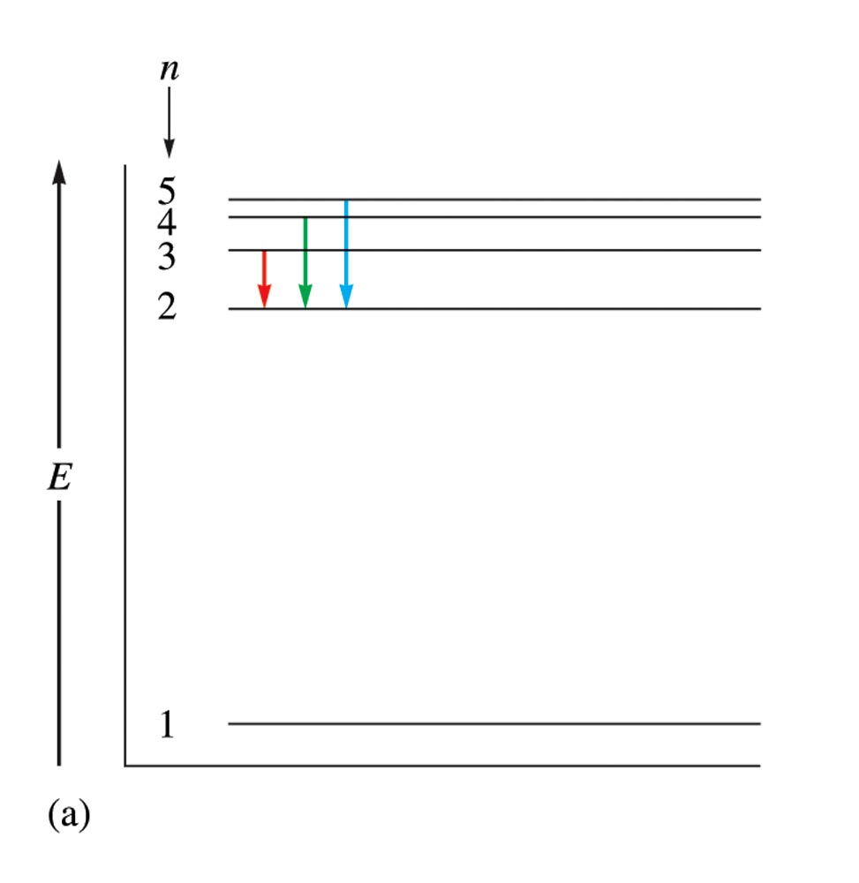
Electronic Transitions in the Bohr Model for the Hydrogen Atom a) An Energy-Level Diagram for Electronic Transitions

Slide 22
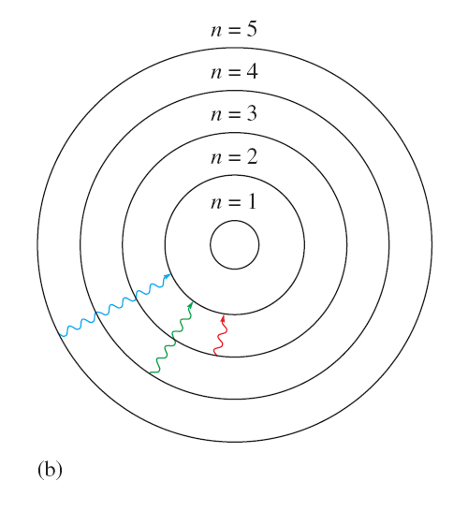
Electronic Transitions in the Bohr Model for the Hydrogen Atom b) An Orbit-Transition Diagram, Which Accounts for the Experimental Spectrum

Slide 23
Bohr’s model is incorrect. This model only works for hydrogen.
Electrons do not move around the nucleus in circular orbits.

Slide 24
We do not know the detailed pathway of an electron.
Heisenberg uncertainty principle:
  There is a fundamental limitation to just how precisely we can know both the position and momentum of a particle at a given time.

Slide 25
Physical Meaning of a Wave Function
The square of the function indicates the probability of finding an electron near a particular point in space.
  Probability distribution – intensity of color is used to indicate the probability value near a given point in space.

Slide 26
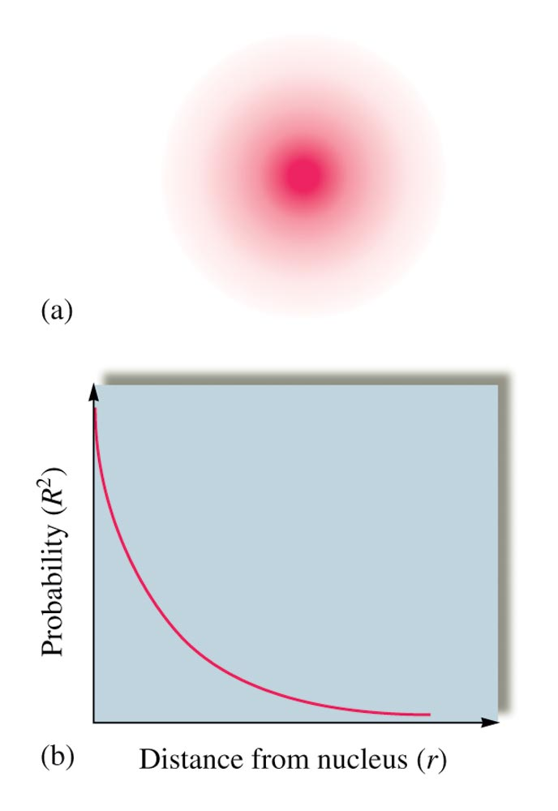
Probability Distribution for the 1s Wave Function

Slide 27
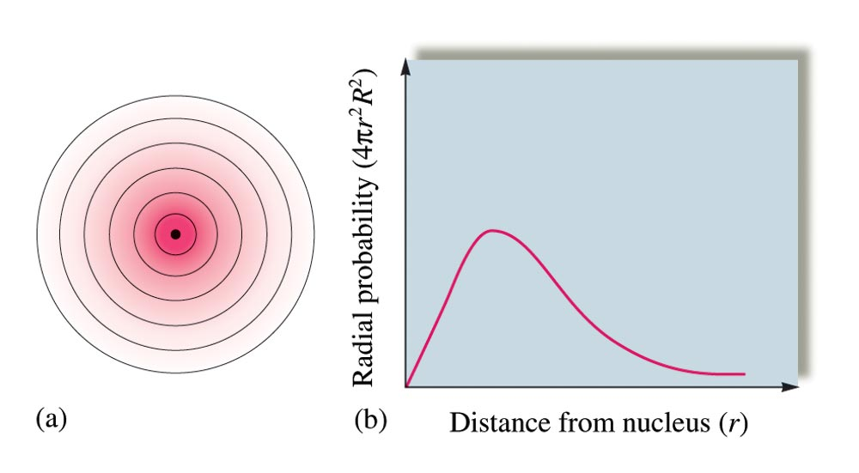
Radial Probability Distribution

Slide 28
Relative Orbital Size
Difficult to define precisely.
Orbital is a wave function.
Picture an orbital as a three-dimensional electron density map.
Hydrogen 1s orbital:
  Radius of the sphere that encloses 90% of the total electron probability.

Slide 29
Principal quantum number (n) – size and energy of the orbital.
Angular momentum quantum number (l) – shape of atomic orbitals (sometimes called a subshell).
Magnetic quantum number (m_{l}) – orientation of the orbital in space relative to the other orbitals in the atom.
** Finding quantum numbers for an electron is no longer in the AP Curriculum

Slide 30
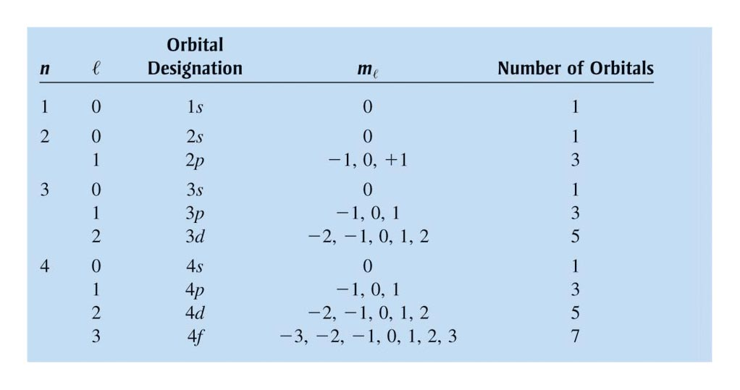
Quantum Numbers for the First Four Levels of Orbitals in the Hydrogen Atom

Slide 31
1s Orbital

Slide 32
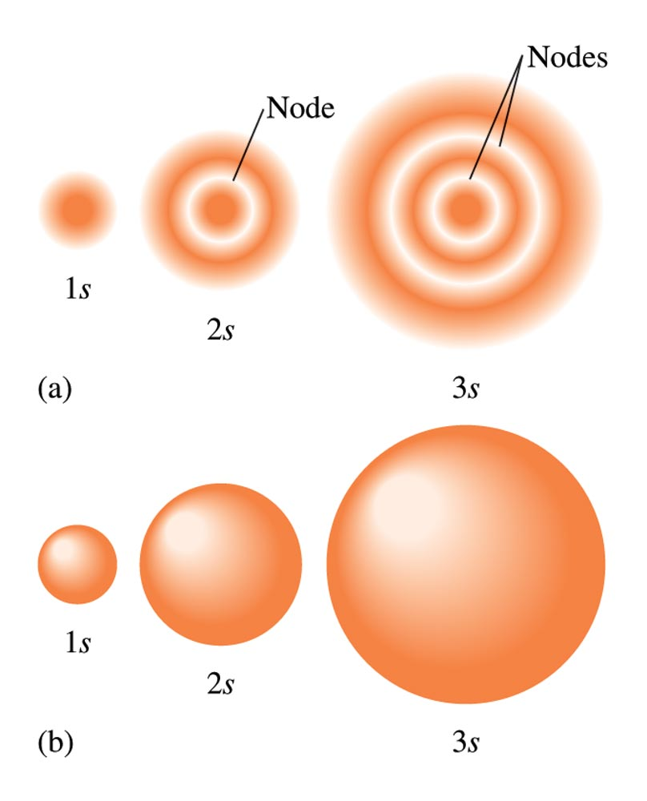
Two Representations of the Hydrogen 1s, 2s, and 3s Orbitals

Slide 33
2p_{x} Orbital

Slide 34
2p_{y} Orbital

Slide 35
2p_{z} Orbital

Slide 36
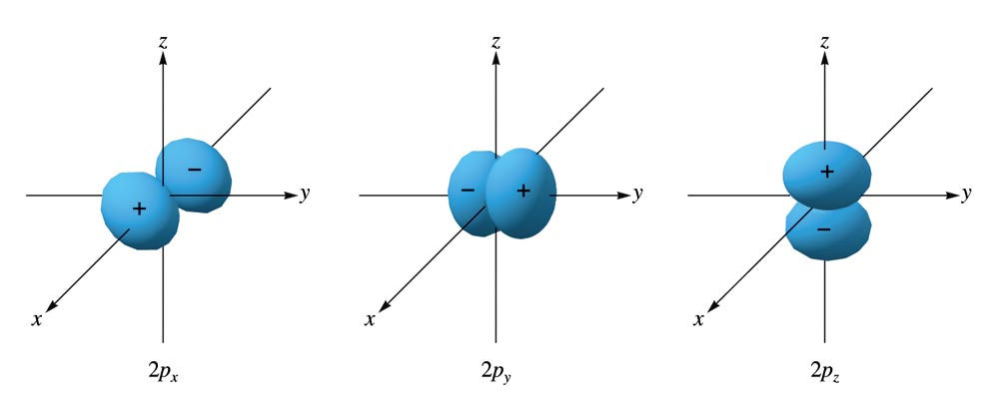
The Boundary Surface Representations of All Three 2p Orbitals

Slide 37
3d_{x}²_{-y}² Orbital

Slide 38
3d_{xy} Orbital

Slide 39
3d_{xz} Orbital

Slide 40
3d_{yz} Orbital

Slide 41
Orbital

Slide 42
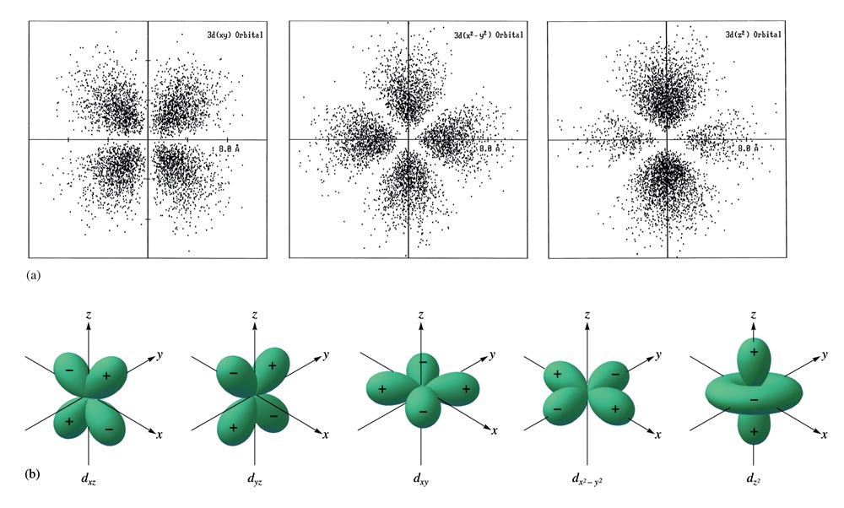
The Boundary Surfaces of All of the 3d Orbitals

Slide 43
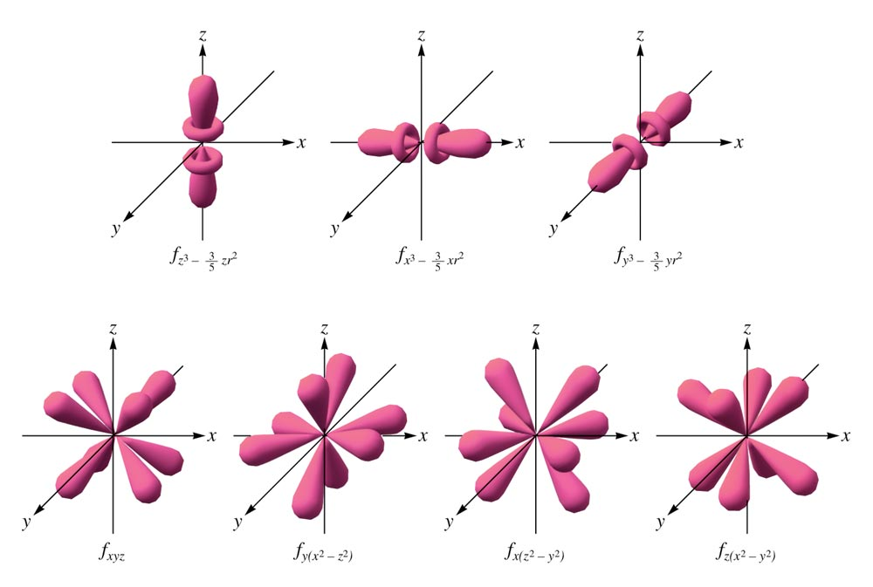
Representation of the 4f Orbitals in Terms of Their Boundary Surfaces

Slide 44
Video of Overlapping Orbitals
https://www.youtube.com/watch?v=VfBcfYR1VQo
https://www.youtube.com/watch?v=aNQV45Wichw

Slide 45
How many electrons can be in a sublevel?
Remember: A maximum of two electrons can be placed in an orbital.
s orbitals
p orbitals
d orbitals
f orbitals
Number of
orbitals
1
3
5
7
Number of electrons
2
6
10
14

Slide 46
Electron Spin
Electron spin quantum number (m_{s}) – can be +½ or -½.
Pauli exclusion principle - in a given atom no two electrons can have the same set of four quantum numbers.
An orbital can hold only two electrons, and they must have opposite spins.

Slide 47
Aufbau Principle
As protons are added one by one to the nucleus to build up the elements, electrons are similarly added to hydrogen–like orbitals.
Electrons fill lowest energy orbitals (not levels!) first!
An oxygen atom as an electron arrangement of two electrons in the 1s subshell, two electrons in the 2s subshell, and four electrons in the 2p subshell.
Oxygen: 1s²2s²2p⁴

Slide 48
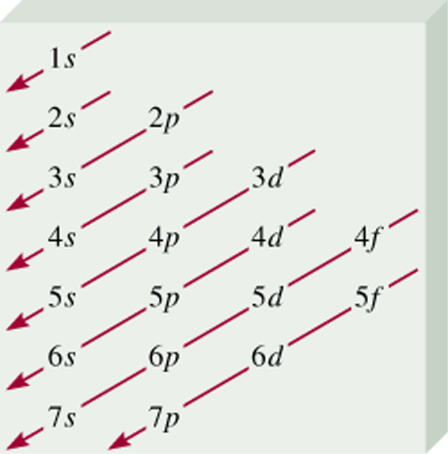
Order of orbitals (filling) in multi-electron atom
1s < 2s < 2p < 3s < 3p < 4s < 3d < 4p < 5s < 4d < 5p < 6s

Slide 49
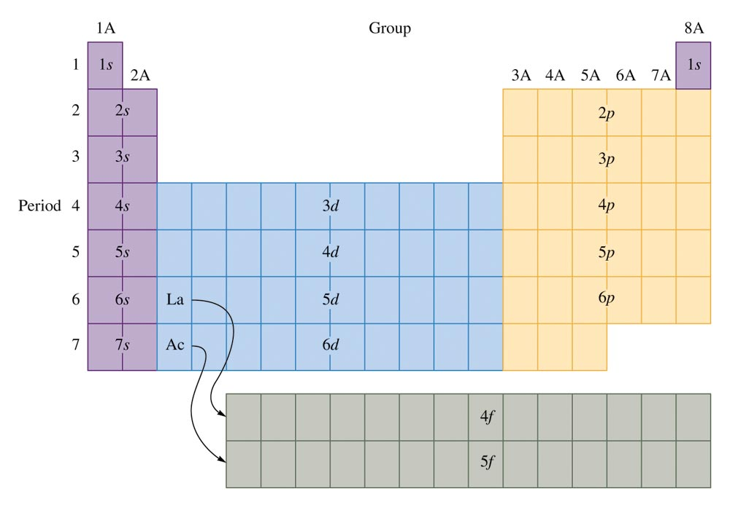
The Orbitals Being Filled for Elements in Various Parts of the Periodic Table

Slide 50
Why are d and f orbitals always in lower energy levels?
d and f orbitals require LARGE amounts of energy
It’s better (lower in energy) to skip a sublevel that requires a large amount of energy (d and f orbtials) for one in a higher level but lower energy
This is the reason for the diagonal rule! BE SURE TO FOLLOW THE ARROWS IN ORDER!

Slide 51
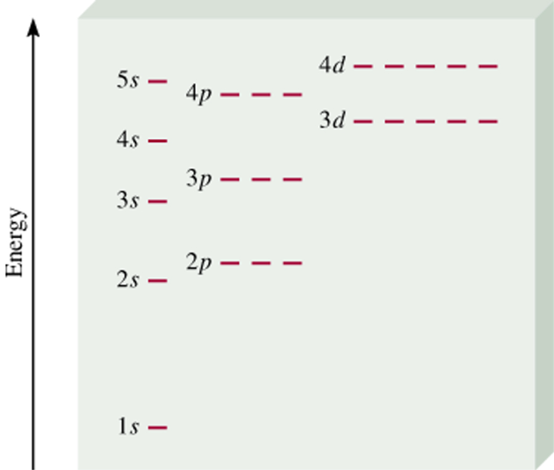
Sneak Peek: Orbital Diagrams
Energy of orbitals in an atom
Small difference between
4s and 3d
Energy depends on n and l
7.7

Slide 52
Hund’s Rule
The lowest energy configuration for an atom is the one having the maximum number of unpaired electrons allowed by the Pauli principle in a particular set of degenerate (same energy) orbitals.
  In orbitals of EQUAL energy, place one electron in each orbital before you add a second electron
  All unpaired electrons should spin the SAME way

Slide 53
Orbital Diagram
A notation that shows how many electrons an atom has in each of its occupied electron orbitals.
Oxygen: 1s²2s²2p⁴
Oxygen: 1s 2s 2p

Slide 54
Orbital Diagrams
Energy of orbitals in a multi-electron atom
n=3 l = 2
n=3 l = 1
n=3 l = 0
n=2 l = 1
n=2 l = 0
Energy depends on n and l
n=1 l = 0
7.7

Slide 55
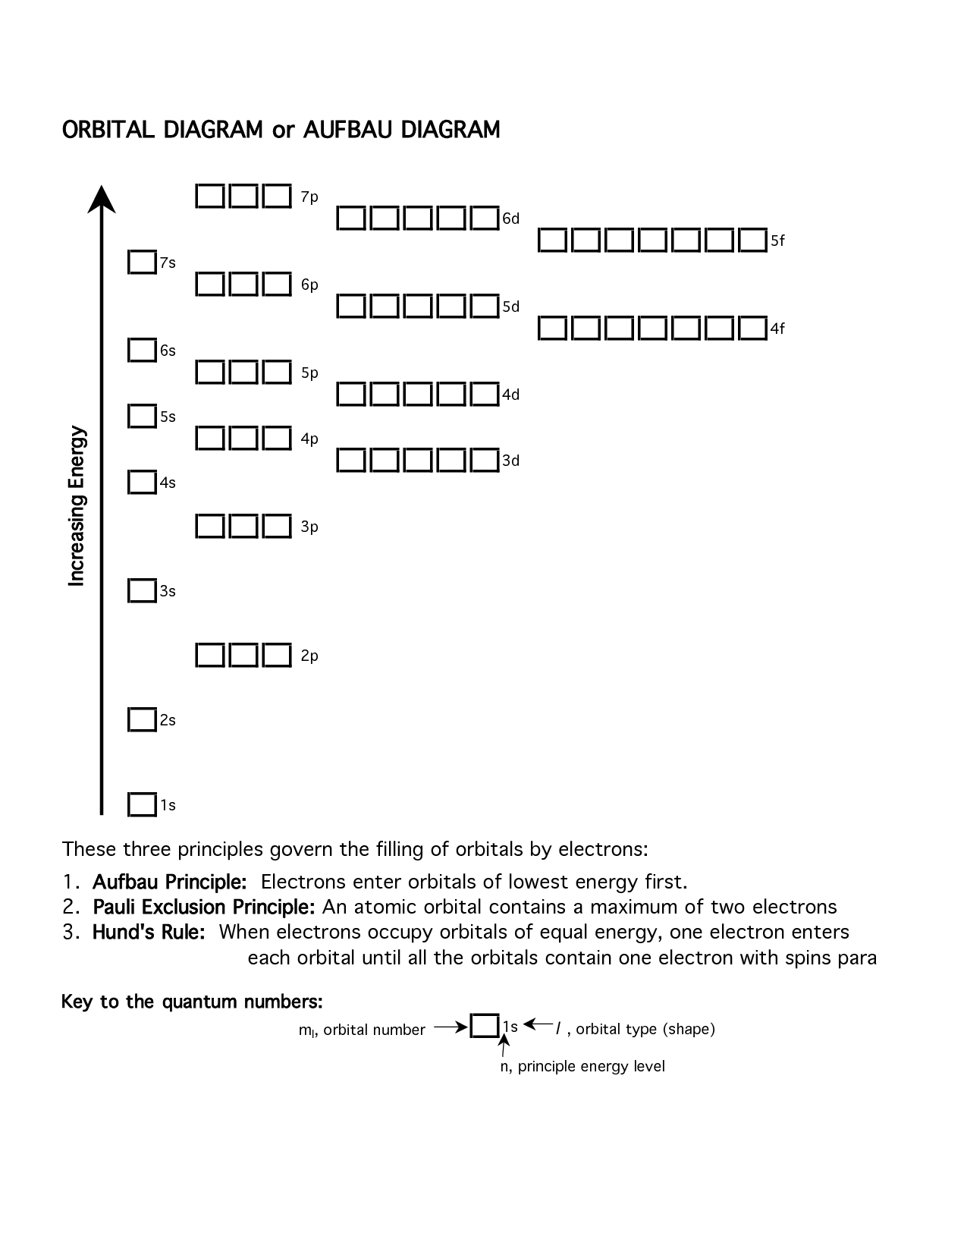

Slide 56
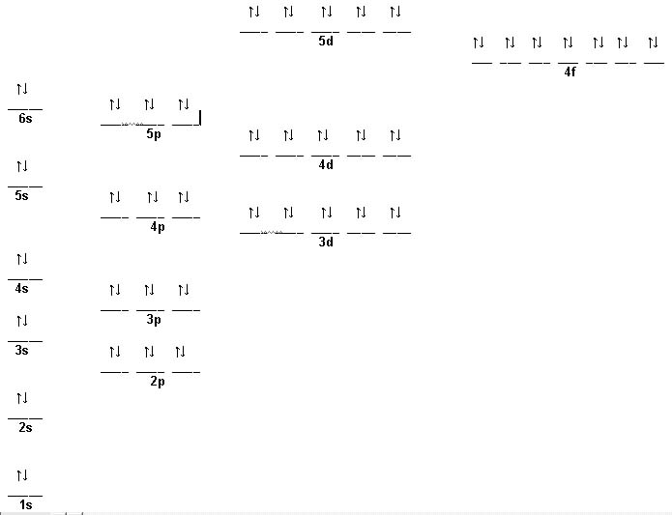
Mercury

Slide 57
Video of Overlapping Orbitals
https://www.youtube.com/watch?v=VfBcfYR1VQo
https://www.youtube.com/watch?v=aNQV45Wichw

Slide 58
Valence Electrons
The electrons in the outermost principal quantum level of an atom.
1s²2s²2p⁶ (valence electrons = 8)
The elements in the same group on the periodic table have the same valence electron configuration.

Slide 59

Shorthand Notation
Step 1: Find the closest noble gas to the atom (or ion), WITHOUT GOING OVER the number of electrons in the atom (or ion). Write the noble gas in brackets [ ].
Step 2: Find where to resume by finding the next energy level.
Step 3: Resume the configuration until it’s finished.

Slide 60

Exercise
Determine the expected electron configurations for each of the following.
a) S
1s²2s²2p⁶3s²3p⁴ or [Ne]3s²3p⁴
b) Ba
[Xe]6s²
c) Eu
[Xe]6s²4f⁷
Notes:
a) 16 electrons total; 1s²2s²2p⁶3s²3p⁴ or [Ne]3s²3p⁴
b) 56 electrons total; [Xe]6s²
c) 63 electrons total; [Xe]6s²4f⁷

Slide 61
Keep an Eye On Those Ions!
Electrons are lost or gained like they always are with ions… negative ions have gained electrons, positive ions have lost electrons
The electrons that are lost or gained should be added/removed from the outermost energy level (not the highest orbital in energy!)

Slide 62
Keep an Eye On Those Ions!
Tin
Atom: [Kr] 5s² 4d¹⁰ 5p²
Sn⁺⁴ ion: [Kr] 4d¹⁰
Sn⁺² ion: [Kr] 5s² 4d¹⁰
Note that the electrons came out of the highest energy level, not the highest energy orbital!

Slide 63
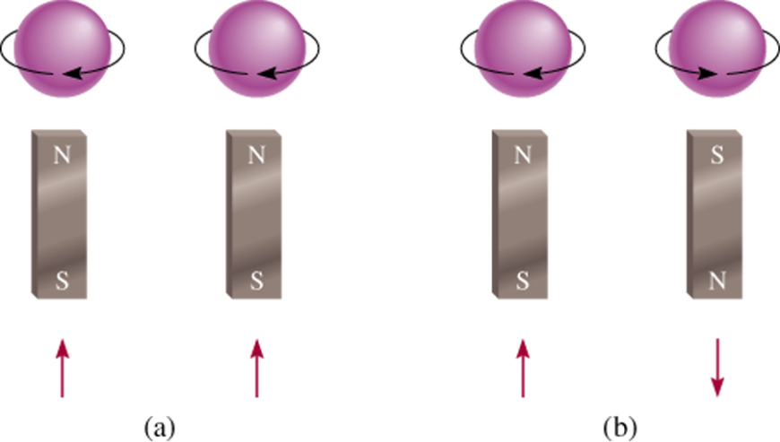
Paramagnetic
Diamagnetic
unpaired electrons
all electrons paired
2p
2p
7.8

Slide 64
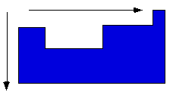
General Periodic Trends
Atomic and ionic size
Ionization energy
Electronegativity
Electron Affinity
Higher effective nuclear charge
Electrons held more tightly
Larger orbitals.
Electrons held less
tightly.
Shielding Effect!

Slide 65
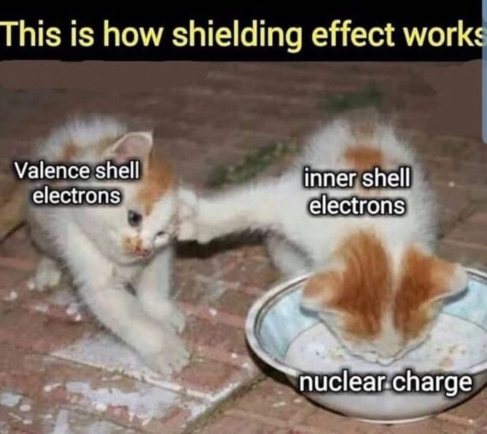

Slide 66
Atomic Radius
In general as we go across a period from left to right, the atomic radius decreases.
  Effective nuclear charge increases, therefore the valence electrons are drawn closer to the nucleus, decreasing the size of the atom.
In general atomic radius increases in going down a group.
  Orbital sizes increase in successive principal quantum levels.
  Shielding

Slide 67
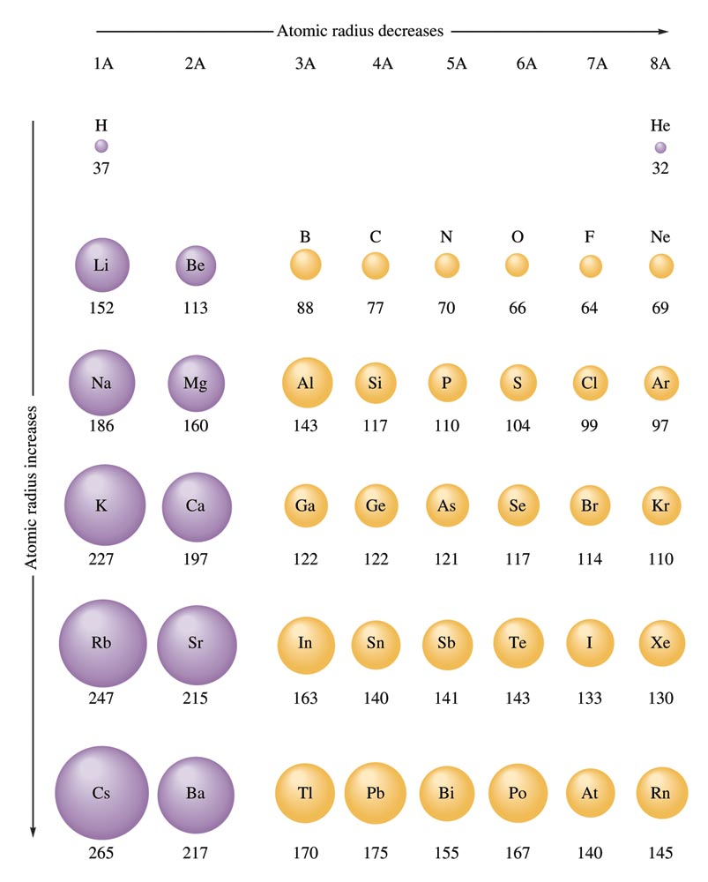
Atomic Radii for Selected Atoms

Slide 68
Concept Check
Which should be the larger atom? Why?
Na Cl
Notes:
Na should be the larger atom because the electrons are not bound as tightly due to a smaller effective nuclear charge.

Slide 69
Concept Check
Which should be the larger atom? Why?
Li Cs
Notes:
Cs should be the larger atom because of the increase in orbital sizes in successive principal quantum levels (to accommodate more electrons).

Slide 70
Concept Check
Which is larger?
The hydrogen 1s orbital
The lithium 1s orbital
Notes:
The hydrogen 1s orbital is larger because the electrons are not as tightly bound as the lithium 1s orbital (lithium has a higher effective nuclear charge and will thus draw in the inner electrons more closely).
The lithium 1s orbital is lower in energy because the electrons are closer to the nucleus.

Slide 71
Stable Compounds
Atoms in stable compounds usually have a noble gas electron configuration.

Slide 72
Isoelectronic Series
A series of ions/atoms containing the same number of electrons.
O²⁻, F⁻, Ne, Na⁺, Mg²⁺, and Al³⁺

Slide 73
Ionic Radii

Slide 74
Ionization Energy
Energy required to remove an electron from a gaseous atom or ion.
  X(g) → X⁺(g) + e–
Mg → Mg⁺ + e– I₁ = 735 kJ/mol (1st IE)
Mg⁺ → Mg²⁺ + e– I₂ = 1445 kJ/mol (2nd IE)
Mg²⁺ → Mg³⁺ + e– I₃ = 7730 kJ/mol *(3rd IE)
*Core electrons are bound much more tightly than valence electrons.

Slide 75
Ionization Energy
In general, as we go across a period from left to right, the first ionization energy increases.
Why?
  Electrons added in the same principal quantum level do not completely shield the increasing nuclear charge caused by the added protons.
  Electrons in the same principal quantum level are generally more strongly bound from left to right on the periodic table.

Slide 76
Ionization Energy
In general, as we go down a group from top to bottom, the first ionization energy decreases.
Why?
  The electrons being removed are, on average, farther from the nucleus.

Slide 77
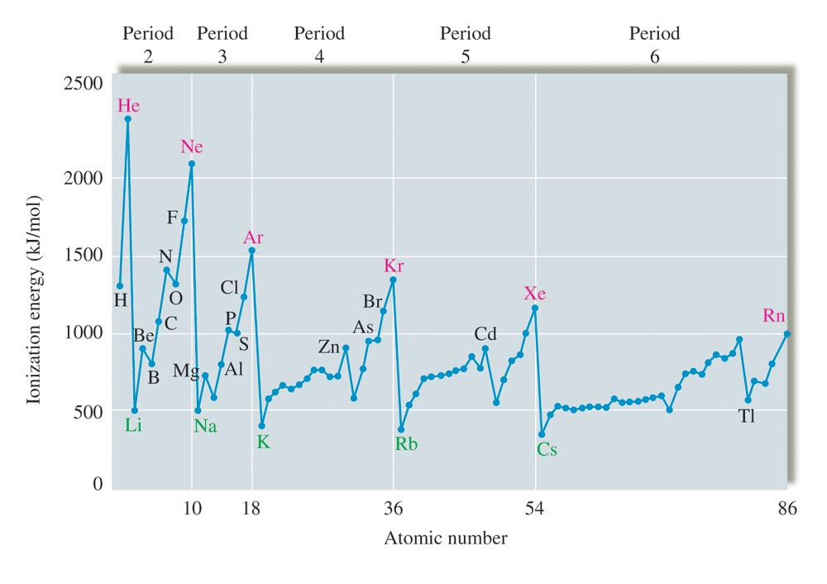
The Values of First Ionization Energy for the Elements in the First Six Periods

Slide 78
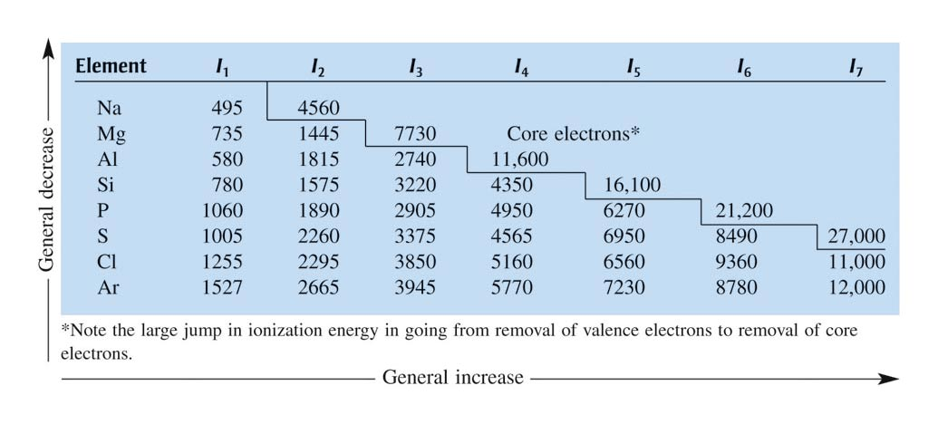
Successive Ionization Energies (KJ per Mole) for the Elements in Period 3

Slide 79
Concept Check
Which atom would require more energy to remove an electron? Why?
Na Cl
Notes:
Cl would require more energy to remove an electron because the electron is more tightly bound due to the increase in effective nuclear charge.

Slide 80
Concept Check
Which atom would require more energy to remove an electron? Why?
Li Cs
Notes:
Li would require more energy to remove an electron because the outer electron is on average closer to the nucleus (so more tightly bound).

Slide 81
Exercise
Arrange the elements oxygen, fluorine, and sulfur according to increasing:
  Ionization energy
  S, O, F
  Atomic size
  F, O, S
Notes:
Ionization Energy: S, O, F (IE increases as you move up a column and to the right across a period.)
Atomic Size: F, O, S (Atomic radius increases as you move to the left across a period and down a column.)

Slide 82
Concept Check
Which has the larger second ionization energy? Why?
Lithium or Beryllium
Notes:
Lithium has the larger second ionization energy because then a core electron is trying to be removed which will require a lot more energy than a valence electron.

Slide 83
Electron Affinity
Energy change associated with the addition of an electron to an atom (in the gas state).
  X(g) + e– → X–(g)
In general as we go across a period from left to right, the electron affinities become more negative.
In general electron affinity becomes more positive in going down a group.

Slide 84
The ability of an atom in a molecule to attract shared electrons to itself.
For a molecule HX, the relative electronegativities of the H and X atoms are determined by comparing the measured H–X bond energy with the “expected” H–X bond energy.

Slide 85
On the periodic table, electronegativity generally increases across a period and decreases down a group.
The range of electronegativity values is from 4.0 for fluorine (the most electronegative) to 0.7 for cesium and francium (the least electronegative).

Slide 86
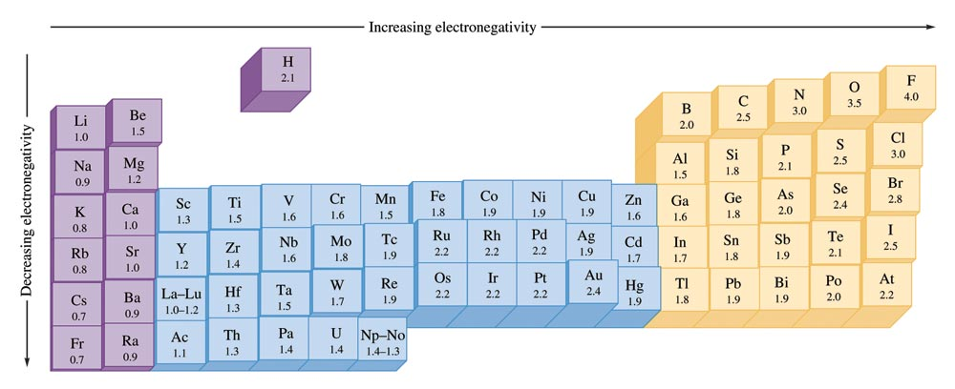
The Pauling Electronegativity Values

Slide 87
Concept Check
If lithium and fluorine react, which has more attraction for an electron? Why?
In a bond between fluorine and iodine, which has more attraction for an electron? Why?
Notes:
The fluorine has more attraction for an electron than does lithium. Both have valence electrons in the same principal energy level (the 2nd), but fluorine has a greater number of protons in the nucleus. Electrons are more attracted to a larger nucleus (if the principal energy level is the same).
The fluorine also has more attraction for an electron than does iodine. In this case the nuclear charge of iodine is greater, but the valence electrons are at a much higher principal energy level (and the inner electrons shield the outer electrons).

Slide 88
The Periodic Table – Final Thoughts
It is the number and type of valence electrons that primarily determine an atom’s chemistry.
Electron configurations can be determined from the organization of the periodic table.
Certain groups in the periodic table have special names.

Slide 89
Special Names for Groups in the Periodic Table

Slide 90
Metals Versus Nonmetals

Slide 91
The Alkali Metals
Li, Na, K, Rb, Cs, and Fr
  Most chemically reactive of the metals
    React with nonmetals to form ionic solids
  Going down group:
    Ionization energy decreases
    Atomic radius increases
    Density increases
    Melting and boiling points smoothly decrease

