Slide 1
Chapter 14
Acids and Bases

Slide 2
14.1 The Nature of Acids and Bases
14.2 Acid Strength
14.3 The pH Scale
14.4 Calculating the pH of Strong Acid Solutions
14.5 Calculating the pH of Weak Acid Solutions
14.6 Bases
14.7 Polyprotic Acids
14.8 Acid–Base Properties of Salts
14.9 The Effect of Structure on Acid–Base Properties
14.10 Acid–Base Properties of Oxides
14.12 Strategy for Solving Acid–Base Problems: A Summary

Slide 3
Models of Acids and Bases
Arrhenius: Acids produce H⁺ ions in solution, bases produce OH⁻ ions.
Brønsted–Lowry: Acids are proton (H⁺) donors, bases are proton acceptors.
HCl + H₂O → Cl⁻ + H₃O⁺
acid base

Slide 4
Brønsted–Lowry Reaction

Slide 5

Acid in Water
HA(aq) + H₂O(l) H₃O⁺(aq) + A⁻(aq)
acid base conjugate conjugate acid base
Conjugate base is everything that remains of the acid molecule after a proton is lost.
Conjugate acid is formed when the proton is transferred to the base.

Slide 6
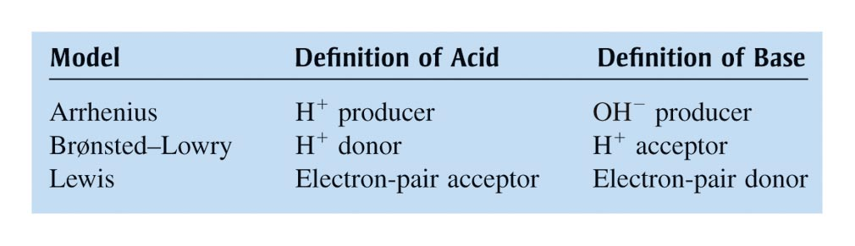
Three Models for Acids and Bases
** No longer need to know Lewis definition for AP

Slide 7
Acid Ionization Equilibrium

Slide 8
Strong acid:
  Ionization equilibrium lies far to the right.
  Yields a weak conjugate base.
  See AP strong acids list!
Weak acid:
  Ionization equilibrium lies far to the left.
  Weaker the acid, stronger its conjugate base.

Slide 9
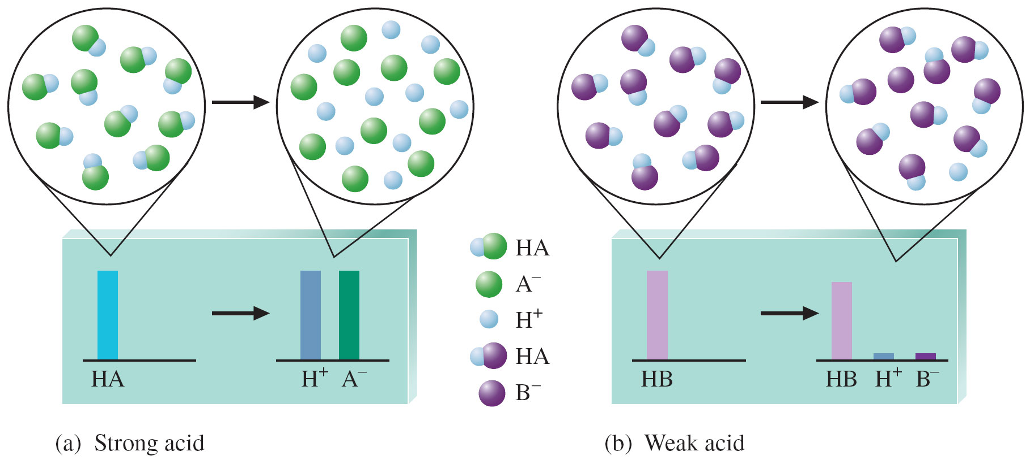

Slide 10
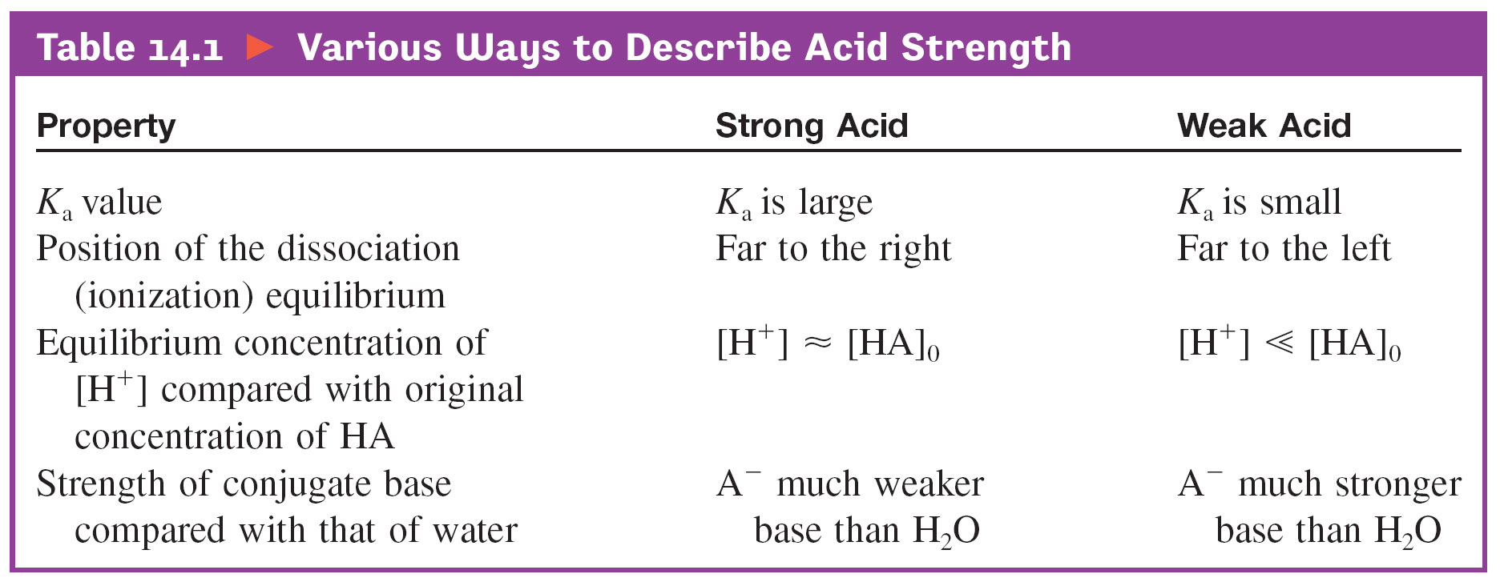
Various Ways to Describe Acid Strength

Slide 11
Water as an Acid and a Base
Water is amphoteric:
  Behaves either as an acid or as a base.
At 25°C:
K_{w} = [H⁺][OH–] = 1.0 × 10^{–14}
No matter what the solution contains, the product of [H⁺] and [OH–] must always equal 1.0 × 10^{–14} at 25°C.

Slide 12
Three Possible Situations
[H⁺] = [OH–]; neutral solution
[H⁺] > [OH–]; acidic solution
[H⁺] < [OH–]; basic solution

Slide 13
Self-Ionization of Water

Slide 14
pH = –log[H⁺]
A compact way to represent solution acidity.
pH decreases as [H⁺] increases.

Slide 15
pH Range
pH = 7; neutral
pH > 7; basic
  Higher the pH, more basic.
pH < 7; acidic
  Lower the pH, more acidic.

Slide 16
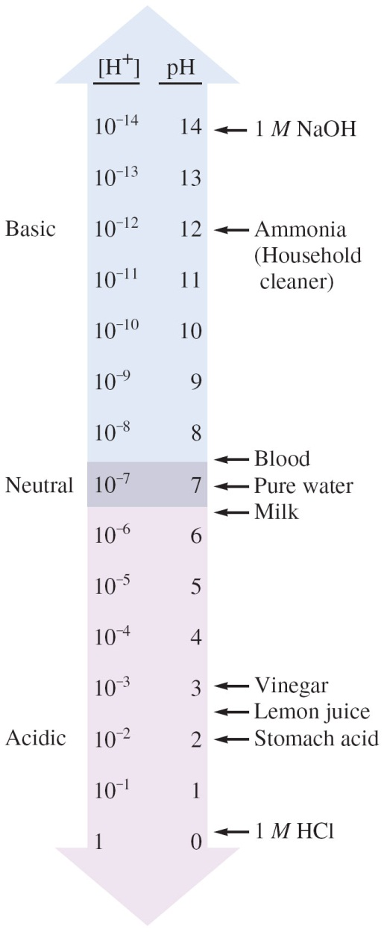
The pH Scale and pH Values of Some Common Substances

Slide 17

Exercise
Calculate the pH for each of the following solutions.
1.0 × 10^{–4} M H⁺
pH = 4.00
b) 0.040 M OH–
pH = 12.60
Notes:
pH = –log[H⁺]
a) pH = –log[H⁺] = –log(1.0 × 10^{–4} M) = 4.00
b) K_{w} = [H⁺][OH–] = 1.00 × 10^{–14} = [H⁺](0.040 M) = 2.5 × 10^{–13} M H⁺
pH = –log[H⁺] = –log(2.5 × 10^{–13} M) = 12.60

Slide 18
Exercise
The pH of a solution is 5.85. What is the [H⁺] for this solution?
[H⁺] = 1.4 × 10^{–6} M
Notes:
[H⁺] = 10^–5.85 = 1.4 × 10^{–6} M

Slide 19
pH and pOH
Recall:
K_{w} = [H⁺][OH–]
–log K_{w} = –log[H⁺] – log[OH–]
pK_{w} = pH + pOH
14.00 = pH + pOH

Slide 20
Exercise
Calculate the pOH for each of the following solutions.
1.0 × 10^{–4} M H⁺
pOH = 10.00
b) 0.040 M OH–
pOH = 1.40
Notes:
pH = –log[H⁺] and pOH = –log[OH–] and 14.00 = pH + pOH
a) pH = –log[H⁺] = –log(1.0 × 10^{–4} M) = 4.00; So, 14.00 = 4.00 + pOH; pOH = 10.00
b) pOH = –log[OH–] = –log(0.040 M) = 1.40

Slide 21
Exercise
The pH of a solution is 5.85. What is the [OH–] for this solution?
[OH–] = 7.1 × 10^{–9} M
Notes:
pH = –log[H⁺] and pOH = –log[OH–] and 14.00 = pH + pOH
14.00 = 5.85 + pOH; pOH = 8.15
[OH–] = 10^–8.15 = 7.1 × 10^{–9} M

Slide 22

Concept Check
Calculate the pH of a 1.5 x 10^{–11} M solution of HCl.
pH = 7.00
Notes:
pH = 7.00
Watch for student to say pH = -log(1.5 x 10⁻¹¹) = 10.82.
This answers neglects that water is a major species and it turns out to be the major contributor of H⁺. If students think about this problem and consider major species, they will answer this correctly.
Major species are H⁺, Cl⁻, and H₂O.
Dominant reaction is: H₂O + H₂O  H₃O⁺ (aq) + OH⁻ (aq)
Water is a major contributor. Thus , pH = 7.00.

Slide 23
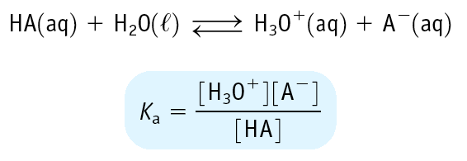
Equilibrium Constants for Weak Acids
Weak acid has K_{a} < 1
Leads to small [H₃O+] and a pH of 2 - 7

Slide 24
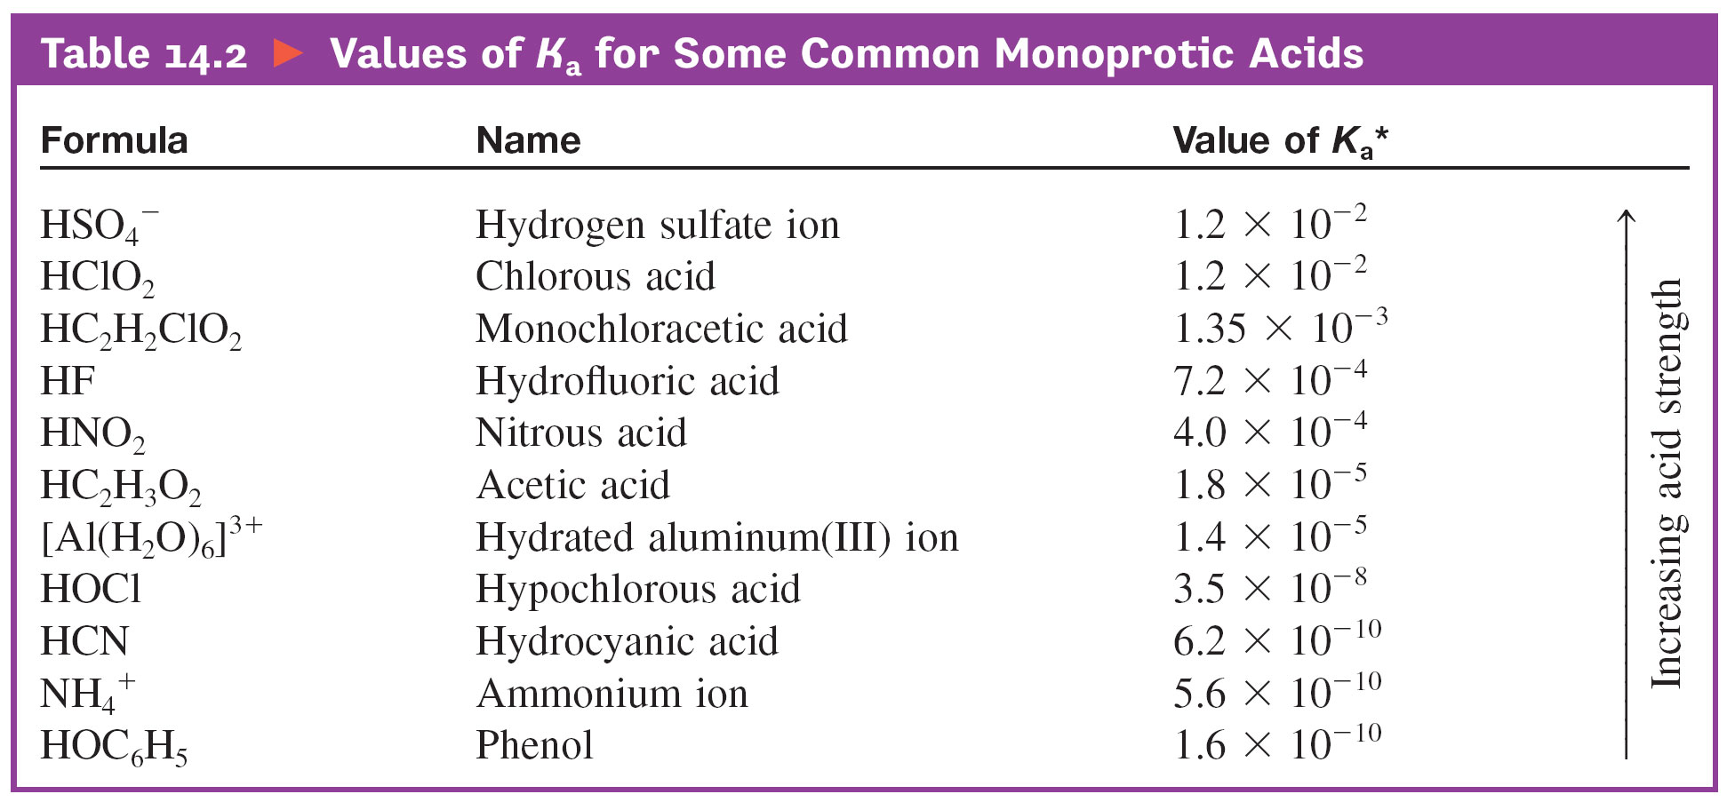
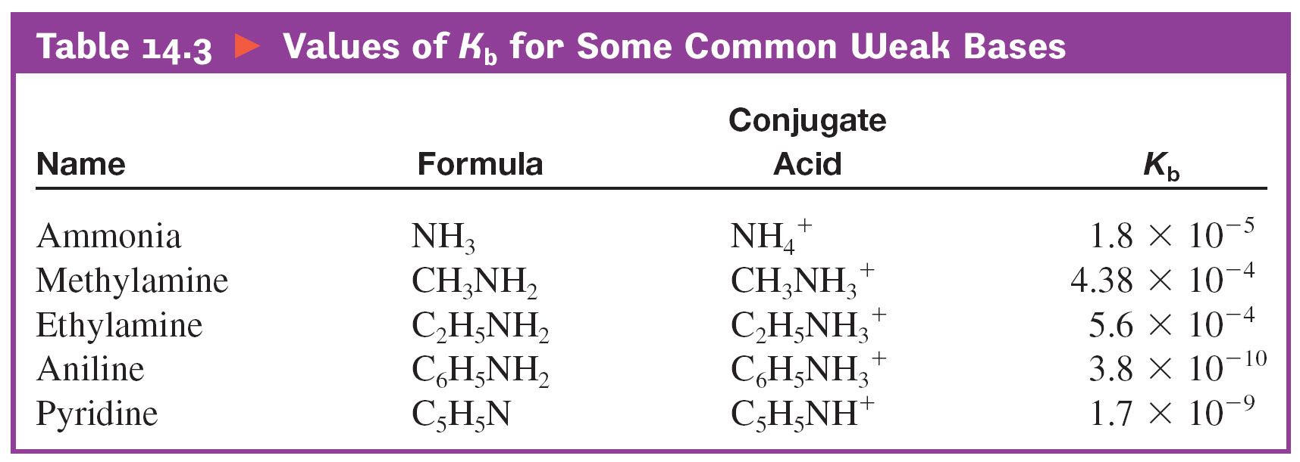

Slide 25
Equilibria Involving A Weak Acid
You have 1.00 M HOAc. Calc. the equilibrium concs. of HOAc, H₃O⁺, OAc⁻, and the pH.
Step 1. Define equilibrium concs. in ICE table.
[HOAc] [H₃O⁺] [OAc⁻]
initial
change
equilib
1.00 0 0
-x +x +x
1.00-x x x

Slide 26
Equilibria Involving A Weak Acid
You have 1.00 M HOAc. Calc. the equilibrium concs. of HOAc, H₃O+, OAc-, and the pH.
Step 2. Write K_{a} expression
This is a quadratic. Solve using quadratic formula.
or you can make an approximation if x is very small! (Rule of thumb: 10-5 or smaller is ok)

Slide 27
Equilibria Involving A Weak Acid
You have 1.00 M HOAc. Calc. the equilibrium concs. of HOAc, H₃O+, OAc-, and the pH.
Step 3. Solve K_{a} expression
First assume x is very small because K_{a} is so small.
Now we can more easily solve this approximate expression.

Slide 28
Equilibria Involving A Weak Acid
You have 1.00 M HOAc. Calc. the equilibrium concs. of HOAc, H₃O+, OAc-, and the pH.
Step 3. Solve K_{a} approximate expression
x = [H₃O+] = [OAc-] = 4.2 x 10-3 M
pH = - log [H₃O+] = -log (4.2 x 10-3) = 2.37

Slide 29
Equilibria Involving A Weak Acid
Calculate the pH of a 0.0010 M solution of formic acid, HCO₂H.
HCO₂H + H₂O ↔ HCO₂⁻ + H₃O⁺
K_{a} = 1.8 x 10⁻⁴
Approximate solution
[H₃O⁺] = 4.2 x 10⁻⁴ M, pH = 3.37
Exact Solution
[H₃O⁺] = [HCO₂⁻] = 3.4 x 10⁻⁴ M
[HCO₂H] = 0.0010 - 3.4 x 10⁻⁴ = 0.0007 M
pH = 3.47

Slide 31
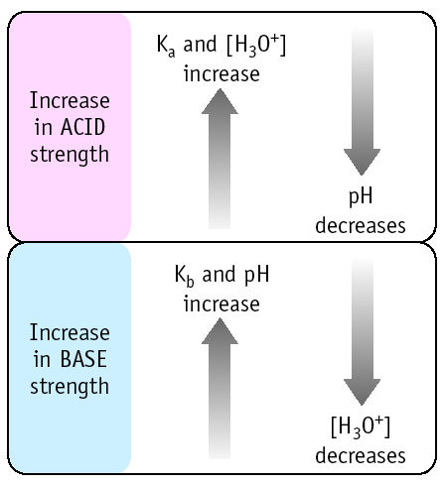
Relation of K_{a}, K_{b}, [H₃O⁺] and pH

Slide 32
Percent Dissociation (Ionization)
For a given weak acid, the percent dissociation increases as the acid becomes more dilute.

Slide 33
Exercise
A solution of 8.00 M formic acid (HCHO₂) is 0.47% ionized in water.
Calculate the K_{a} value for formic acid.
K_{a} = 1.8 x 10^{–4}
Notes:
K_{a} = 1.8 x 10⁻⁴
If 8.00 M of the acid is 0.47% ionized, then 0.038 M dissociates.
HCHO₂(aq) + H₂O  H₃O⁺(aq) + CHO₂⁻(aq)
I 8.00 0 0
C -0.038 +0.038 +0.038
E 7.96 0.038 0.038

Slide 34
Arrhenius: bases produce OH– ions.
Brønsted–Lowry: bases are proton acceptors.
In a basic solution at 25°C, pH > 7.
Ionic compounds containing OH⁻ are generally considered strong bases.
  See strong bases list!
pOH = –log[OH–]
pH = 14.00 – pOH

Slide 35
Concept Check
Calculate the pH of a 1.0 x 10^{–3} M solution of sodium hydroxide.
pH = 11.00
Notes:
pH = 11.00

Slide 36
Concept Check
Calculate the pH of a 1.0 x 10^{–3} M solution of calcium hydroxide.
pH = 11.30
Notes:
pH = 11.30
Students need to see that the concentration of the hydroxide ion is twice that of the calcium hydroxide.

Slide 37
Equilibrium expression for weak bases uses K_{b}.
CN–(aq) + H₂O(l) HCN(aq) + OH–(aq)

Slide 38
pH calculations for solutions of weak bases are very similar to those for weak acids.
K_{w} = [H⁺][OH–] = 1.0 × 10^{–14}
pOH = –log[OH–]
pH = 14.00 – pOH

Slide 39
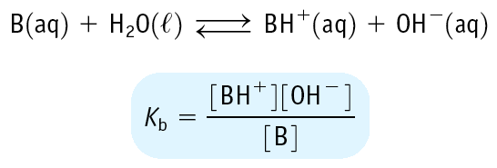
Equilibrium Constants for Weak Bases
Weak base has K_{b} < 1
Leads to small [OH-] and a pH of 12 - 7

Slide 40
Equilibria Involving A Weak Base
You have 0.010 M NH₃. Calc. the pH.
NH₃ + H₂O ↔ NH₄⁺ + OH⁻
K_{b} = 1.8 x 10⁻⁵
Step 1. Define equilibrium concs. in ICE table
[NH₃] [NH₄⁺] [OH⁻]
initial
change
equilib
0.010 0 0
-x +x +x
0.010 - x x x

Slide 41
Equilibria Involving A Weak Base
You have 0.010 M NH₃. Calc. the pH.
NH₃ + H₂O → NH₄⁺ + OH⁻
K_{b} = 1.8 x 10⁻⁵
Step 2. Solve the equilibrium expression
Assume x is small, so
x = [OH-] = [NH₄+] = 4.2 x 10-4 M
and [NH₃] = 0.010 - 4.2 x 10-4 ≈ 0.010 M
The approximation is valid !

Slide 42
Equilibria Involving A Weak Base
You have 0.010 M NH₃. Calc. the pH.
NH₃ + H₂O → NH₄⁺ + OH⁻
K_{b} = 1.8 x 10⁻⁵
Step 3. Calculate pH
[OH⁻] = 4.2 x 10⁻⁴ M
so pOH = - log [OH⁻] = 3.37
Because pH + pOH = 14,
pH = 10.63

Slide 43
Ionization Constants of Conjugate Acid-Base Pairs
HA (aq) H+ (aq) + A- (aq)
K_{a}
A- (aq) + H₂O (l) OH- (aq) + HA (aq)
K_{b}
H₂O (l) H+ (aq) + OH- (aq)
K_{w}
K_{a}K_{b} = K_{w}
Weak Acid and Its Conjugate Base
K_{w}
K_{w}
K_{a} =
K_{b} =
K_{b}
K_{a}
15.7

Slide 44
Acids that can furnish more than one proton.
Always dissociates in a stepwise manner, one proton at a time.
The conjugate base of the first dissociation equilibrium becomes the acid in the second step.
For a typical weak polyprotic acid:
K_{a1} > K_{a2} > K_{a3}
For a typical polyprotic acid in water, only the first dissociation step is important to pH.

Slide 45
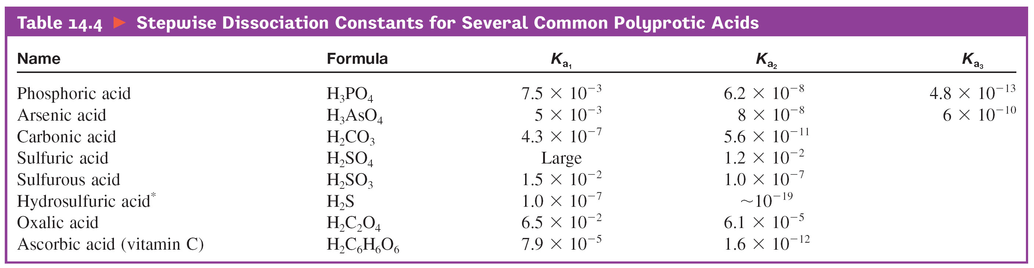
K_{a} table

Slide 46
Exercise
Calculate the pH of a 1.00 M solution of H₃PO₄.
    K_{a1} = 7.5 x 10⁻³
    K_{a2} = 6.2 x 10⁻⁸
    K_{a3} = 4.8 x 10⁻¹³
    pH = 1.08
Notes:
pH = 1.08 (if the students neglect "x", they will get 1.06)
This is a good problem to discuss how to treat polyprotic acids. The students should understand why only the first dissociation reaction is important.

Slide 47
Sulfuric Acid
AP always treats H₂SO₄ in this way:
  The first H⁺ is STRONG. Assume 100% ionization.
  The second H⁺ is WEAK. Use the K_{a}.
  Add the H⁺ Molarities together to find the pH.

Slide 48
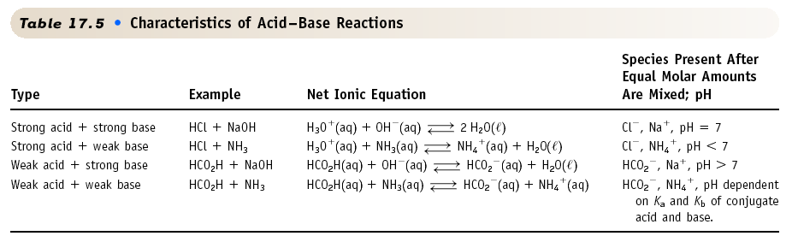
Types of Acid/Base Reactions: Summary

Slide 49
Salts
Ionic compounds.
When dissolved in water, break up into its ions (which can behave as acids or bases).

Slide 50
Salts
The salt of a strong acid and a strong base gives a neutral solution.
  KCl, NaNO₃

Slide 51
Salts
A basic solution is formed if the anion of the salt is the conjugate base of a weak acid.
  NaF, KC₂H₃O₂
  K_{w} = K_{a} × K_{b}
    Use K_{b} when starting with base.

Slide 52
Salts
An acidic solution is formed if the cation of the salt is the conjugate acid of a weak base.
  NH₄Cl
  K_{w} = K_{a} × K_{b}
    Use K_{a} when starting with acid.

Slide 54
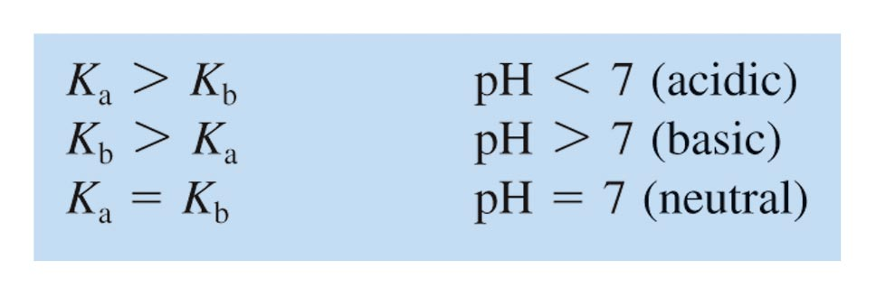
Qualitative Prediction of pH of Salt Solutions (from Weak Parents)

Slide 55
Exercise
Calculate the pH of a 0.75 M aqueous solution of NaCN.
K_{a} for HCN is 6.2 x 10^{–10}.
Notes:
Major Species: Na⁺, CN⁻, H₂O
Possibilities:
CN⁻(aq) + H₂O  HCN(aq) + OH⁻(aq)
H₂O + H₂O  H₃O⁺(aq) + OH⁻(aq)
The primary reaction is the first one, and the K_{b} value is 1.6 x 10⁻⁵. This is many times larger than the K value for the second reaction (K_{w}).
pH = 11.54

Slide 57
Steps Toward Solving for pH
 | CN–(aq) + | H₂O |  | HCN(aq) + | OH–(aq)
Initial | 0.75 M |  |  | 0 | ~ 0
Change | –x |  |  | +x | +x
Equilibrium | 0.75–x |  |  | x | x
K_{b} = 1.6 x 10^{–5}
pH = 11.54
Notes:
x can be safely neglected here.

Slide 58
Calculate the pH of a 0.60 M aqueous solution of NH₄Cl.
Notes:
Base! Kb = 1.8 E-5 for NH3
Set up Ka for the conjugate acid of NH3, which is NH4+
4.7

Slide 59
Models of Acids and Bases
Two factors for acidity in binary compounds (that create more ionization):
  Bond Polarity (high is good)
  Bond Strength (low is good)

Slide 60
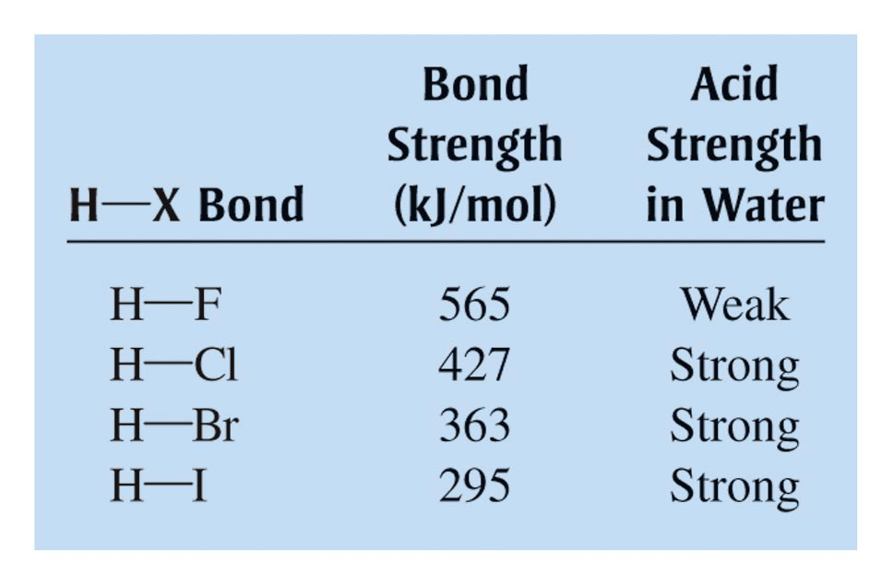
Bond Strengths and Acid Strengths for Hydrogen Halides

Slide 61
Oxyacids
Contains the group H–O–X.
For a given series, the acid strength increases with an increase in the number of oxygen atoms attached to the central atom.
The greater the ability of X to draw electrons toward itself, the greater the acidity of the molecule.

Slide 62
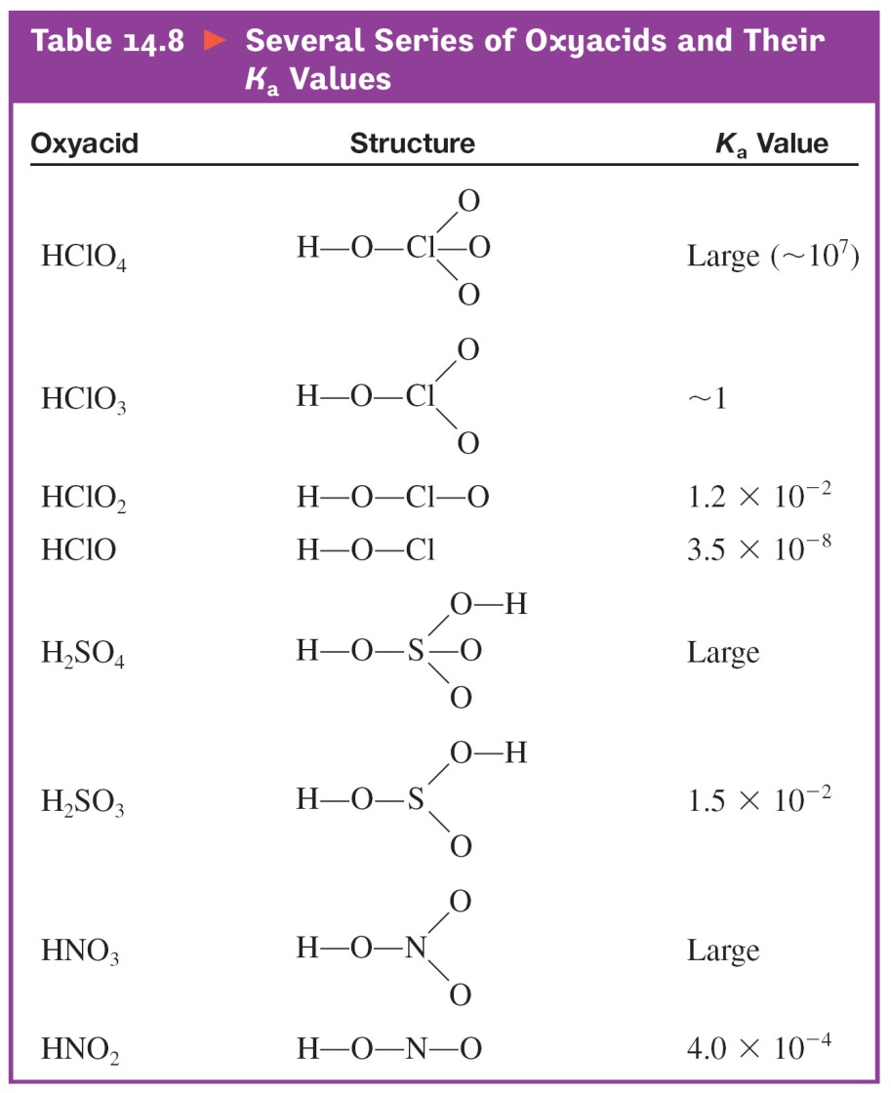
Several Series of Oxyacids and Their K_{a} Values

Slide 63
Oxides
Acidic Oxides (Acid Anhydrides):
  O-X bond is strong and covalent.
SO₂, NO₂, CO₂
When H-O-X grouping is dissolved in water, the O-X bond will remain intact. It will be the polar and relatively weak H-O bond that will tend to break, releasing a proton.

Slide 64
Oxides
Basic Oxides (Basic Anhydrides):
  O-X bond is ionic.
K₂O, CaO
If X has a very low electronegativity, the O-X bond will be ionic and subject to being broken in polar water, producing a basic solution.

Slide 65
Chapter 15
Acid–Base Equilibria

Slide 66
15.1 Solutions of Acids or Bases Containing a Common Ion
15.2 Buffered Solutions
15.3 Buffering Capacity
15.4 Titrations and pH Curves
15.5 Acid–Base Indicators

Slide 67
Common Ion Effect
Shift in equilibrium position that occurs because of the addition of an ion already involved in the equilibrium reaction.
An application of Le Châtelier’s principle.

Slide 68
Example
HCN(aq) + H₂O(l) H₃O⁺(aq) + CN⁻(aq)
Addition of NaCN will shift the equilibrium to the left because of the addition of CN⁻, which is already involved in the equilibrium reaction.
A solution of HCN and NaCN is less acidic than a solution of HCN alone.

Slide 69
Key Points about Buffered Solutions
Buffered Solution – resists a change in pH.
They are weak acids or bases containing a salt with common ion.
After addition of strong acid or base, deal with stoichiometry first, then the equilibrium.

Slide 70
Which of the following are buffer systems? (a) KF/HF
(b) KCl/HCl, (c) Na₂CO₃/NaHCO₃
(a) KF is a weak acid and F- is its conjugate base
buffer solution
(b) HCl is a strong acid
not a buffer solution
(c) CO₃2- is a weak base and HCO₃- is it conjugate acid
buffer solution
16.3

Slide 71
Adding an Acid to a Buffer

Slide 72
Buffers

Slide 73
What is the pH of a solution containing 0.30 M HCOOH and 0.52 M HCOOK?
Mixture of weak acid and conjugate base!
HCOOH (aq) H+ (aq) + HCOO- (aq)
Initial (M)
0.30
0.00
0 + 0.52
Change (M)
-x
+x
+x
Equilibrium (M)
0.30 - x
x
0.52 + x
K_{a} for HCOOH = 1.8 x 10 -4
x = 1.038 X 10 -4
[H+] [HCOO-]
K_{a} =
[HCOOH]
pH = 3.98
16.2

Slide 74
Henderson–Hasselbalch Equation
For a particular buffering system (conjugate acid–base pair), all solutions that have the same ratio [A–] / [HA] will have the same pH.

Slide 75
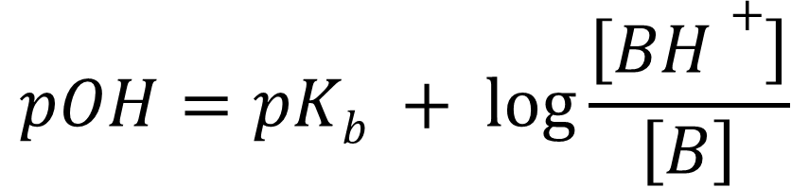
Henderson–Hasselbalch Equation
$$pOH=pKb + \log{\frac{\left[BH+\right]}{\left[B\right]}}$$
The BASIC version of the H-H equation shown here is NOT on the AP formula sheet!

Slide 76
What is the pH of a solution containing 0.30 M HCOOH and 0.52 M HCOOK?
Mixture of weak acid and conjugate base!
HCOOH (aq) H+ (aq) + HCOO- (aq)
Initial (M)
0.30
0.00
0 + 0.52
Change (M)
-x
+x
+x
Equilibrium (M)
0.30 - x
x
0.52 + x
[HCOO-]
Common ion effect
pH = pK_{a} + log
[HCOOH]
0.30 – x ≈ 0.30
[0.52]
0.52 + x ≈ 0.52
pH = 3.77 + log
= 4.01
[0.30]
HCOOH pK_{a} = 3.77
16.2

Slide 77
Calculate the pH of the 0.30 M NH₃/0.36 M NH₄Cl buffer system.
NH₃ (aq) + H₂O (l) NH₄+ (aq) + OH- (aq)
[NH₄+] [OH-]
[NH₃]
K_{b} =
= 1.8 X 10-5
Initial
0.30
0 + 0.36
0
Change
- x
+ x
+ x
End
0.30 - x
0.36 + x
x
(.36 + x)(x)
(.30 – x)
1.8 X 10-5 =
0.36x
0.30
1.8 X 10-5 ≈
x = 1.5 X 10-5
pOH = 4.82
pH= 9.18
16.3

Slide 78
Buffered Solution Characteristics
Buffers contain relatively large amounts of weak acid and corresponding conjugate base.
Added H⁺ reacts to completion with the conjugate base.
Added OH⁻ reacts to completion with the weak acid.

Slide 79
The amount of protons or hydroxide ions the buffer can absorb without a significant change in pH.
Determined by the magnitudes of [HA] and [A–].
A buffer with large capacity contains large concentrations of the buffering components.

Slide 80
Optimal buffering occurs when [HA] is equal to [A–].
It is for this condition that the ratio [A–] / [HA] is most resistant to change when H⁺ or OH– is added to the buffered solution.

Slide 81
Titration Curve
Plotting the pH of the solution being analyzed as a function of the amount of titrant added.
Equivalence (Stoichiometric) Point – point in the titration when enough titrant has been added to react exactly with the substance in solution being titrated.

Slide 82
Neutralization of a Strong Acid with a Strong Base

Slide 83
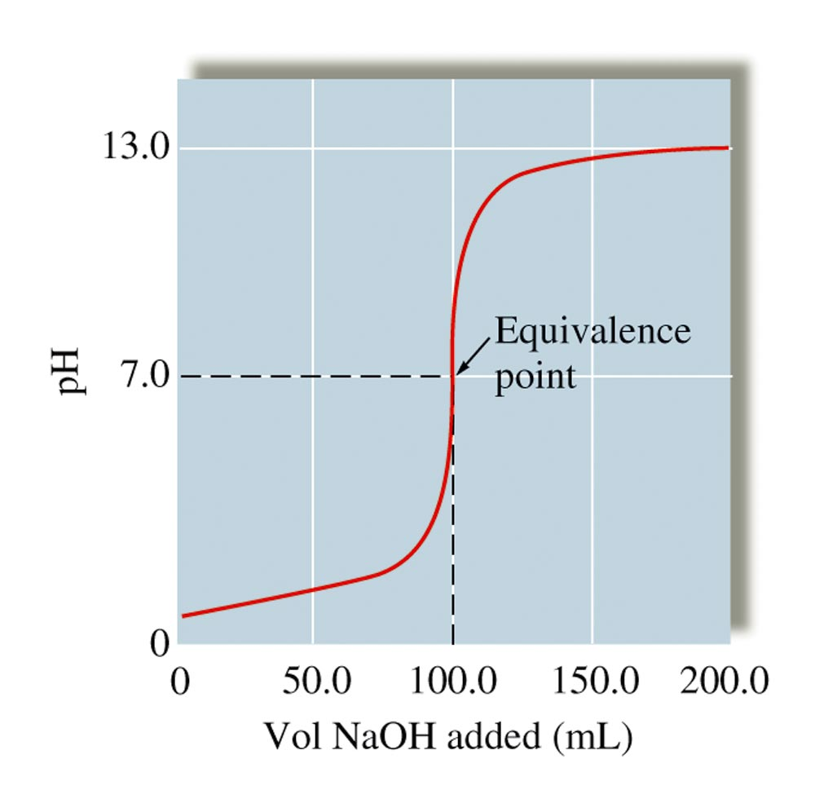
The pH Curve for the Titration of 50.0 mL of 0.200 M HNO₃ with 0.100 M NaOH

Slide 84
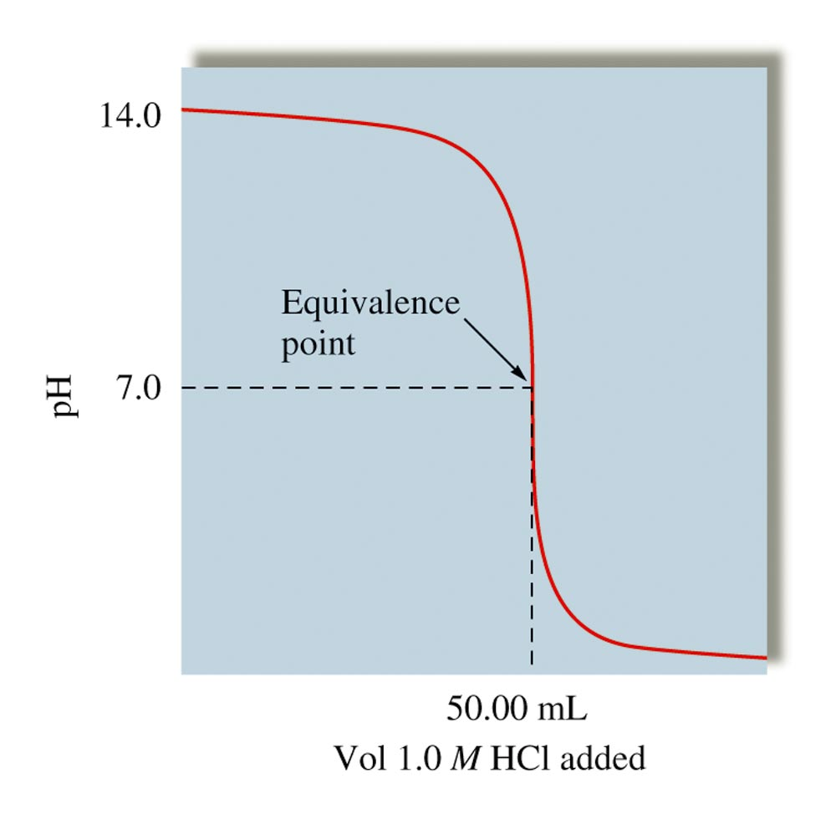
The pH Curve for the Titration of 100.0 mL of 0.50 M NaOH with 1.0 M HCI

Slide 85
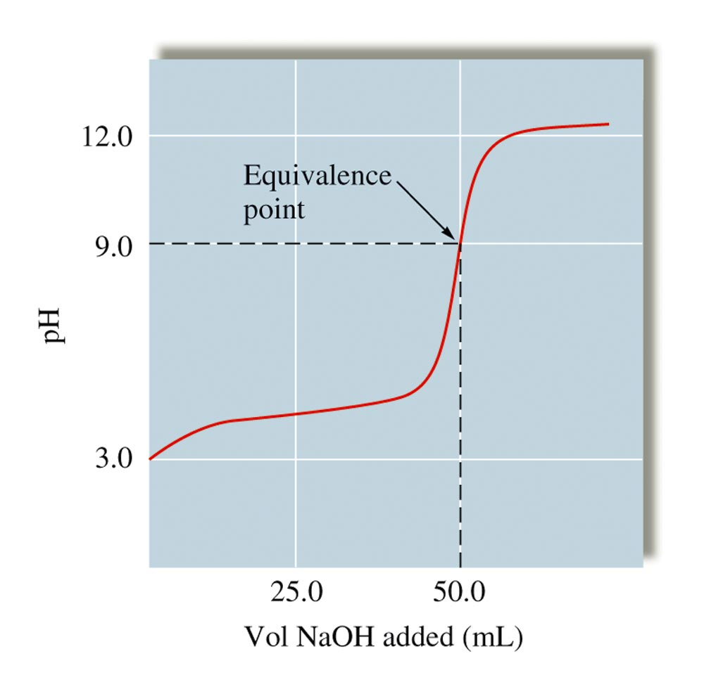
The pH Curve for the Titration of 50.0 mL of 0.100 M HC₂H₃O₂ with 0.100 M NaOH

Slide 86
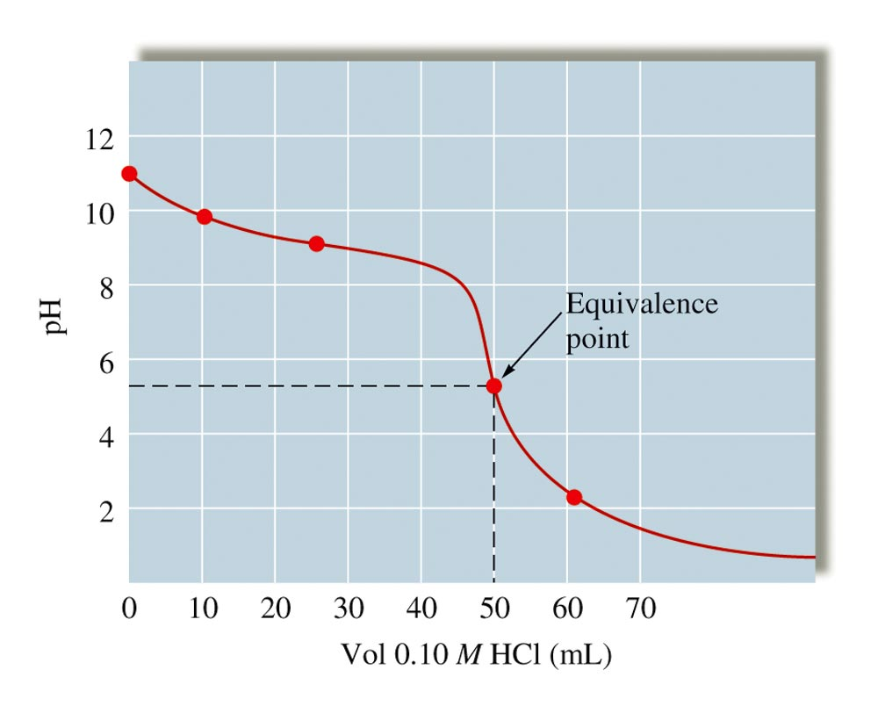
The pH Curve for the Titration of 100.0mL of 0.050 M NH₃ with 0.10 M HCl

Slide 87
Finding the Equivalence Point
(calculation method)
Strong Acid vs. Strong Base
  100 % ionized! pH = 7 No equilibrium!
Weak Acid vs. Strong Base
  Acid is neutralized; Need K_{b} for conjugate base equilibrium
Strong Acid vs. Weak Base
  Base is neutralized; Need K_{a} for conjugate acid equilibrium
Weak Acid vs. Weak Base
  Depends on the strength of both; could be conjugate acid, conjugate base, or pH 7

Slide 88
Weak Acid–Strong Base Titration
Step 1: A stoichiometry problem (reaction is assumed to run to completion) then determine remaining species.
Step 2: An equilibrium problem (determine position of weak acid equilibrium and calculate pH).

Slide 89
Exactly 100 mL of 0.10 M HNO₂ are titrated with 100 mL of a 0.10 M NaOH solution. What is the pH at the equivalence point ?
start (moles)
0.01
0.01
HNO₂ (aq) + OH- (aq) NO₂- (aq) + H₂O (l)
end (moles)
0.0
0.0
0.01
0.01
Final volume = 200 mL
[NO₂-] =
= 0.05 M
0.200
NO₂- (aq) + H₂O (l) OH- (aq) + HNO₂ (aq)
Initial (M)
0.05
0.00
0.00
Change (M)
-x
+x
+x
Equilibrium (M)
0.05 - x
x
x
[OH-][HNO₂]
x2
K_{b} =
=
= 2.2 x 10-11
pOH = 5.98
[NO₂-]
0.05-x
0.05 – x ≈ 0.05
x ≈ 1.05 x 10-6
= [OH-]
pH = 14 – pOH = 8.02

Slide 90
Marks the end point of a titration by changing color.
The equivalence point is not necessarily the same as the end point (but they are ideally as close as possible).

Slide 91
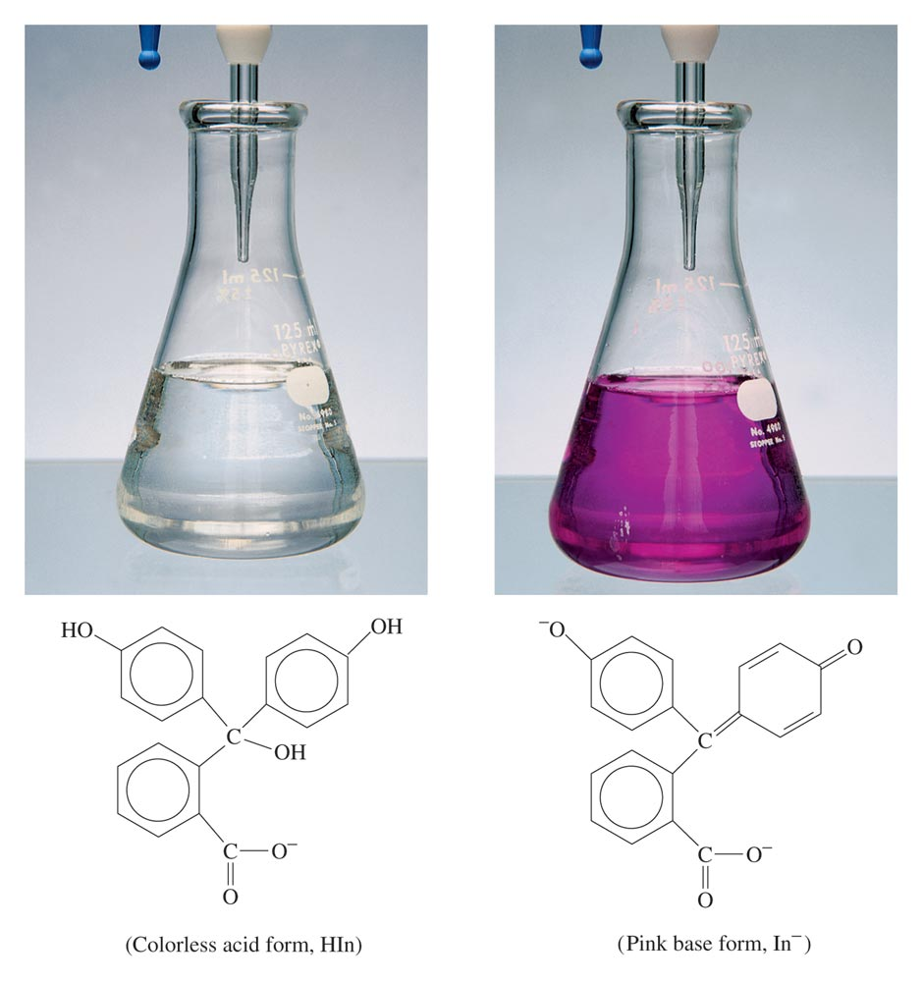
The Acid and Base Forms of the Indicator Phenolphthalein

Slide 92
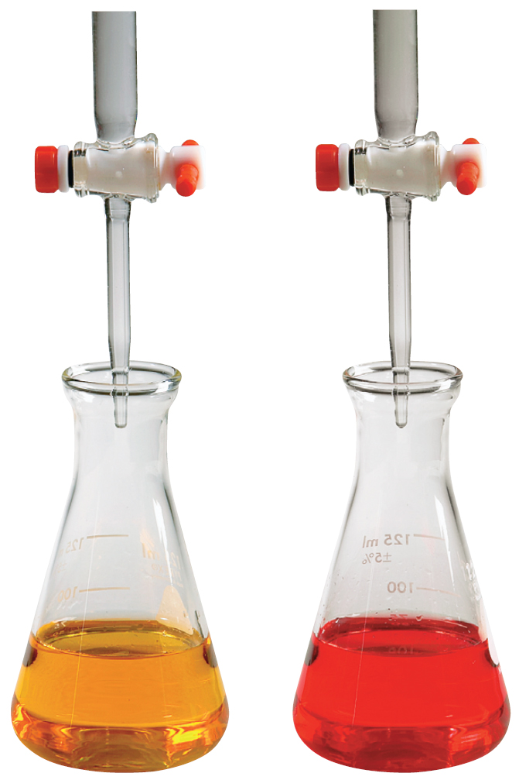
The Methyl Orange Indicator is Yellow in Basic Solution and Red in Acidic Solution

Slide 93
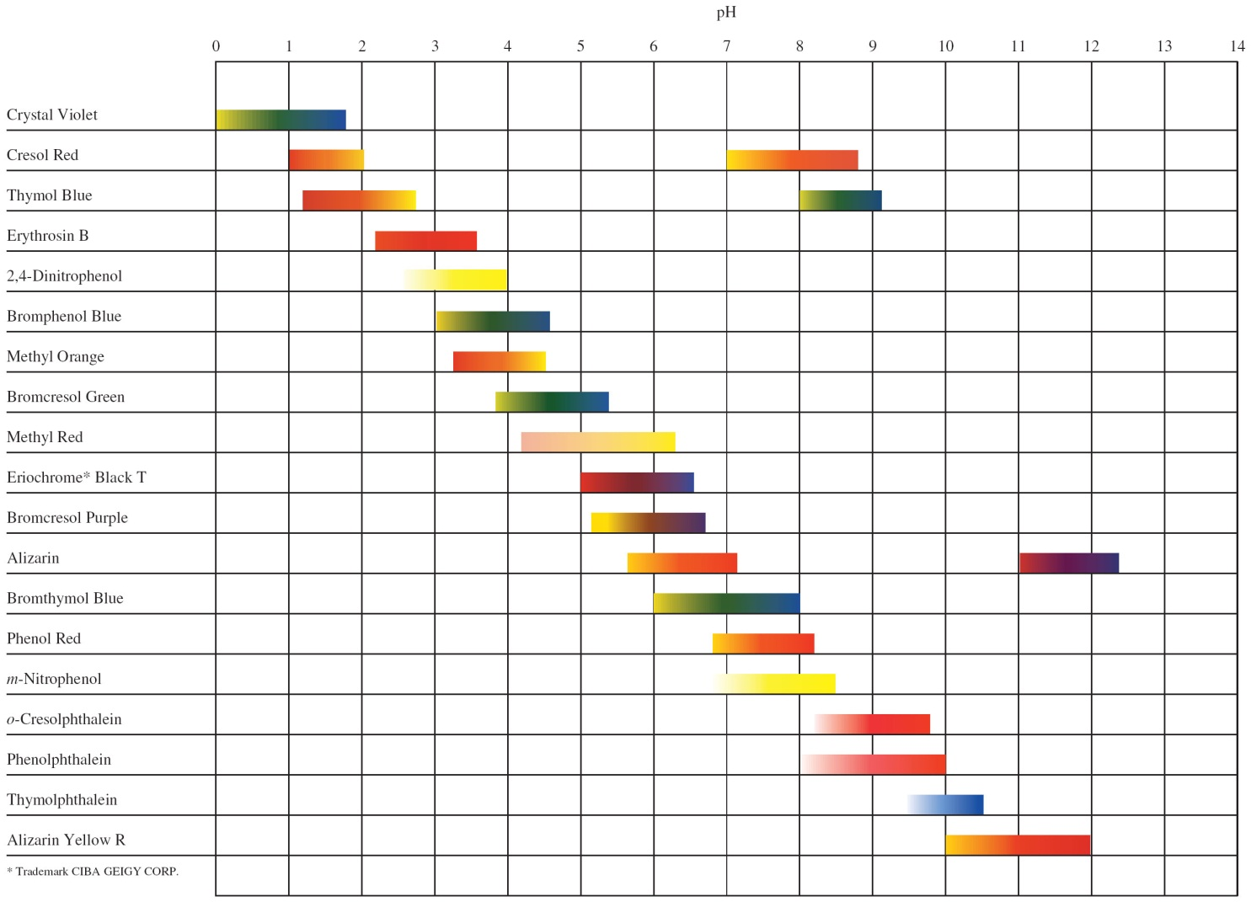
Useful pH Ranges for Several Common Indicators

