Slide 1
Chapter 1
Chemical Foundations

Slide 2
1.1 Chemistry: An Overview
1.2 The Scientific Method
1.3 Units of Measurement
1.4 Uncertainty in Measurement
1.5 Significant Figures and Calculations
1.6 Dimensional Analysis
1.7 Temperature
1.8 Density
1.9 Classification of Matter

Slide 3
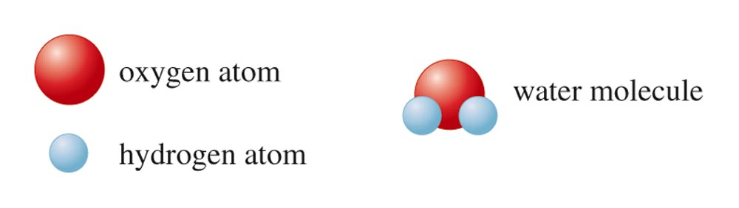
Atoms vs. Molecules
Matter is composed of tiny particles called atoms.
Atom: smallest part of an element that is still that element.
Molecule: Two or more atoms joined and acting as a unit.

Slide 4
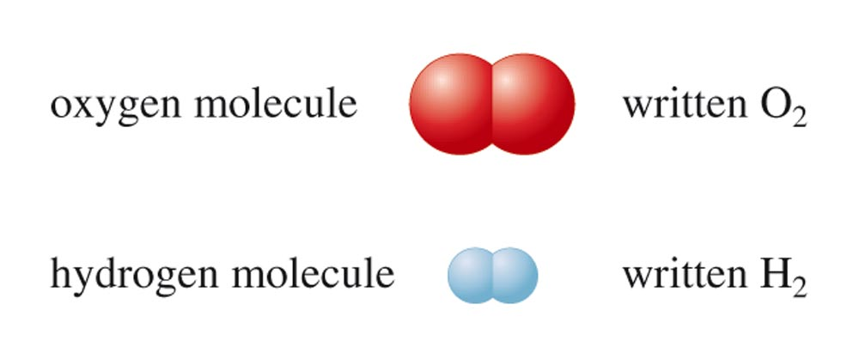
Oxygen and Hydrogen Molecules
  Use subscripts when more than one atom is in the molecule.

Slide 5
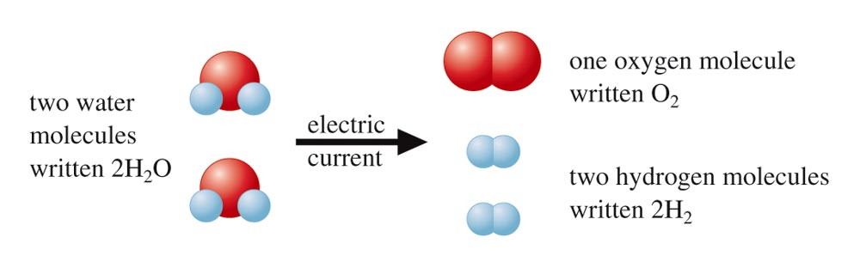
A Chemical Reaction
One substance changes to another by reorganizing the way the atoms are attached to each other.

Slide 6
Science
Science is a framework for gaining and organizing knowledge.
Science is a plan of action — a procedure for processing and understanding certain types of information.
Scientists are always challenging our current beliefs about science, asking questions, and experimenting to gain new knowledge.
  Scientific method is needed.

Slide 7
Fundamental Steps of the Scientific Method
Process that lies at the center of scientific inquiry.

Slide 8
Scientific Models
  Law
Summarizes what happens.
  Hypothesis
A possible explanation for an observation.
  Theory (Model)
An attempt to explain why it happens.
Set of tested hypotheses that gives an overall explanation of some natural phenomenon.

Slide 9
Nature of Measurement
  Measurement
Quantitative observation consisting of two parts.
  number
  scale (unit)
Examples
  20 grams
  6.63 × 10–34 joule·seconds

Slide 10
The Fundamental SI Units
Physical Quantity | Name of Unit | Abbreviation
Mass | kilogram | kg
Length | meter | m
Time | second | s
Temperature | kelvin | K
Electric current | ampere | A
Amount of substance | mole | mol

Slide 11
Prefixes Used in the SI System
Prefixes are used to change the size of the unit.

Slide 12
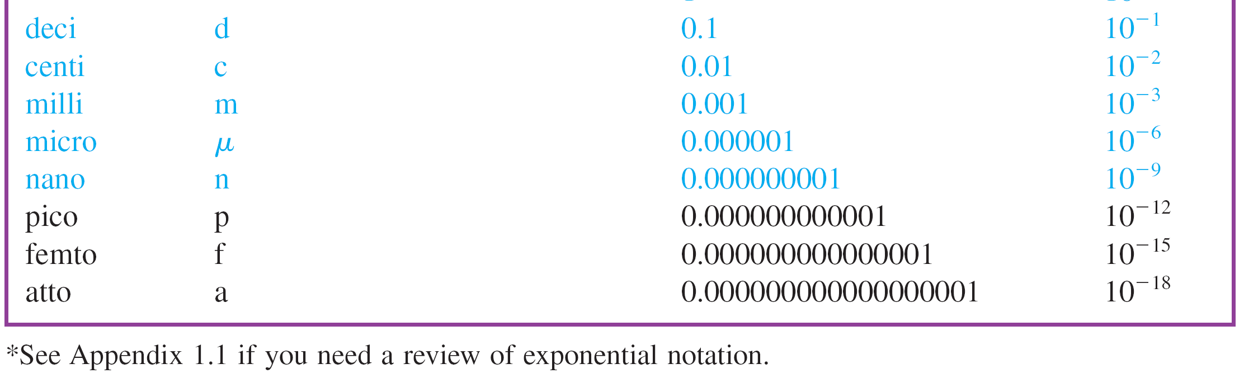
Prefixes Used in the SI System

Slide 13
A digit that must be estimated is called uncertain.
A measurement always has some degree of uncertainty.
Record the certain digits and the first uncertain digit (the estimated number).

Slide 14
Measurement of Volume Using a Buret
The volume is read at the bottom of the liquid curve (meniscus).
Meniscus of the liquid occurs at about 20.15 mL.
  Certain digits: 20.15
  Uncertain digit: 20.15

Slide 15
Precision and Accuracy
  Accuracy
Agreement of a particular value with the true value.
  Precision
Degree of agreement among several measurements of the same quantity.

Slide 16
Precision and Accuracy

Slide 17
Rules for Counting Significant Figures
1. Nonzero integers always count as significant figures.
  3456 has 4 sig figs (significant figures).
AP Chemistry Exam Hint:
You must be within 1 sig fig – it does not need to be perfect, but sig figs DO count!

Slide 18
Rules for Counting Significant Figures
There are three classes of zeros.
a. Leading zeros are zeros that precede all the nonzero digits. These do not count as significant figures.
  0.048 has 2 sig figs.

Slide 19
Rules for Counting Significant Figures
b. Captive zeros are zeros between nonzero digits. These always count as significant figures.
  16.07 has 4 sig figs.

Slide 20
Rules for Counting Significant Figures
c. Trailing zeros are zeros at the right end of the number. They are significant only if the number contains a decimal point.
  9.300 has 4 sig figs.
  150 has 2 sig figs.

Slide 21
Rules for Counting Significant Figures
3. Exact numbers have an infinite number of significant figures.
  1 m = 100 cm, exactly.
  9 pencils (obtained by counting).
  (exactly) 1 inch = 2.54 cm
  (3 sig figs… the 1 is exact)

Slide 22
Exponential Notation
Example
  300. written as 3.00 × 10²
  Contains three significant figures.
Two Advantages
  Number of significant figures can be easily indicated.
  Fewer zeros are needed to write a very large or very small number.

Slide 23
Significant Figures in Mathematical Operations
1. For multiplication or division, the number of significant figures in the result is the same as the number in the least precise measurement used in the calculation.
  1.342 × 5.5 = 7.381 → 7.4

Slide 24
Significant Figures in Mathematical Operations
2. For addition or subtraction, the result has the same number of decimal places as the least precise measurement used in the calculation.

Slide 25

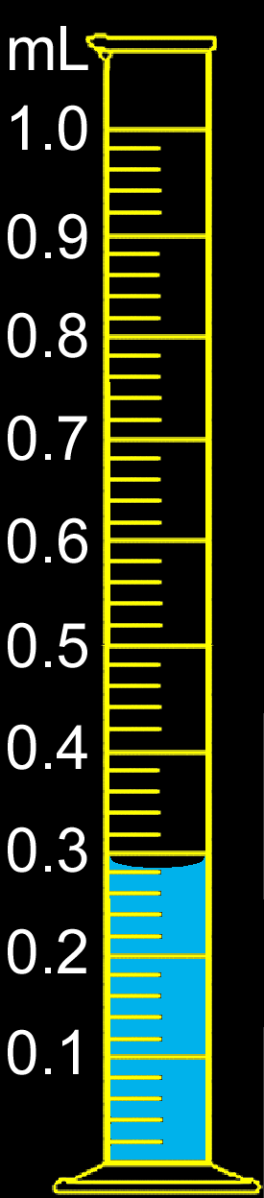
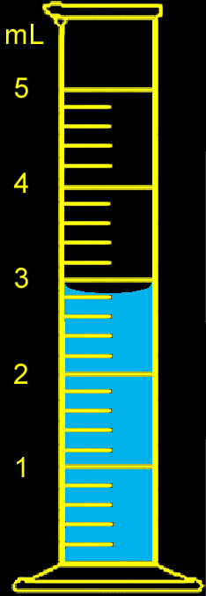
Concept Check
You have water in each graduated cylinder shown. You then add both samples to a beaker (assume that all of the liquid is transferred).
How would you write the number describing the total volume?
3.1 mL
What limits the precision of the total volume?
Notes:
The total volume is 3.1 mL. The first graduated cylinder limits the precision of the total volume with a volume of 2.8 mL. The second graduated cylinder has a volume of 0.28 mL. Therefore, the final volume must be 3.1 mL since the first volume is limited to the tenths place.

Slide 26
Use when converting a given result from one system of units to another.
  To convert from one unit to another, use the equivalence statement that relates the two units.
  Derive the appropriate unit factor by looking at the direction of the required change (to cancel the unwanted units).
  Multiply the quantity to be converted by the unit factor to give the quantity with the desired units.

Slide 27
Example #1
  A golfer putted a golf ball 6.8 ft across a green. How many inches does this represent?
Derive the appropriate unit factor by looking at the direction of the required change (to cancel the unwanted units).

Slide 28
Example #1
  A golfer putted a golf ball 6.8 ft across a green. How many inches does this represent?
Multiply the quantity to be converted by the unit factor to give the quantity with the desired units.

Slide 29
English and Metric Conversions
If you know ONE conversion for each type of measurement, you can convert anything!
You must memorize and use these conversions:
  Mass: 454 grams = 1 pound
  Length: 2.54 cm = 1 inch
  Volume: 0.946 L = 1 quart

Slide 30
Square and Cubic units
Use the conversion factors you already know, but when you square or cube the unit, don’t forget to cube the number also!
Best way: Square or cube the ENITRE conversion factor
Example: Convert 4.3 cm³ to mm³
4.3 cm³ 10 mm ³
1 cm
4.3 cm³ 10³ mm³
1³ cm³
( )
=
= 4300 mm³

Slide 31
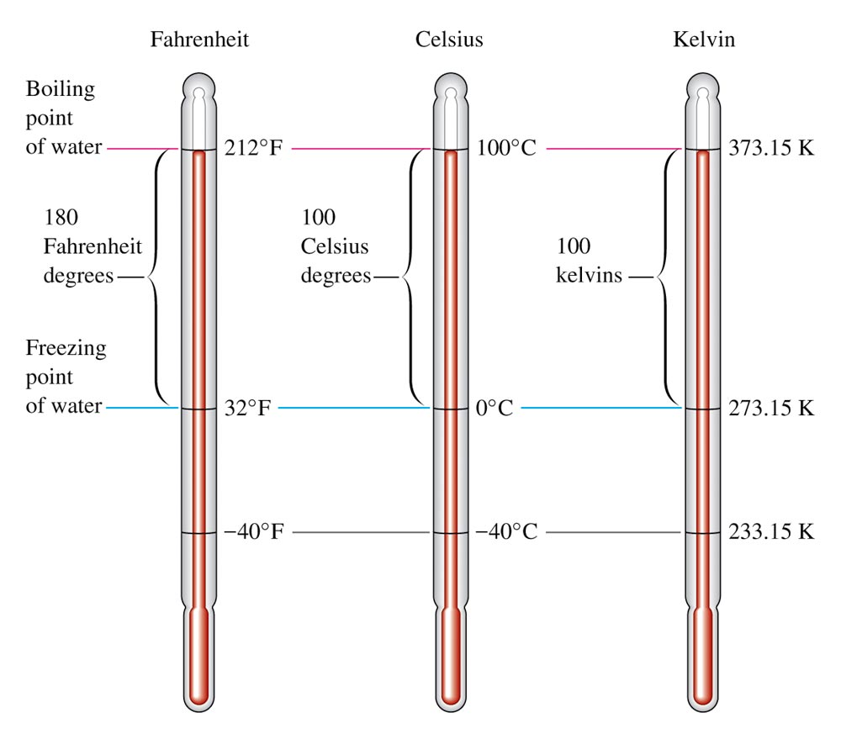
The Three Major Temperature Scales

Slide 32
Converting Between Scales

Slide 33
Mass of substance per unit volume of the substance.
Common units are g/cm³ or g/mL.

Slide 34
Example #1
  What is the mass of a 49.6-mL sample of a liquid, which has a density of 0.85 g/mL?

Slide 35
Matter
Anything occupying space and having mass.
Matter exists in three states.
  Solid
  Liquid
  Gas

Slide 36
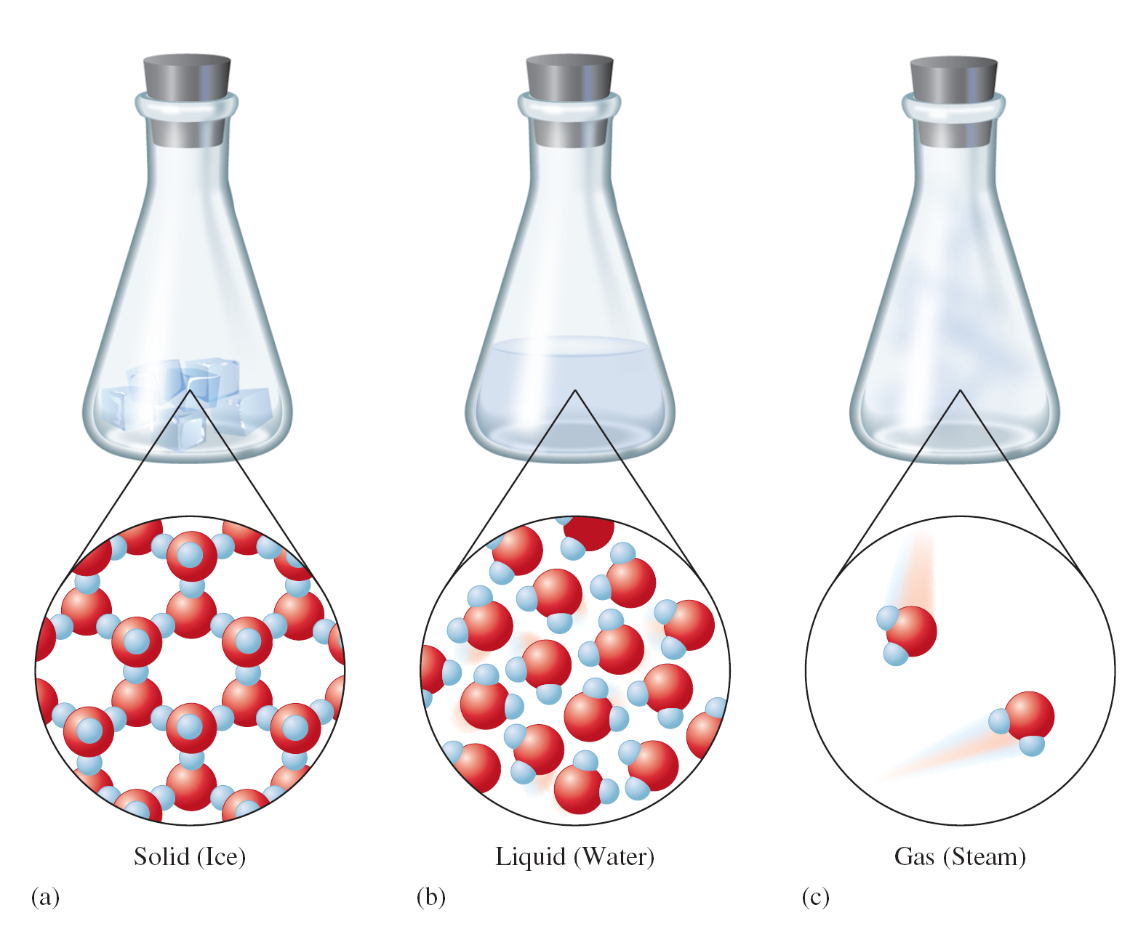
The Three States of Water

Slide 37
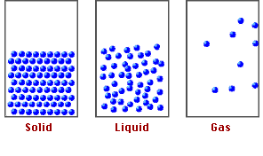
Kinetic Nature of Matter
Matter consists of atoms and molecules in motion.

Slide 38
Solid
Rigid
Has fixed volume and shape.

Slide 39

Structure of a Solid

Slide 40
Liquid
Has definite volume but no specific shape.
Assumes shape of container.

Slide 41
Structure of a Liquid

Slide 42
Gas
Has no fixed volume or shape.
Takes on the shape and volume of its container.

Slide 43
Structure of a Gas

Slide 44
OTHER STATES OF MATTER
PLASMA — an electrically charged gas; Example: the sun or any other star
BOSE-EINSTEIN CONDENSATE — a condensate that forms near absolute zero that has superconductive properties; Example: supercooled Rb gas

Slide 45
Mixtures
Have variable composition.
  Homogeneous Mixture
Having visibly indistinguishable parts; solution.
  Heterogeneous Mixture
Having visibly distinguishable parts.

Slide 46
Homogeneous Mixtures

Slide 47
Homogeneous vs. Heterogeneous Mixtures

Slide 48
Compound vs. Mixture

Slide 49
Concept Check
Which of the following is a homogeneous mixture?
  Pure water
  Gasoline
  Jar of jelly beans
  Soil
  Copper metal
Notes:
gasoline

Slide 50
Physical Change
Change in the form of a substance, not in its chemical composition.
  Example: boiling or freezing water
Can be used to separate a mixture into pure compounds, but it will not break compounds into elements.
  Distillation
  Filtration
  Chromatography

Slide 51
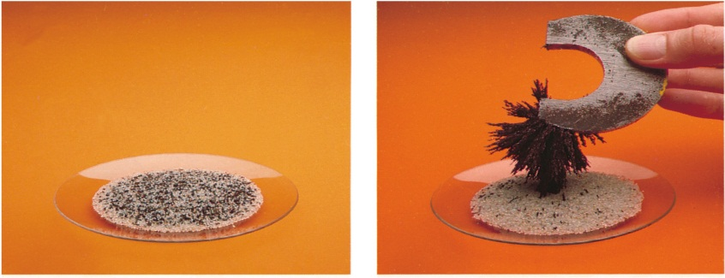
Physical means can be used to separate a mixture into its pure components.
magnet
distillation
1.4

Slide 52
Chemical Change
A given substance becomes a new substance or substances with different properties and different composition.
  Example: Bunsen burner (methane reacts with oxygen to form carbon dioxide and water)

Slide 53
The Organization of Matter

Slide 54
Concept Check
How many of the following are examples of a chemical change?
  Pulverizing (crushing) rock salt
  Burning of wood
  Dissolving of sugar in water
  Melting a popsicle on a warm summer day
Notes:
1 (burning of wood)

